Slide 1



2023-1-EE01-KA220-ADU-000150753
TRAINING PROGRAMME
LEARNING UNIT 5: Sustainability
Elaborated by:
Funded by the European Union. Views and opinions expressed are however those of the author(s) only and do not necessarily reflect those of the European Union or Estonian National Agency. Neither the European Union nor the granting authority can be held responsible for them.

Slide 2
LESSON 2: Natural Heritage and SUSTAINABLITY

Slide 3
DEFINITIONS & KEY CONCEPTS I
1.1. Definition of Natural Heritage
Natural heritage includes natural features, geological and geomorphological formations and defined areas that are home to endangered animal and plant species and natural sites of scientific, conservation or natural beauty value.
It includes privately and publicly protected natural areas, zoos, aquariums and botanical gardens, natural habitats, marine ecosystems, protected areas, reservoirs, etc.
Cultural and natural heritage reflects the richness and diversity of human civilization and the natural world, contributing to social cohesion, identity formation, and ecological balance.

Slide 4
DEFINITIONS & KEY CONCEPTS II
Biodiversity
Biodiversity - the variety of life on Earth - provides us with ecosystem services that are vital to human health, well-being and economies. However, societies and economies are threatened by the rapid loss of terrestrial, marine and freshwater biodiversity.
Ambitious policies and scaled-up funding needed to halt biodiversity loss by 2030.Concerted action on many fronts is needed to address the multiple pressures on biodiversity, as agreed in the Kunming-Montreal Global Biodiversity Framework. The rate of global biodiversity loss is unprecedented and accelerating. The five main drivers of this loss are land and sea use change, overexploitation of natural resources, climate change, pollution and invasive alien species.
Biodiversity forms the web of life on which we depend for so many things - food, water, medicines, a stable climate, economic growth and more. More than half of global GDP depends on nature. More than 1 billion people depend on forests for their livelihoods. And land and sea absorb more than half of all carbon emissions. But nature is in crisis. Up to a million species are threatened with extinction, many within decades. Irreplaceable ecosystems such as parts of the Amazon rainforest are being turned from carbon sinks into carbon sources by deforestation. And 85 per cent of wetlands, such as salt marshes and mangrove swamps, which absorb large amounts of carbon, have disappeared.

Slide 5
Best Practice - Wachau Cultural Landscape, Austria
Wachau Cultural Landscape, Austria
The Wachau is a stretch of the Danube valley between Melk and Krems, a remarkably well-preserved medieval landscape that has evolved organically over time.
The architecture in the towns and villages shows the development of the region and its society over many centuries.
- The Wachau has inspired romantic legends for centuries and the castles are full of tales of love and heartbreak, especially from the Middle Ages. Explore Wachau's natural paradise through its riverside villages and discover a land of castles, majestic abbeys and breathtaking wineries.

Slide 6
SOME DEFINITIONS & CONCEPTS 1/2
3. The Role of Natural Heritage on Sustainability– some examples
THE AREA OF PRESPES LAKES: MEGALI AND MIKRI PRESPA, GREECE
The area of Prespes Lakes, comprising Megali and Mikri Prespa in Greece, provides an exemplar of the harmonious coexistence of humans and nature. The PNP is a protected area of global significance, classified as an ecosystem of outstanding importance. It has been identified as one of Europe's most significant transboundary 'ecological brick sites'. It is noteworthy that the Prespa National Park, a restricted geographical area, is home to a diverse array of life forms, including numerous rare, endangered, and endemic species. The Prespa National Park (PNP) is located in the northwest of Greece, within the Region of West Macedonia. It encompasses an area of 327 km², and forms part of the Transboundary Prespa Park.
The landscape of the Göreme Valley and its surrounding area has been entirely sculpted by erosion, which has created unique rock-hewn sanctuaries containing compelling evidence of the Byzantine art produced during the post-Iconoclastic period. Additionally, the region boasts a variety of subterranean settlements, including dwellings, troglodyte villages, and underground towns. These structures, which date back to the 4th century, offer insights into the traditional human habitat of the region.

Slide 7
SOME DEFINITIONS & CONCEPTS 2/2
TRAKAI HISTORICAL NATIONAL PARK, LITHUANIA
Trakai Park is situated in the eastern region of the Lithuanian Republic, approximately 25 km to the west of the capital city, Vilnius. This distinctive and concentrated collection of natural and cultural assets encapsulates pivotal eras and occurrences in Lithuania's and Eastern Europe's shared history. It encompasses a meticulously preserved cultural landscape centred on an historic town and castle complexes situated amidst a lake landscape.
RUNDALE PALACE ENSEMBLE WITH A GARDEN AND FOREST PARK, LETONIA
The Rundāle Palace ensemble, comprising a garden and forest park, is situated in the Zemgale plain in close proximity to the Latvian-Lithuanian border. The nearest town is Bauska, situated 12 km away, with Jelgava located 43 km away and Riga 79 km away. The Palace territory encompasses an area of 85 hectares and comprises a variety of features, including a complex of buildings, the site of an old medieval castle, and a pond. Additionally, it features orchards on the eastern, western, and northern sides, a French garden, a forest park, a plant nursery, a garden area, and parking lots on the eastern and western sides.

Slide 8
Interactive Activity 1/3
Objective:
The aim of this activity is providing students with a deeper understanding of natural heritage, its importance and the threats it faces. Apart from this, encouraging learners to analyse complex environmental issues, evaluate potential solutions and propose innovative conservation strategies. Besides this, learners can provide opportunities to work in teams, share ideas and work together to develop solutions to real-world problems and enable learner to communicate their findings and ideas clearly and persuasively through a variety of media. Through a project-based learning approach, learners will gain hands-on experience, develop essential skills and contribute to the protection of our planet's natural heritage.
Materials Needed:
- Printed handouts with information on various cultural and natural heritage sites ,
- Markers, colored pencils, glue, scissors
- Printed or digital images of cultural and natural heritage sites
- A projector
Procedure:
Start class by discussing the concept of natural heritage and its components (biodiversity, geological formations, cultural landscapes). Then, highlight the importance of preserving natural heritage for future generations. Introduce the idea of sustainable practices and their role in protecting natural heritage.

Slide 9
Interactive Activity 2/3
It would be beneficial to prompt learners to contemplate the ethical implications of species loss, considering not only the impact on animals but also on entire ecosystems and human society. It is recommended that the findings be shared with the class to facilitate the presentation of diverse perspectives on the issue.
Learners will conduct comprehensive research on a particular endangered species, examining its status, the factors that threaten its survival, and the initiatives in place to protect it. The research assignment is to be completed in 60 minutes. Learners are required to conduct research on a specific that:
- Group 1 : Endangered species
- Group 2 : Critically endangered
- Group 3 : Vulnerable
- Group 4: Near threatened.
Each group should choose an animal of these titles and after that they should prepeare an infographic. The infographic should include the answers of these questions besides the short information about the animal.
- What are the principal factors that have led to the species becoming endangered? It is also important to
consider the species' role within its ecosystem and to evaluate the significance of its loss.
- What conservation initiatives are currently in place, and what measures are being taken to protect the species, for example, the designation of protected areas, the enactment of anti-poaching legislation, and the implementation of breeding programmes?
- What sustainable practices could be employed to ensure the species’ long-term protection?

Slide 10
Interactive Activity 3/3
What are the principal causes of their endangerment? These may include habitat loss, poaching and climate change. - What role do these animals play in their respective ecosystems? What measures are being taken to ensure their protection?
What measures can be taken by humans to provide assistance, including conservation efforts and the implementation of sustainable living practices? It is recommended that students utilise reliable online resources, books and videos in order to gather information.
The groups will then proceed to organise their findings and begin preparing a presentation. This may entail the presentation of a visual representation of the species in question, such as a drawing, digital image, or infographic, accompanied by a concise account of the animal's role within its ecosystem.
A discussion on sustainability will ensue for a period of fifteen minutes. The concept of sustainability should be introduced, defined as meeting current needs without compromising the ability of future generations to meet their own needs. The discussion should address the ways in which sustainable practices, including but not limited to reducing carbon footprints, protecting habitats, and sustainable agriculture, can contribute to the protection of endangered species. The students should be encouraged to consider the impact of their own actions on biodiversity, with specific reference to the following areas: waste, energy consumption and the use of plastics.

Slide 11
Discussion and Reflection 1/2
Questions for Group Discussion:
What measures might be taken at the individual, community, or governmental level to guarantee the sustainability of heritage sites? What methods might be employed to utilise technology for the preservation and protection of heritage, such as the creation of digital archives, the development of virtual tours, and the implementation of renewable energy sources for conservation purposes?
- Answer: Governments can legislate to protect heritage from threats like urban development, pollution and vandalism. Governments should provide budgets to maintain, restore and conserve heritage. The implementation of policies that promote responsible tourism and the provision of incentives to businesses that adopt sustainable practices. For individual effort, one cean contribute to the sustainability of the site, visitors should follow guidelines, avoid harmful activities and support environmentally friendly tourism options. The organisation of workshops, exhibitions and educational programmes can be a way of strengthening the link between the community and heritage sites. Communities can adopt environmentally friendly practices, such as recycling programs, waste management and sustainable resource use, around heritage sites.
Why is of natural heritage important and how can sustainability help in this effort?
- Answer : Natural heritage areas, including forests, wetlands, and coral reefs, serve as habitats for a multitude of species and ecosystems that contribute to the maintenance of ecological balance. Biodiversity enhances resilience, enabling ecosystems to adapt to alterations and recuperate from disturbances. The implementation of sustainable practices serves to safeguard biodiversity by curbing the destruction of habitats, pollution, and the adverse effects of climate change. To illustrate, sustainable agricultural practices have the dual benefit of reducing land degradation and safeguarding habitats for native species.

Slide 12
Discussion and Reflection 2/2
Conclusion:
-- In the absence of sustainable practices, there is a significant risk of degradation, loss, or even disappearance of these sites.
The objective of this study is to gain insight into the concept of heritage. The project's objective was to examine the significance of cultural and natural heritage, acknowledging their role in shaping our collective identity, historical narrative, and environmental context.
The learners were introduced to a variety of heritage sites and the reasons why they are of significance not only at the local level but also on a global scale. Furthermore, learners came to understand that ensuring the preservation of these valuable heritage sites and traditions for future generations hinges on the implementation of sustainable practices.
The learners presented creative posters that highlighted the issues facing their selected heritage sites and proposed solutions that were both thoughtful and realistic. They demonstrated an understanding of the ways in which challenges such as climate change, over-tourism, pollution, and a lack of awareness can impact the preservation of heritage.
Reflection:
Please use Annex 5 for the reflection session. You can distribute it to learners after you print or adapt it to a Google Form.

Slide 13
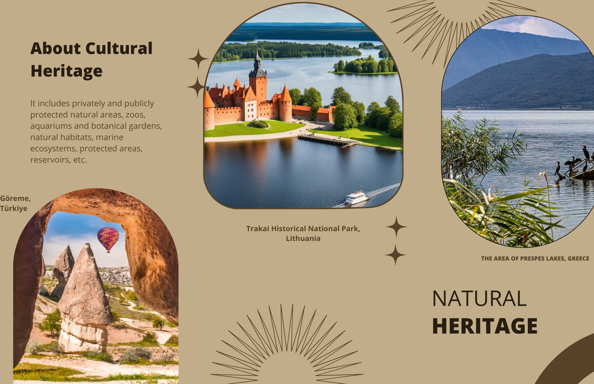
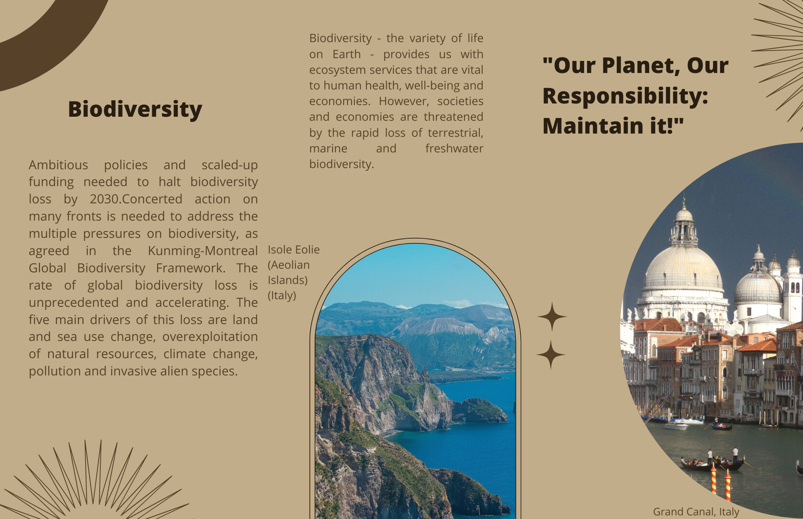
Appendix 4
Canva Link is here.

Slide 14
Appendix 5 - Reflection Form 1/2
Reflection Form
1. What have you learnt today about the cultural landscape of the Wachau?
2. What was your level of understanding of today's activity? Please circle.
Very well
Somewhat
Not very
3. Which activity did you enjoy most? (Circle one or more options):
Learning about the Wachau landscape
Role-playing different people from the Wachau
Listening to the ideas of my classmates
Something else: _______________

Slide 15
Appendix 5 - Reflection Form 2/2
Reflection Form
4. Was there anything about the activity that you found challenging?
Yes, there was: _______________
No, I didn't find anything challenging.
5. Overall, how would you rate today's activity? (Circle one):
Excellent
Good
Fair
Not so good
6. To improve this lesson, what is one suggestion you have?

