Slide 1
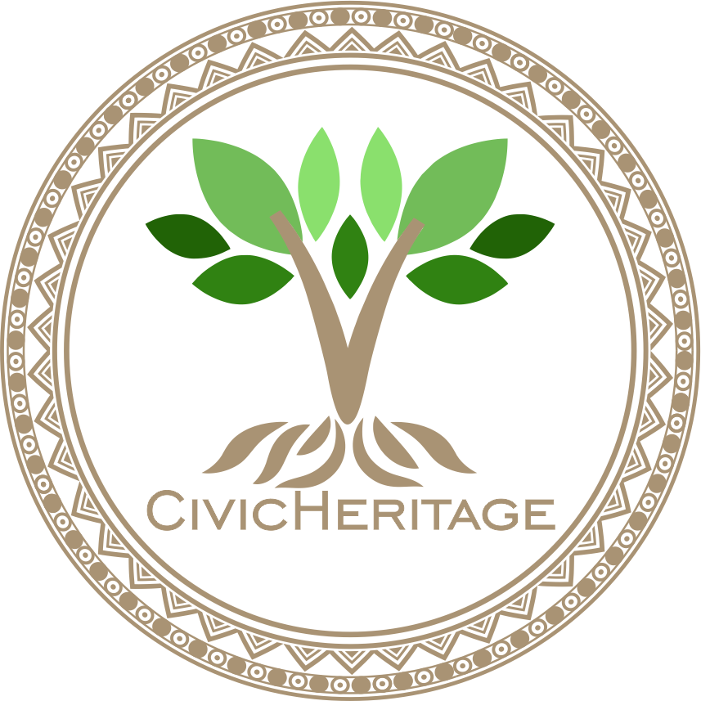


2023-1-EE01-KA220-ADU-000150753
TRAINING PROGRAMME
LEARNING UNIT 1: Sense of belonging
Funded by the European Union. Views and opinions expressed are however those of the author(s) only and do not necessarily reflect those of the European Union or Estonian National Agency. Neither the European Union nor the granting authority can be held responsible for them.

Slide 2
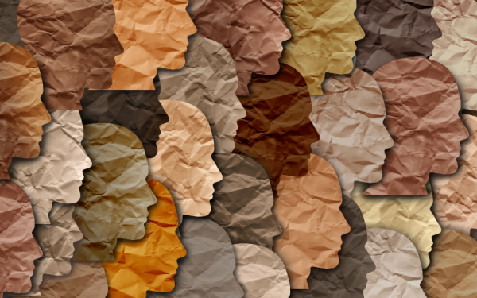
LESSON 1: Heritage and Identity
Source: freshidea/AdobeStock

Slide 3
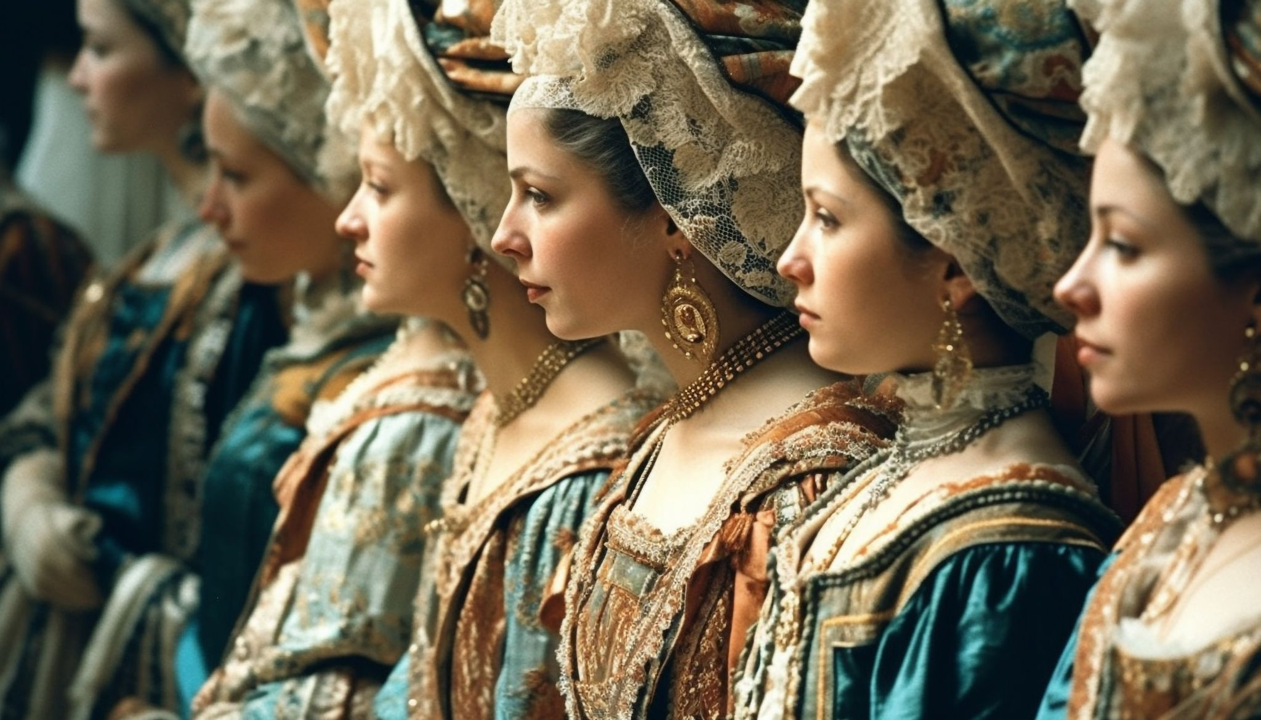
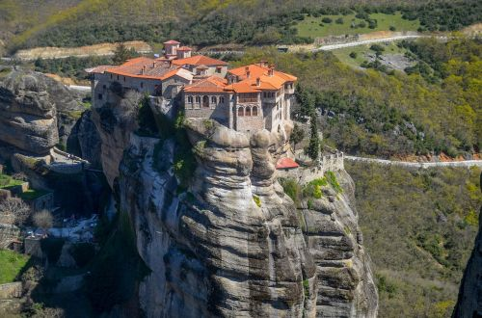
SOME DEFINITIONS & CONCEPTS (1/3)
1. Definition of Cultural and Natural Heritage
Cultural heritage refers to the tangible and intangible aspects of human life passed down through generations, such as monuments, artifacts, languages, traditions, and rituals. It embodies a society’s historical, artistic, and cultural identity.
Natural heritage, on the other hand, includes significant natural landscapes, ecosystems, and biodiversity that are protected for their ecological, aesthetic, or scientific value.
UNESCO recognizes both cultural and natural heritage as vital to humanity’s shared history. Together, they reflect the interactions between human societies and the natural environment, forming a foundation for cultural continuity, environmental conservation, and sustainable development.
Source: https://www.freepik.com/free-ai-image/young-women-traditional-clothing-parade-outdoors-generated-by-ai_42431165.htm#fromView=search&page=1&position=20&uuid=ba464ac0-e44f-4baf-8e1c-390ae766ac3f
AI Generated
Source, free image: https://www.needpix.com/photo/825772/

Slide 4
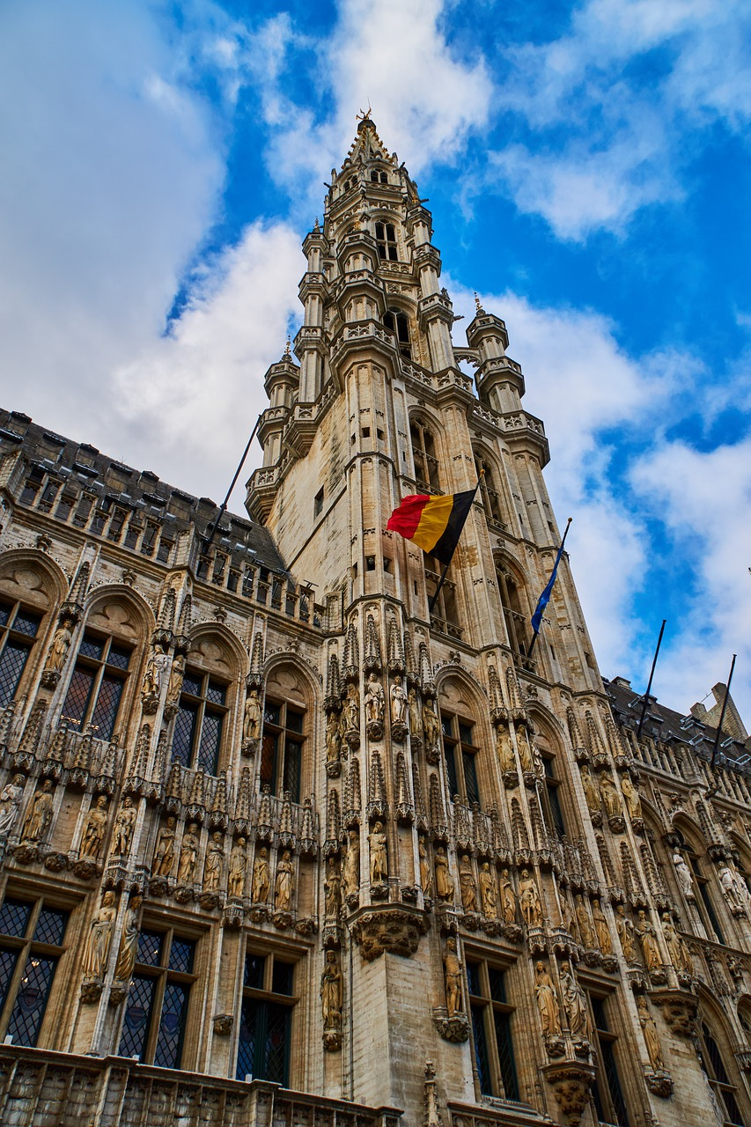
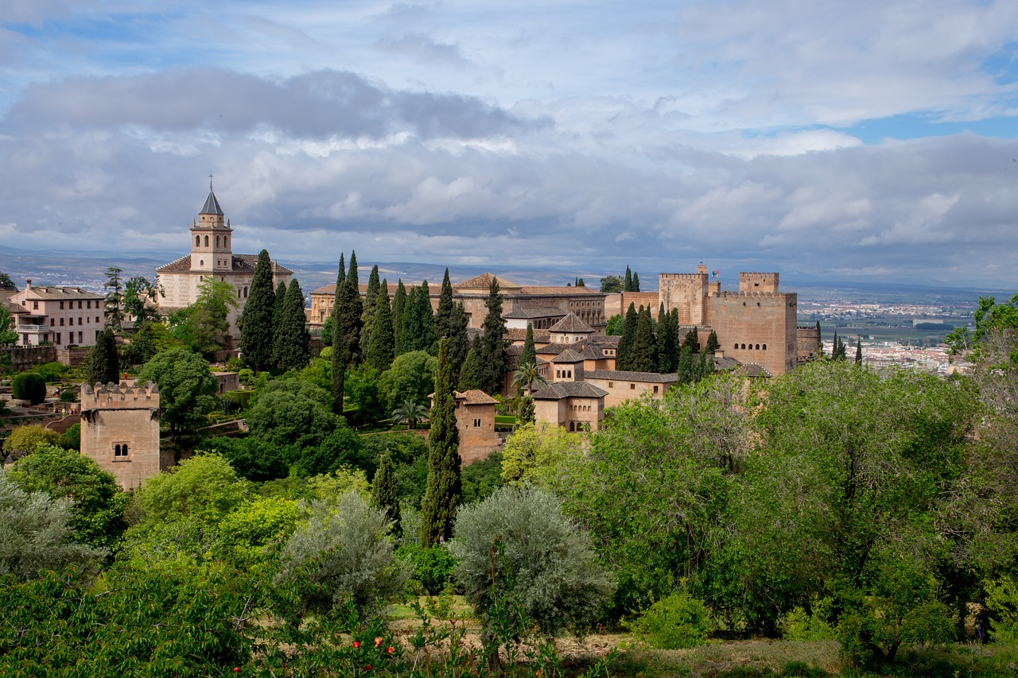
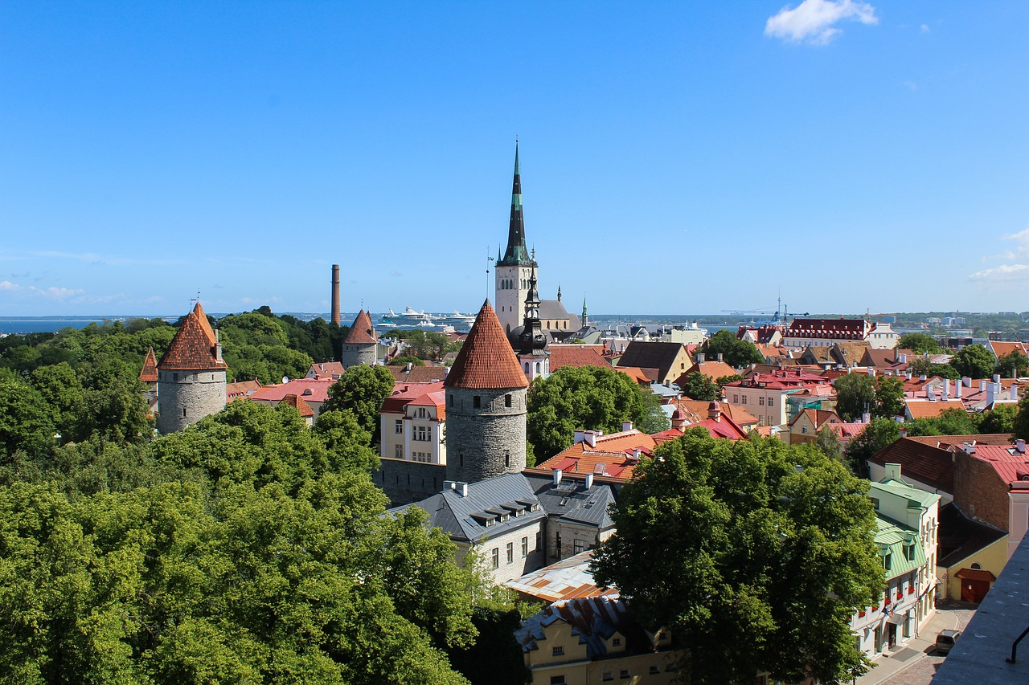
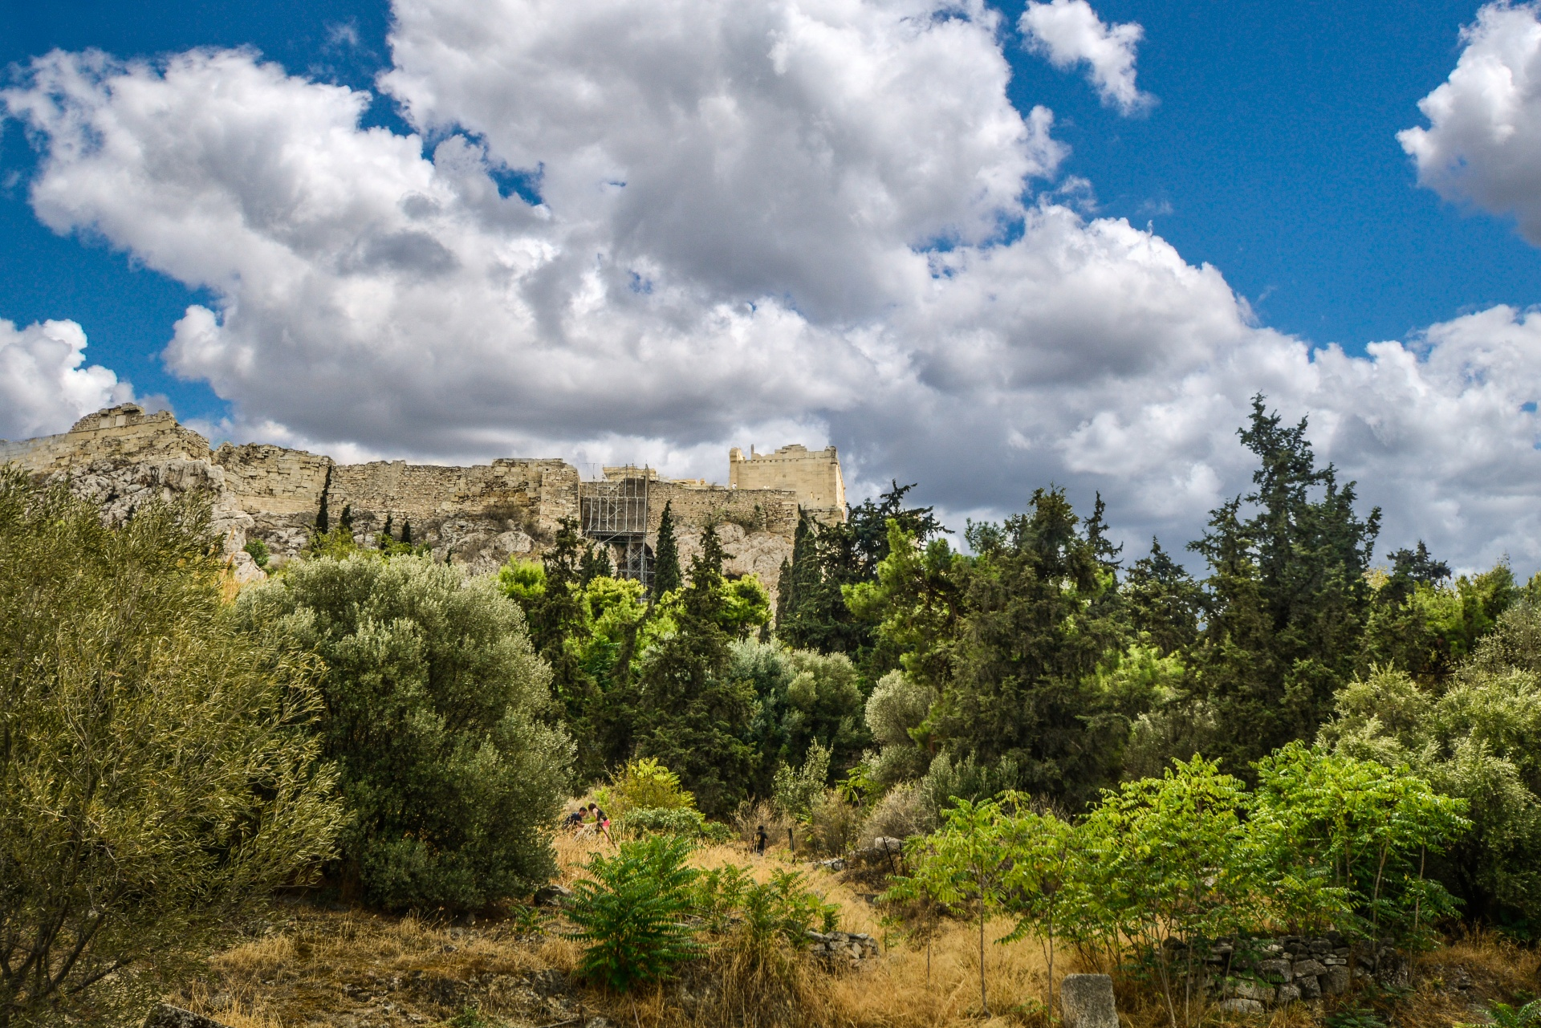
SOME DEFINITIONS & CONCEPTS
1. Definition of Cultural and Natural Heritage – some examples
Belgium: The Grand Place in Brussels, a UNESCO World Heritage Site, is a prime example of Belgium’s rich cultural heritage, with its Gothic and Baroque architecture. The Sonian Forest, which spans across Belgium’s capital, is part of Europe’s ancient forests, representing Belgium’s natural heritage.
Spain: The Alhambra in Granada is one of Spain’s most important cultural heritage sites, reflecting the country’s Islamic history. The Doñana National Park is a major natural heritage site, with its wetlands and rich biodiversity.
Estonia: Estonia’s cultural heritage includes the medieval Old Town of Tallinn, which has been preserved since the Middle Ages. In terms of natural heritage, Lahemaa National Park is one of Estonia’s most significant natural reserves, known for its forests and coastlines.
Greece: The Acropolis of Athens is a prime symbol of ancient Greek civilization, playing a central role in Western culture’s heritage. Greece’s Mount Olympus National Park, the mythological home of the Greek gods, represents its natural heritage and is a key biodiversity hotspot.
Grand Place in Brussels
Source, free image: https://www.needpix.com/photo/1816480
Alhambra in Granada
Source, free image: https://www.needpix.com/photo/1069312/
Old Town of Tallinn
Source, free image:
https://www.needpix.com/photo/1674002
Acropolis of Athens
Source, free image: https://www.needpix.com/photo/1517953

Slide 5
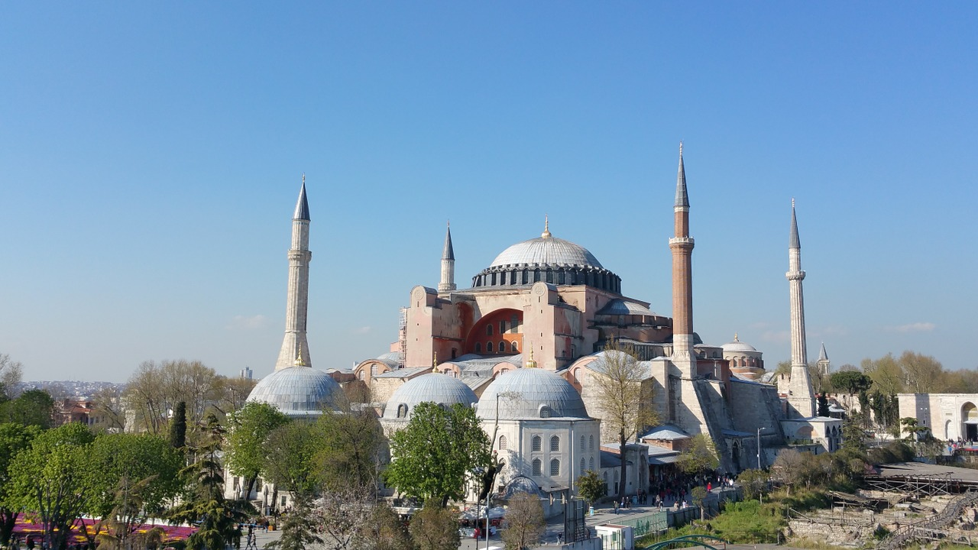
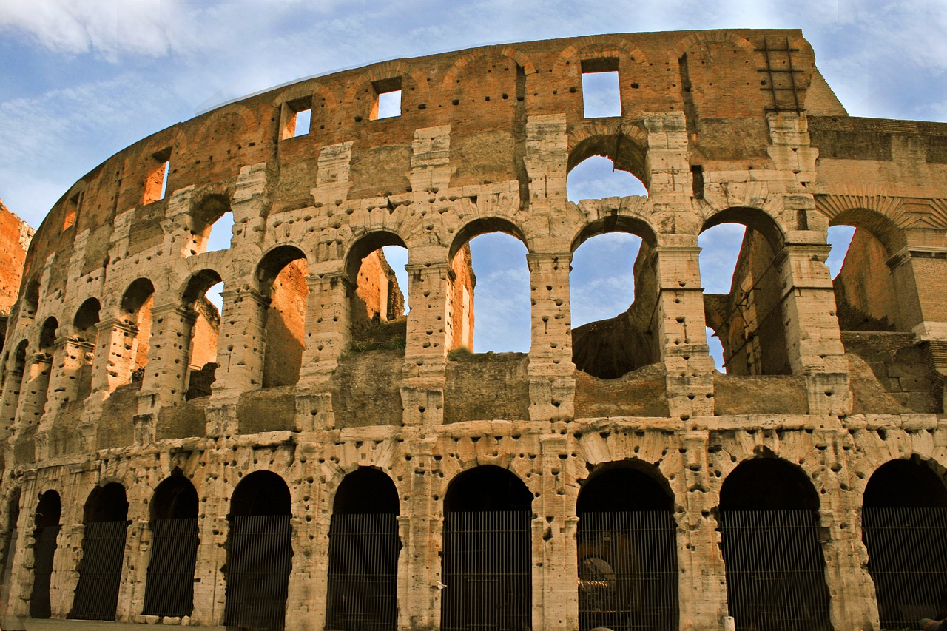
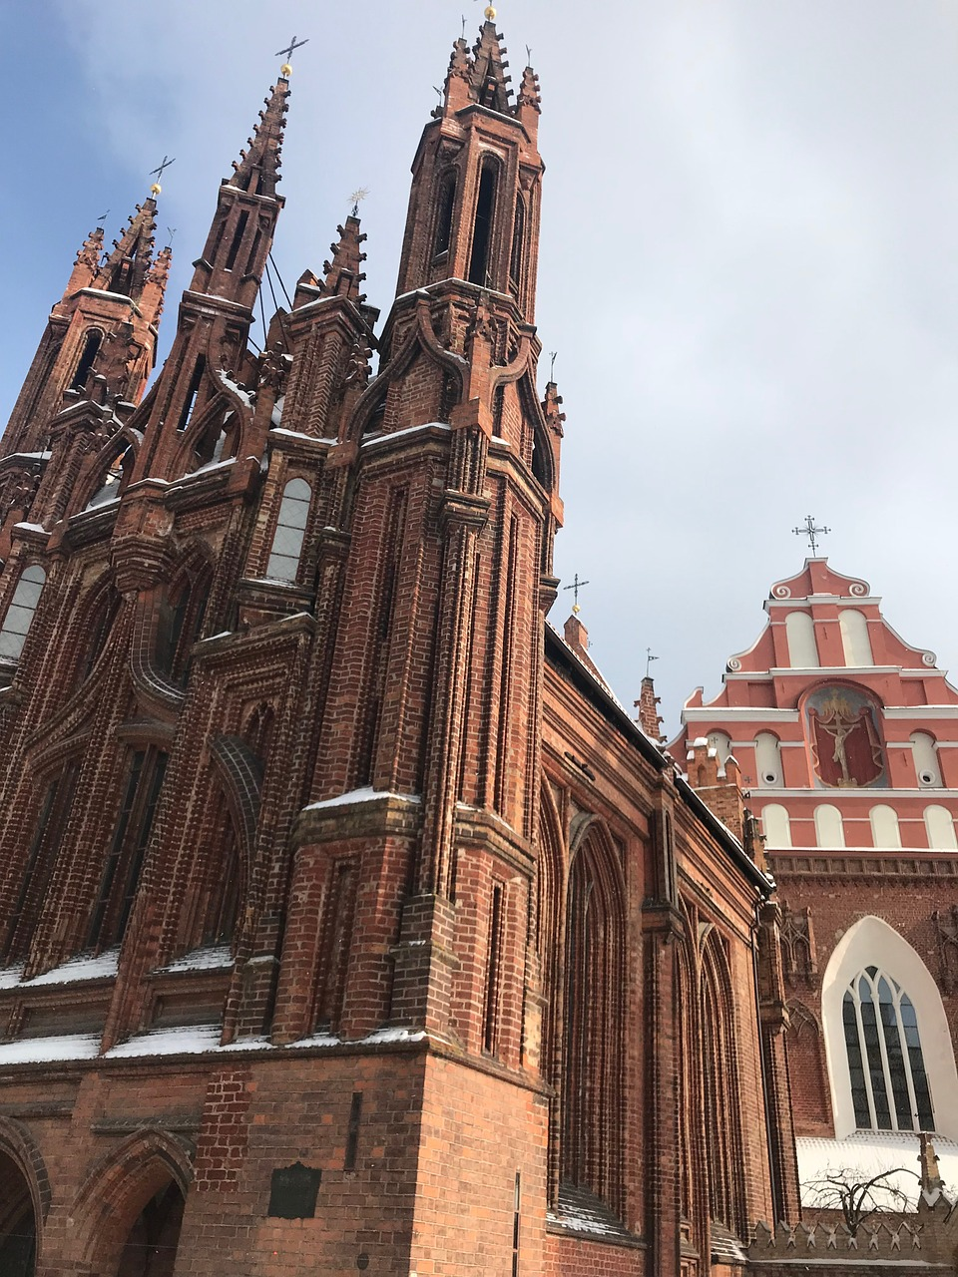
SOME DEFINITIONS & CONCEPTS
1. Definition of Cultural and Natural Heritage – some examples
Turkey: Hagia Sophia in Istanbul is a significant cultural landmark that embodies Turkey’s Byzantine and Ottoman heritage. For natural heritage, Göreme National Park in Cappadocia is a UNESCO site known for its unique rock formations and ancient cave dwellings.
Italy: The Colosseum in Rome is a symbol of Italy’s Roman heritage and a major cultural landmark. Cinque Terre National Park represents Italy’s natural heritage, showcasing coastal landscapes and ancient terraces that reflect human interaction with nature.
Lithuania: The Vilnius Historic Centre is a UNESCO World Heritage Site and a prime example of Lithuania’s cultural heritage. This Old Town area features Gothic, Renaissance, Baroque, and Classical buildings that reflect the country’s history as a cultural crossroads of Eastern and Western Europe. The Hill of Crosses near Šiauliai is a significant religious and cultural site where thousands of crosses have been placed by pilgrims over centuries, symbolizing Lithuanian resistance, faith, and cultural identity.
Hagia Sophia, Istanbul
Source, free image: https://www.needpix.com/photo/533044
Colosseum, Rome
Source, free image: https://www.needpix.com/photo/571218
Vilnius Historic Centre
Source, free image: https://www.needpix.com/photo/1622664/

Slide 6
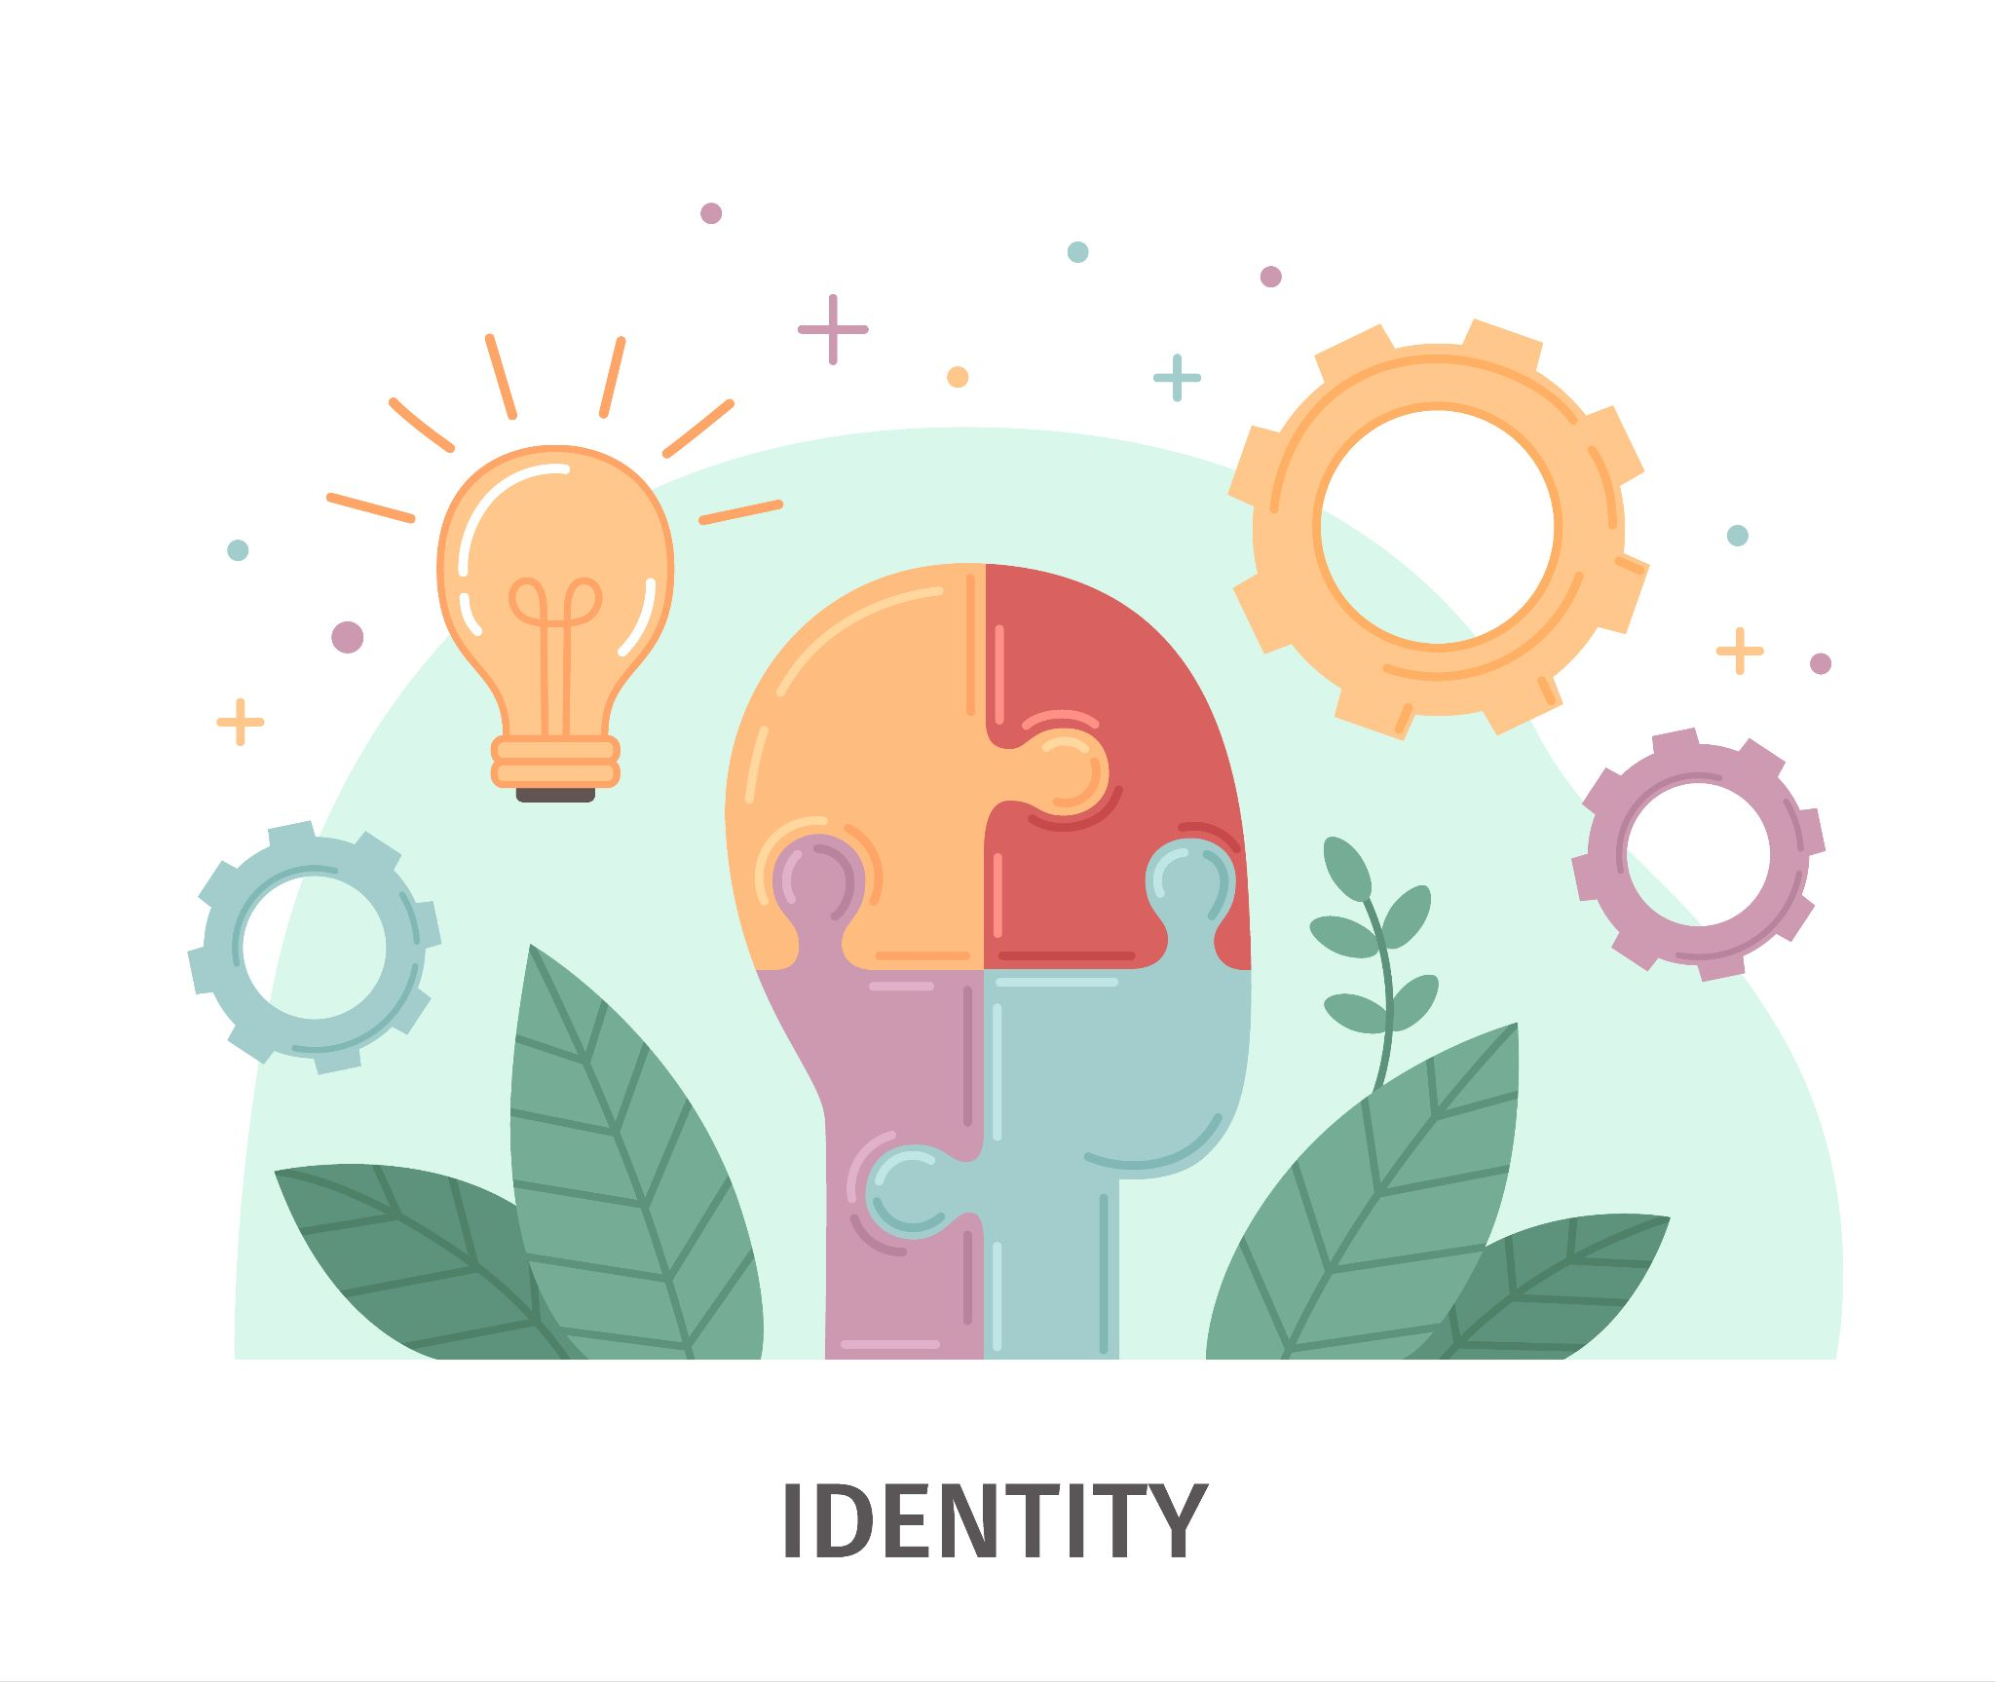
SOME DEFINITIONS & CONCEPTS
2. Identity Definition and Formation
Identity is the set of characteristics, beliefs, and expressions that define an individual or group. It is a complex, fluid concept shaped by personal experiences, social interactions, culture, and historical context.
Identity can be individual (personal identity) or collective (group, cultural, national identity), evolving through a dynamic process of self-perception and external recognition.
This formation occurs as individuals and communities engage with their environments, internalize norms and values, and negotiate belonging within broader societal frameworks.
Identity is often reaffirmed through social practices, heritage, language, and symbolic markers that distinguish groups and sustain cultural continuity.

Slide 7
SOME DEFINITIONS & CONCEPTS
2. Identity Definition and Formation – some examples
Belgium: Belgian identity is shaped by the linguistic divide between Flanders (Dutch-speaking) and Wallonia (French-speaking). Each region has a distinct cultural and political identity, contributing to Belgium’s complex national identity. The Manneken Pis statue in Brussels humorously reflects Belgian identity and values of freedom and resilience.
Spain: Regional identities in Spain are very strong. The Catalonian and Basque regions maintain distinct languages and cultures. Catalan identity is reinforced through language (Catalan) and traditions like the Castells (human towers), while Basque identity is shaped by the use of Euskara and a distinct history of autonomy movements.
Estonia: Estonian identity has been significantly shaped by its experience under Soviet rule. The Singing Revolution (1987-1991), during which Estonians peacefully protested for independence by gathering to sing traditional songs, played a key role in forming modern Estonian national identity.
Greece: Greek identity is heavily influenced by its ancient history and Orthodox Christianity. The Greek War of Independence (1821-1830) from the Ottoman Empire is a key event in the formation of modern Greek national identity, rooted in ideals of freedom and continuity with ancient Hellenic civilization.

Slide 8
SOME DEFINITIONS & CONCEPTS
2. Identity Definition and Formation – some examples
Turkey: Turkish identity has been shaped by the reforms of Mustafa Kemal Atatürk, which established a secular, nationalist identity following the collapse of the Ottoman Empire. Turkish identity balances its secular Republican values with a rich Ottoman and Islamic cultural legacy, symbolized by landmarks like Topkapi Palace.
Italy: Italy’s regionalism is central to identity formation. Regions like Tuscany, Veneto, and Sicily each maintain strong local identities. The Palio di Siena in Tuscany is a historic horse race that reinforces local pride and belonging among its different neighborhoods (contrade).
Lithuania: Lithuanian identity is deeply tied to its language and Catholic faith. During Soviet occupation, maintaining the Lithuanian language and traditions became a form of resistance. The Singing Revolution and the Day of Restoration of Independence (March 11, 1990) are crucial moments that shaped modern Lithuanian national identity.
.

Slide 9

SOME DEFINITIONS & CONCEPTS
3. The Role of Heritage in Building a Sense of Belonging Within Communities
Heritage plays a crucial role in fostering a sense of belonging within communities by connecting individuals to a shared history, culture, and values. Through tangible (monuments, artifacts) and intangible (traditions, language) heritage, people feel rooted in their collective past, which reinforces group identity.
Celebrations of cultural heritage, such as festivals and communal activities, create spaces for members to experience solidarity and continuity, strengthening emotional bonds.
In this way, heritage serves as a foundation for social cohesion, allowing people to affirm their place within their community and maintain their identity in a rapidly changing world.
Source, free image: https://www.freepik.com/free-vector/flat-international-human-solidarity-day-illustration_33433039.htm#fromView=keyword&page=2&position=16&uuid=e52df06c-7243-42fa-8489-68f60d33410d

Slide 10
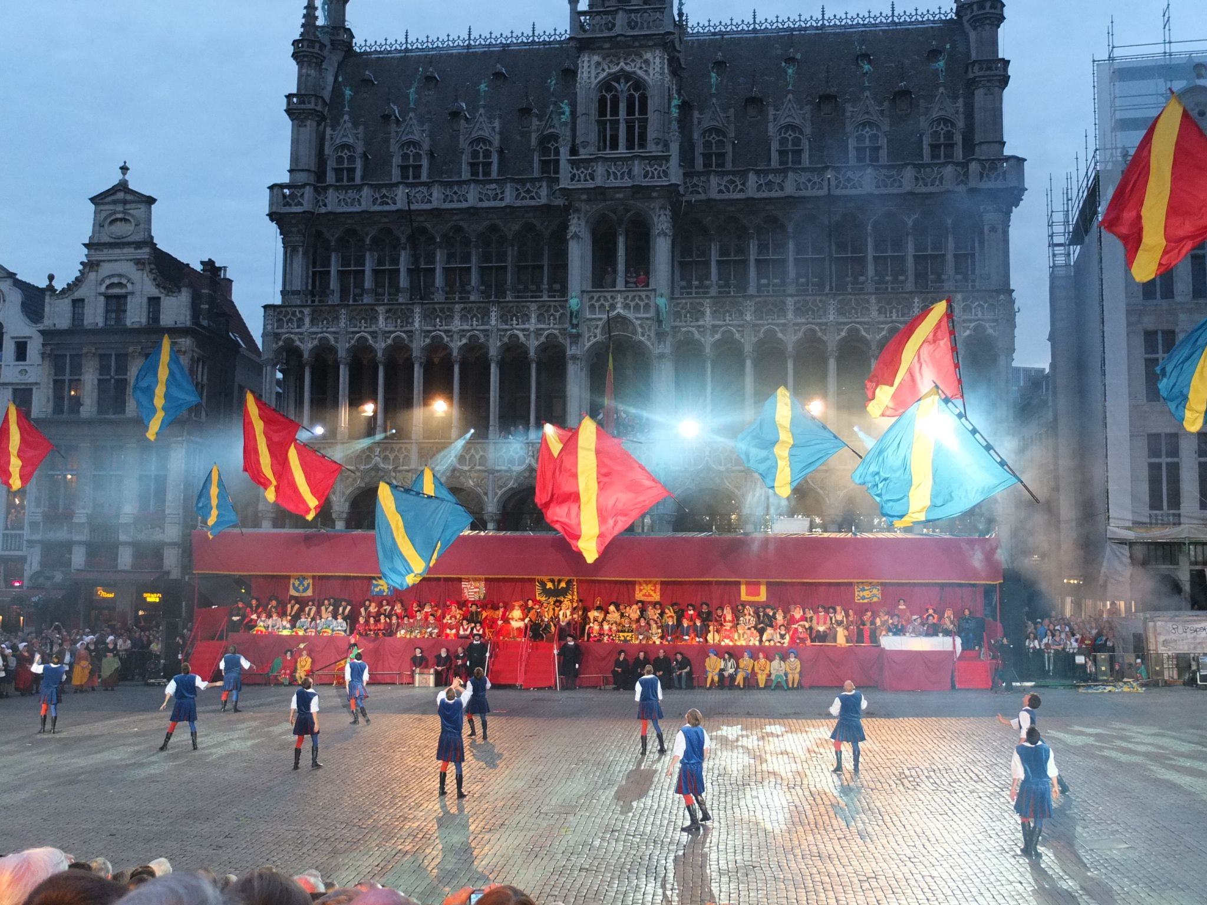
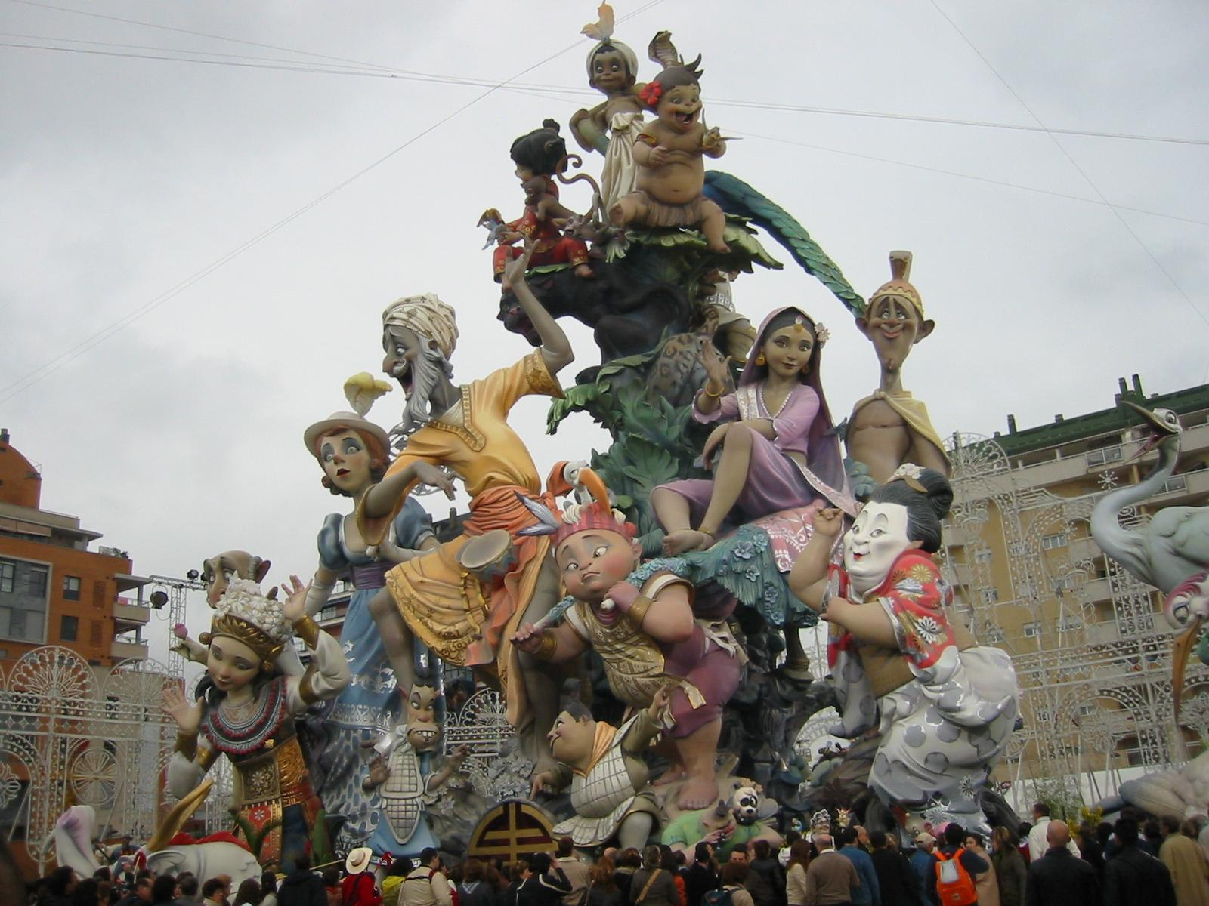
SOME DEFINITIONS & CONCEPTS
3. The Role of Heritage in Building a Sense of Belonging Within Communities – some examples
Belgium:
The Ommegang Festival in Brussels revives medieval traditions and brings the community together to celebrate their shared heritage. Events like this reinforce local identity and create a sense of belonging within the city.
Spain:
The Fallas Festival in Valencia, where giant effigies are burned in a spectacular display, strengthens community ties through shared participation in creating and celebrating cultural heritage. It fosters a sense of collective belonging among Valencians.
Ommegang Festival in Brussels
By Christophe Degryse - Own work, CC BY-SA 4.0, https://commons.wikimedia.org/w/index.php?curid=61595177
The Fallas Festival, Valencia
By Alberto Ceballos - originally posted to Flickr as Fallas 2006 Nou Campanar (Valencia), CC BY-SA 2.0,ttps://commons.wikimedia.org/w/index.php?curid=9654774

Slide 11
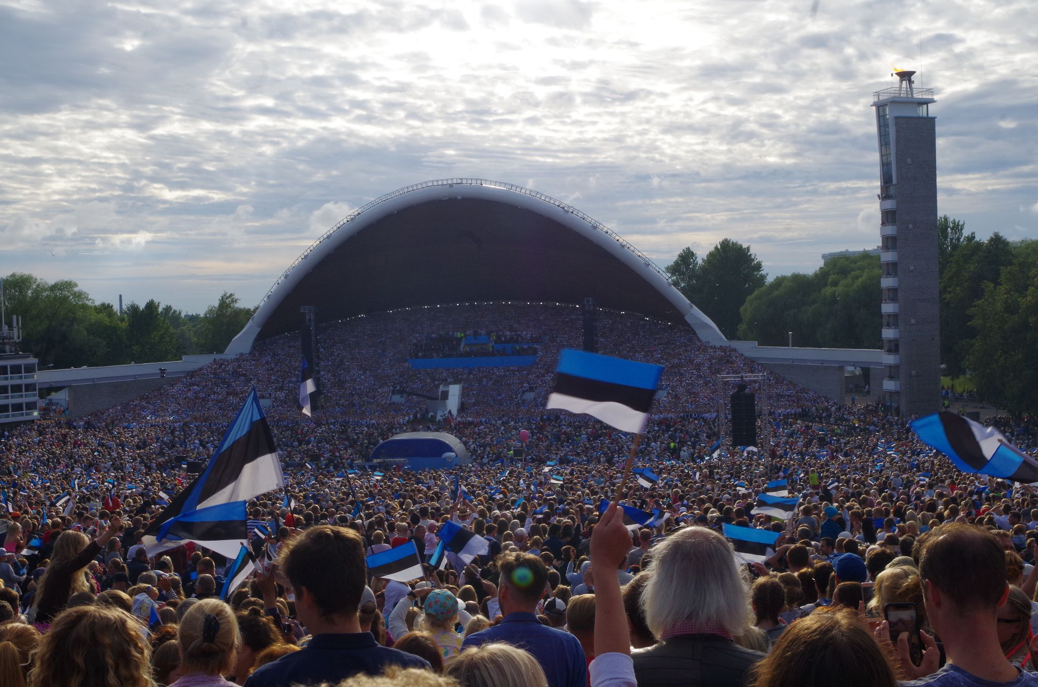
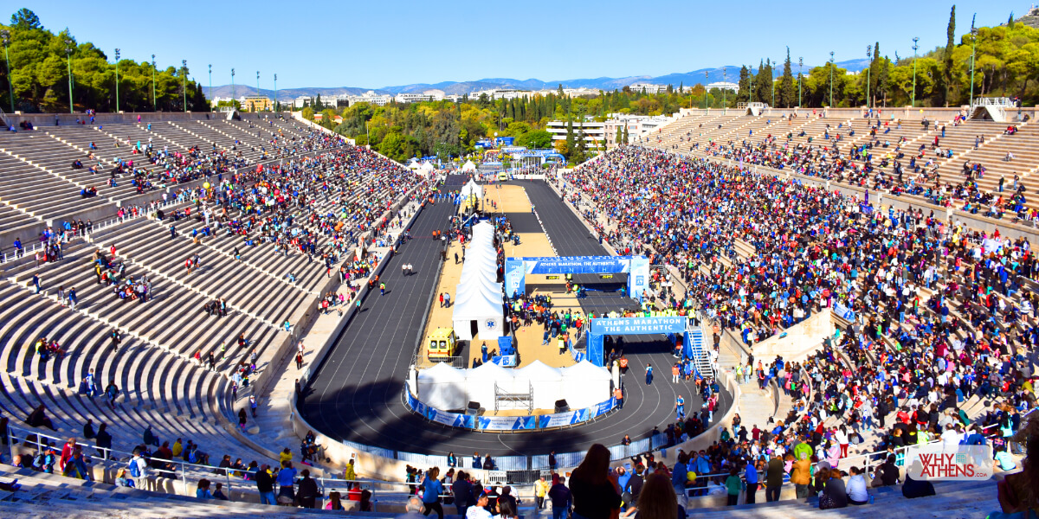
SOME DEFINITIONS & CONCEPTS
3. The Role of Heritage in Building a Sense of Belonging Within Communities – some examples
Estonia:
The Estonian Song Festival, which gathers tens of thousands of people to sing traditional Estonian songs, is one of the most significant cultural events in Estonia. It has historically played a role in uniting the nation and fostering a strong sense of belonging and national pride.
Greece:
The Panathenaic Festival in ancient Greece, which has been revived in modern forms like the Athens Marathon, allows Greeks to connect with their historical identity. It fosters unity and belonging through shared participation in cultural and historical events.
Estonian Song Festival
By Metsavend - Own work, CC BY-SA 4.0, https://commons.wikimedia.org/w/index.php?curid=80239355
The finish line for the Athens Marathon is the Panathenaic Stadium. Photograph: Why Athens

Slide 12
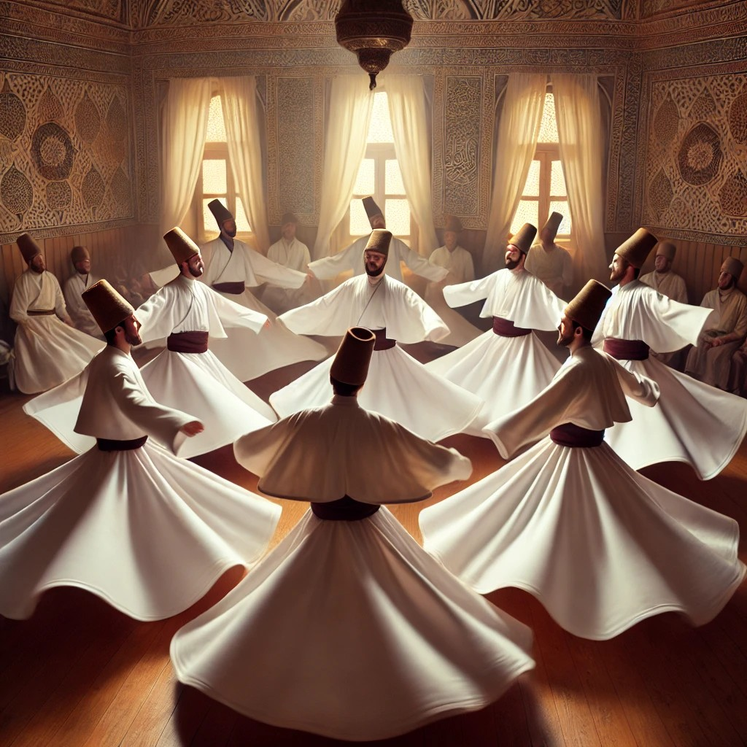
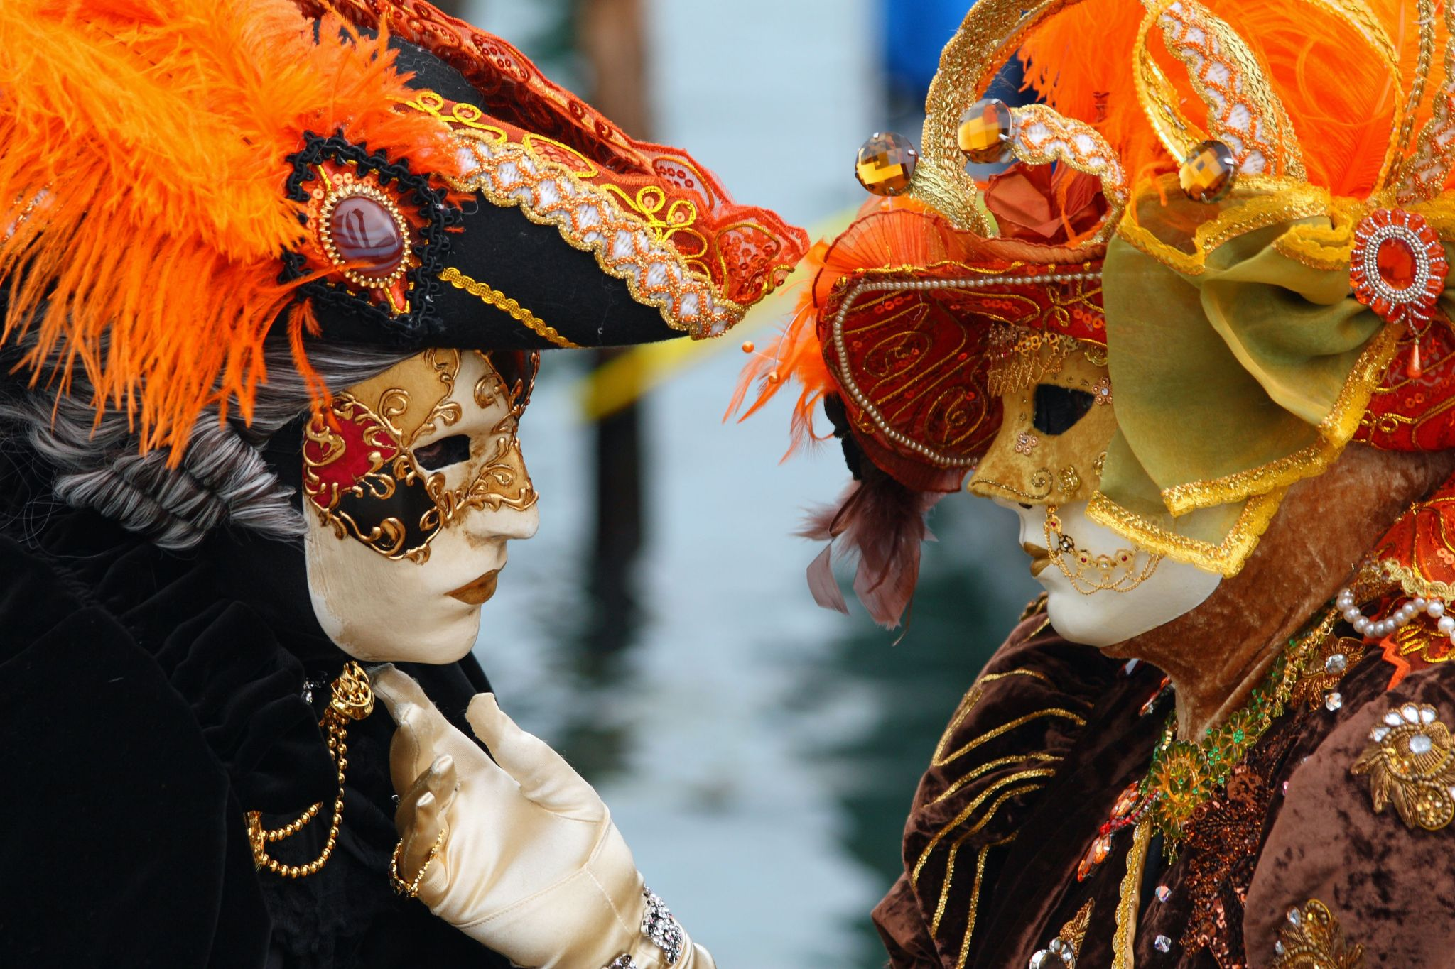
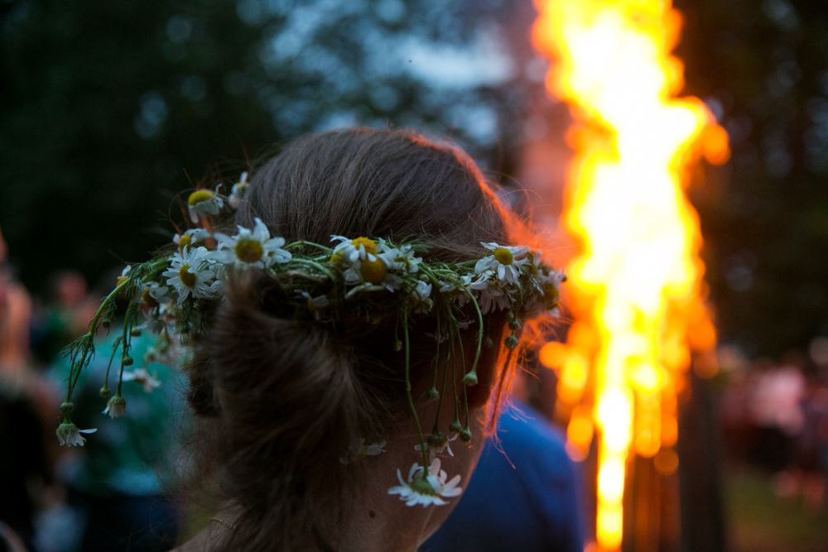
SOME DEFINITIONS & CONCEPTS
3. The Role of Heritage in Building a Sense of Belonging Within Communities – some examples
Turkey:
The Whirling Dervishes ceremonies in Konya, rooted in Sufism, are a spiritual and cultural event that fosters a deep sense of belonging and connection among participants. These ceremonies link people to Turkey’s Islamic heritage, creating a shared communal experience.
Italy:
The Venice Carnival is a centuries-old tradition that continues to bring Venetians and visitors together, celebrating the city’s unique history, art, and identity. Wearing traditional masks and costumes reinforces local pride and creates a sense of unity and belonging.
Lithuania:
The Joninės (St. John’s Day) or Rasos Festival is an ancient midsummer celebration in Lithuania, where communities gather to celebrate with bonfires and folk rituals. This event connects Lithuanians to their pagan roots and strengthens a sense of belonging through shared cultural traditions.
Whirling Dervishes
AI Generated
Venice Carnival
By Frank Kovalchek from Anchorage, CC BY 2.0, https://commons.wikimedia.org/w/index.php?curid=13290679
By Unknown author - C0, https://commons.wikimedia.org/w/index.php?curid=91511482

Slide 13
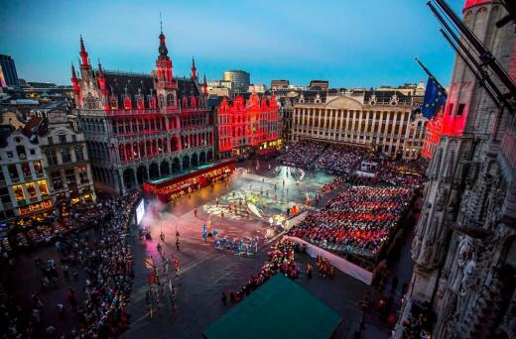
Best practice on sense of belonging
The Ommegang Festival in Brussels
The Ommegang Festival in Brussels is a centuries-old celebration that dates back to the 14th century, initially held to honor a religious procession. Today, it has evolved into a vibrant reenactment of medieval traditions, featuring historical costumes, parades, and performances in Brussels' Grand Place, a UNESCO World Heritage Site.
This festival symbolizes Belgium's rich historical identity and fosters a shared sense of belonging among its participants.
The Ommegang also reflects Belgium’s multicultural fabric, bridging its linguistic divide (Dutch, French, and German) by celebrating a common heritage. This public event offers an opportunity to explore how historical traditions shape modern Belgian identity, bringing together communities from different regions and backgrounds. It underscores the importance of festivals and heritage in creating unity, pride, and continuity in national identity formation, especially in a country characterized by linguistic and cultural diversity like Belgium.
Source, Free image, https://www.brussels.be/ommegang

Slide 14
Best practice on sense of belonging
How does The Ommegang Festival in Brussels enhance community identity and engagement
The Ommegang Festival in Brussels serves as a powerful tool for enhancing community identity and engagement in several key ways, especially in the context of Belgium's linguistic and cultural diversity.
Celebration of shared heritage: The Ommegang Festival draws from a rich historical tradition that dates back to the 14th century. This shared historical narrative provides Belgians with a common cultural anchor, allowing people from different linguistic and regional backgrounds to connect through a collective memory. It strengthens the sense of belonging to a national heritage that transcends regional divisions.
Multicultural integration: Belgium is characterized by its complex linguistic landscape, with Dutch, French, and German as official languages. The Ommegang Festival, celebrated in the iconic Grand Place of Brussels, transcends these linguistic boundaries by focusing on Belgium's historical identity, which is a unifying element for all Belgians. The festival’s inclusive approach brings together people from different regions, encouraging interaction, mutual understanding, and a shared appreciation for Belgium's cultural diversity. This helps foster a sense of unity in a country where linguistic and cultural divisions can sometimes lead to political tensions.
Public participation and engagement: The Ommegang Festival is not just a spectacle for tourists; it actively involves local communities through performances, parades, and public celebrations. The participants in historical reenactments often come from different Belgian regions, reflecting the country’s multicultural fabric. By engaging the public in the festival—whether as performers, organizers, or spectators—the event strengthens communal bonds. This active participation in shared traditions nurtures civic pride and reinforces a collective sense of identity.

Slide 15
Best practice on sense of belonging
How does The Ommegang Festival in Brussels enhance community identity and engagement
4. Symbol of continuity and national pride: The festival acts as a living symbol of continuity, linking the past to the present. It highlights the importance of preserving traditions and passing them on to future generations. This helps maintain a sense of continuity in Belgium’s national identity, despite modern changes and challenges. In doing so, the Ommegang promotes national pride and solidarity, offering a space where historical awareness intersects with contemporary Belgian identity.
5. Representation of diverse origins: Over time, the Ommegang has expanded to reflect the cultural plurality of Belgium and Brussels, which is a melting pot of different ethnicities and nationalities. Brussels itself is one of the most cosmopolitan cities in Europe, The Ommegang has modernized over the years to ensure that it remains relevant to contemporary Belgian society, which is increasingly diverse. Although the festival preserves its medieval roots, there is a conscious effort to present it in a way that resonates with modern values of inclusion, tolerance, and multiculturalism.
6. Cultural tourism and international visibility: Beyond local engagement, the Ommegang Festival attracts international tourists, showcasing Belgium’s heritage on a global stage. This boosts cultural tourism and strengthens Brussels’ position as a key European cultural capital. International visibility enhances the pride of locals in their unique traditions and fosters a greater sense of belonging to a globally recognized cultural and historical legacy.

Slide 16


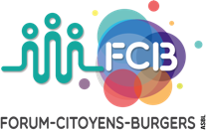
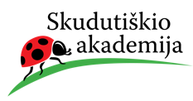

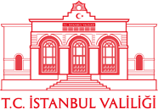

2023-1-EE01-KA220-ADU-000150753
Thank you for your attention
PARTNERS
Funded by the European Union. Views and opinions expressed are however those of the author(s) only and do not necessarily reflect those of the European Union or Estonian National Agency. Neither the European Union nor the granting authority can be held responsible for them.

