Slide 1



2023-1-EE01-KA220-ADU-000150753
TRAINING PROGRAMME
LEARNING UNIT 1: Sense of belonging
Funded by the European Union. Views and opinions expressed are however those of the author(s) only and do not necessarily reflect those of the European Union or Estonian National Agency. Neither the European Union nor the granting authority can be held responsible for them.

Slide 2
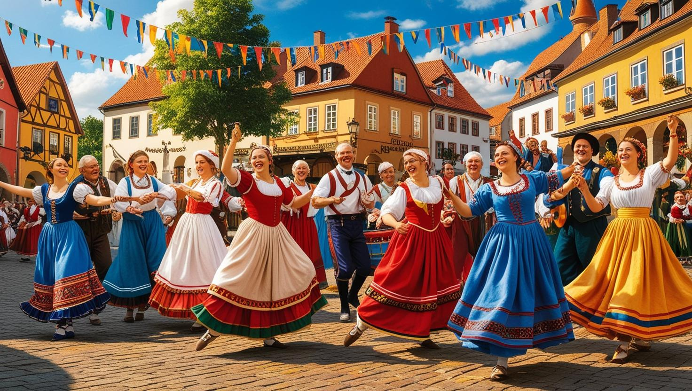
LESSON 2: Engaging Communities through Heritage

Slide 3

Interactive Activity: Designing a Heritage Engagement Campaign 1/2
Objective:
The aim of this activity is to empower participants to develop strategies for engaging specific demographic groups through local heritage. Encourage creative use of digital tools to promote heritage engagement projects. Foster teamwork, innovation, and practical application of community engagement principles.
Materials Needed:
- Access to digital tools: laptops, smartphones, or tablets.
- Graphic design platforms (e.g., Canva), social media platforms, and video editing tools.
- Information about the local heritage site or event.
- Handouts with key engagement strategies and demographic considerations.
- Flipcharts, markers, and sticky notes for brainstorming.
- Projector or smartboard for presentations.
Procedure:
1. Introduction (15 minutes):
Brief participants on the activity’s purpose and objectives. Provide a quick overview of the case study, highlighting how Las Fallas engages diverse demographics.Discuss the importance of tailoring engagement strategies to specific groups (e.g., youth prefer interactive and digital approaches, while elderly groups might value storytelling or oral history initiatives).
Source, Freepik, clipart by brbfx
https://www.freepik.com/free-vector/aerial-view-people-working-light-bulb_38346952.htm#fromView=search&page=1&position=4&uuid=f293cdce-ce0f-457f-a119-a3dc2c259697

Slide 4
Interactive Activity: Designing a Heritage Engagement Campaign 2/2
2. Team Formation and Brainstorming (30 minutes):
Divide participants into small teams, each assigned a specific demographic (e.g., youth, elderly, minority groups). Provide background information about a chosen local heritage site or event. Ask teams to brainstorm ideas for a mini-project aimed at engaging their assigned demographic. Use flipcharts or sticky notes to outline their ideas.
3. Project Development (45 minutes):
Teams will use digital tools to design a campaign for their mini-project. Examples include: Designing posters or infographics using Canva.Creating a short promotional video. Developing a social media strategy (hashtags, posts, and interactive content). Proposing a digital storytelling project (e.g., interviews or blog posts). Each campaign should include a title, a description of the engagement activity, and promotional materials.
4. Presentation and Feedback (30 minutes):
Each team will present their mini-project and campaign to the group. Encourage peer feedback by asking participants to identify strengths and areas for improvement.
Source, Freepik, clipart by brbfx
https://www.freepik.com/free-vector/aerial-view-people-working-light-bulb_38346952.htm#fromView=search&page=1&position=4&uuid=f293cdce-ce0f-457f-a119-a3dc2c259697

Slide 5

Discussion and Reflection
Questions for Group Discussion and conclusion:
To help close the activity and highlight key learnings with the learners, here are five reflection questions to ask:
1. What challenges did you face while designing your engagement project, and how did you address them? (This question encourages participants to reflect on problem-solving and adaptability during the activity. It helps them recognize the complexities of community engagement and learn from their approaches)
2. How did your understanding of the target demographic influence the design of your project? (This prompts participants to think critically about how they tailored their project to meet the needs and interests of their assigned group, emphasizing the importance of inclusivity and relevance in community engagement)
3. What role did digital tools play in shaping your campaign, and what advantages or limitations did you encounter? (This question highlights the role of technology in modern heritage promotion, encouraging participants to assess its effectiveness and consider how to leverage it in future projects)
4. How did working as a team contribute to the development of your project? (By reflecting on teamwork dynamics, participants can evaluate how collaboration, communication, and shared creativity enhanced their outcomes, fostering a sense of collective effort)
5. What key takeaway from this activity will you apply to future heritage engagement initiatives? (This forward-looking question encourages participants to consolidate their learning and think about how the insights gained can influence their approach to real-world heritage projects)
Source,Freepik, free image by pch.vector
https://www.freepik.com/free-vector/people-talking-arguing_9176206.htm#fromView=search&page=1&position=32&uuid=9ec0301a-dddf-4d25-a241-a5349c9e3205

Slide 6







2023-1-EE01-KA220-ADU-000150753
Thank you for your attention
PARTNERS
Funded by the European Union. Views and opinions expressed are however those of the author(s) only and do not necessarily reflect those of the European Union or Estonian National Agency. Neither the European Union nor the granting authority can be held responsible for them.

