Slide 1
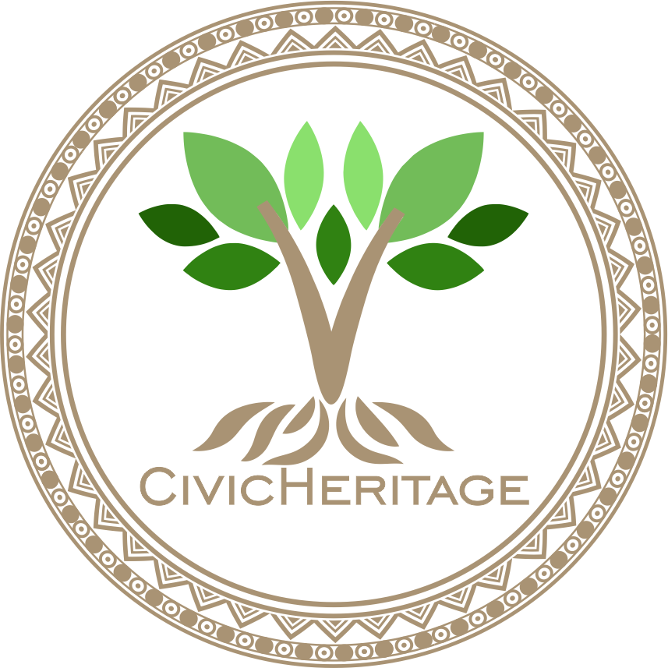


2023-1-EE01-KA220-ADU-000150753
TRAINING PROGRAMME
LEARNING UNIT 1: Sense of belonging
Funded by the European Union. Views and opinions expressed are however those of the author(s) only and do not necessarily reflect those of the European Union or Estonian National Agency. Neither the European Union nor the granting authority can be held responsible for them.

Slide 2
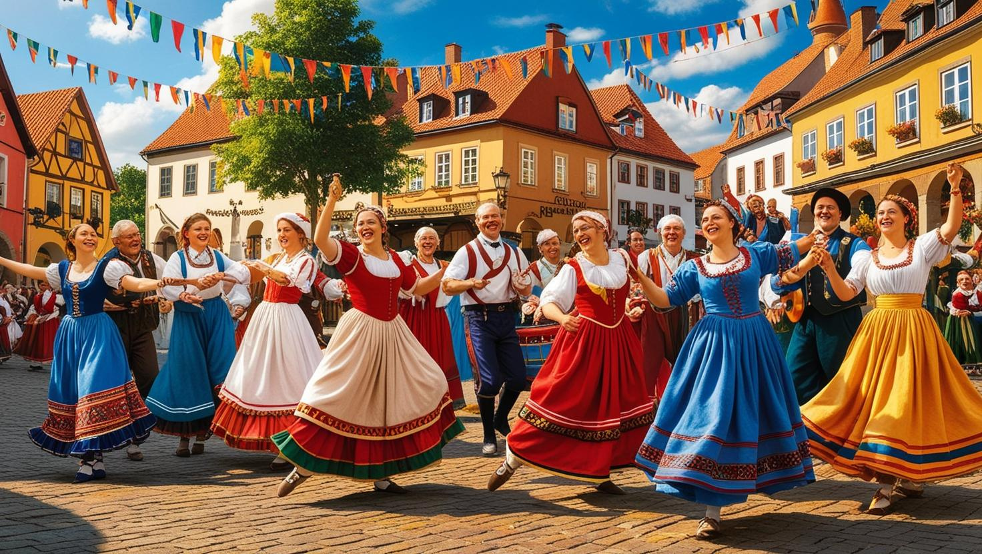
LESSON 2: Engaging Communities through Heritage

Slide 3
  SOME DEFINITIONS & CONCEPTS (1/3)
1. Introduction to Community Engagement Strategies and Techniques for Involving Local Populations in Heritage Projects
Community engagement strategies aim to involve local populations in heritage projects by fostering collaboration, inclusivity, and shared ownership. Techniques include workshops, public consultations, participatory mapping, and co-creation activities that empower communities to preserve and celebrate their heritage collaboratively.

Slide 4
  SOME DEFINITIONS & CONCEPTS
1. Community Engagement Strategies – some examples
Belgium: The Beguinages Restoration Projects in Flanders involved local communities in preserving these historic women's housing complexes. Public workshops and consultations ensured the community's needs and historical context were considered.
Italy: In Matera, a UNESCO World Heritage Site, residents collaborated on revitalizing the ancient Sassi cave dwellings. Community-driven planning preserved the site while promoting sustainable tourism and local development.
Estonia: The Kihnu Cultural Space project engaged the island’s inhabitants in preserving their unique traditions, including handicrafts and dances. Locals participated in documenting and revitalizing their cultural heritage.
Spain: The restoration of Mezquita-Catedral de Córdoba involved local stakeholders, integrating public input and educational programs to balance preservation with community needs.
Greece: The Delphi Landscape Initiative engaged local populations in conserving the archaeological site and surrounding environment through participatory workshops and sustainable agricultural practices.
Lithuania: Living Heritage in Samogitia, in the Samogitian region, initiatives to preserve traditional wooden cross-crafting involve local artisans and families in training programs, ensuring the continuity of this unique intangible cultural heritage
Turkey: The Safranbolu Urban Conservation Project worked closely with residents to restore Ottoman-era houses while ensuring the preservation of cultural practices tied to these historic structures.
.

Slide 5
  SOME DEFINITIONS & CONCEPTS (2/3)
2. The Role of Storytelling, Events, and Partnerships in Fostering Community Participation
Storytelling, events, and partnerships enhance community participation by making heritage relatable and accessible. Through personal narratives, cultural festivals, and collaborations with local organizations, they create emotional connections and shared experiences, fostering deeper community engagement.

Slide 6
  SOME DEFINITIONS & CONCEPTS
2. Community Participation – some examples
Belgium: The Ommegang Festival in Brussels, through historical reenactments, uses storytelling to connect the community to its medieval heritage, engaging residents and visitors in the city’s history.
Italy: The Palio di Siena horse race is a historic event that fosters community participation through centuries-old rivalries between city neighborhoods (contrade), deepening their sense of belonging and identity.
Estonia: The Estonian Song and Dance Festival uses storytelling through songs and folk performances, engaging communities in preserving and celebrating their national identity and cultural heritage.
Spain: The Las Fallas Festival in Valencia combines partnerships with artisans and storytelling through satirical effigies to engage the community in celebrating and reflecting on their cultural traditions.
Greece: The Athens Epidaurus Festival, with its performances of ancient Greek dramas, uses storytelling to link contemporary audiences to classical heritage, fostering community participation and cultural continuity.
Lithuania: Curonian Spit Community Project, local partnerships on the Curonian Spit involve storytelling about fishing traditions and legends tied to the region. Events like the Fisherman’s Festival ensure active participation in preserving both natural and cultural heritage.
Turkey: The Whirling Dervishes Festival in Konya celebrates Rumi’s legacy, using storytelling, music, and partnerships with local cultural organizations to engage the community in spiritual and cultural traditions.

Slide 7
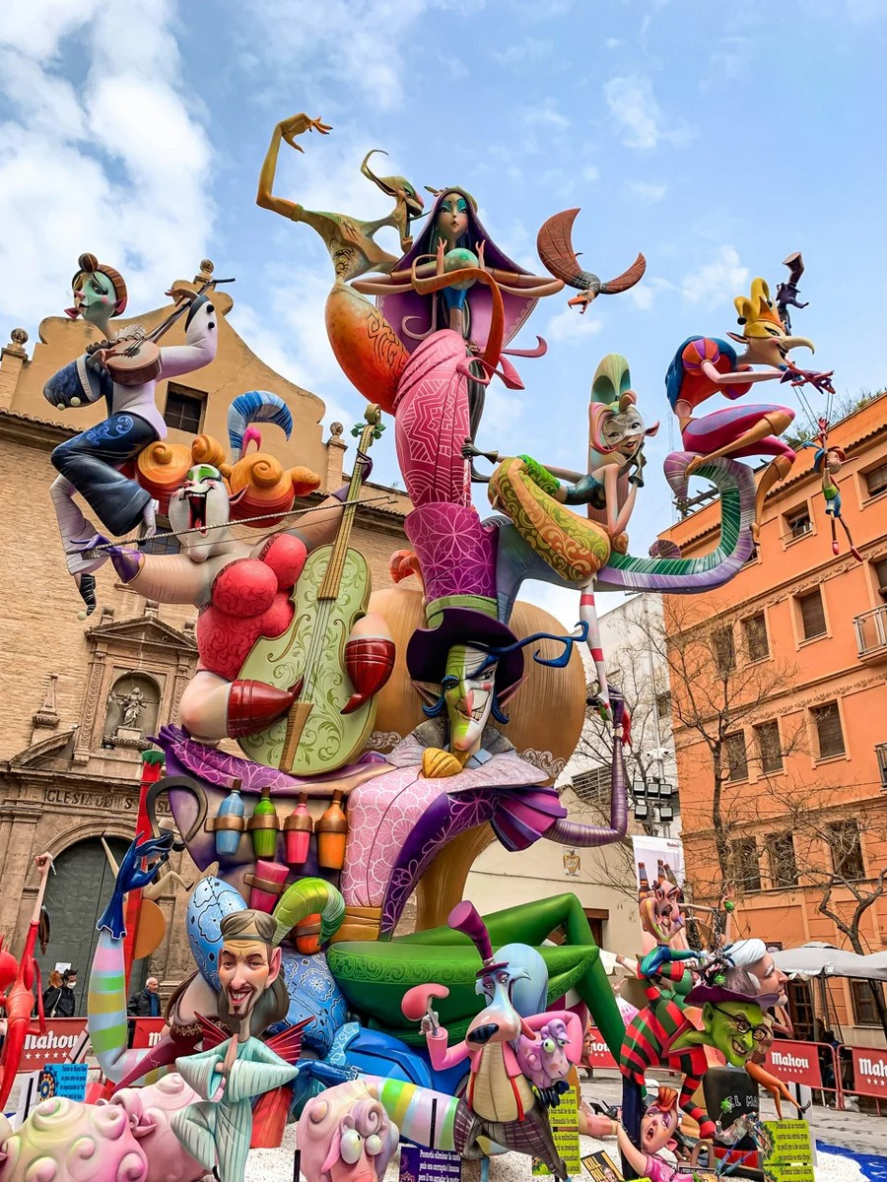
  Best practice on engaging communities through heritage
Las Fallas Festival in Valencia
The Las Fallas Festival in Valencia is a vibrant celebration where massive satirical effigies (fallas) are constructed, displayed, and ceremonially burned. This UNESCO-recognized festival is deeply rooted in Valencian traditions and engages the entire community, from artisans creating the fallas to residents participating in street parades and events. The festival blends creativity, storytelling, and communal pride, fostering a sense of identity and belonging among participants. Local partnerships with artisans, schools, and cultural organizations ensure intergenerational knowledge transfer and community involvement. Las Fallas serves as a powerful example of how heritage can unite diverse groups, promote cultural continuity, and sustain community engagement in preserving traditions.
Website: https://www.fallas.com

Slide 8
  Best practice on engaging communities through heritage
How does The Las Fallas Festival in Valencia enhances community engagement through heritage
The Las Fallas Festival in Valencia enhances community engagement through heritage in several impactful ways:
1. Artistic Collaboration: Local artisans, including carpenters, sculptors, and painters, work together to create the intricate fallas effigies. This collaborative effort involves apprenticeships, ensuring the transmission of traditional skills and fostering a sense of pride and belonging among artisans and participants.
2. Intergenerational Participation: Families and schools engage children in the festival’s traditions, such as designing smaller fallas for youth categories. This nurtures cultural continuity and ensures the younger generation feels connected to their heritage.
3. Community Identity: Each neighborhood (barrio) sponsors its own falla, creating friendly competition while reinforcing local identities. Residents come together to plan, fund, and celebrate their unique contributions, fostering solidarity and pride.

Slide 9
  Best practice on engaging communities through heritage
How does The Las Fallas Festival in Valencia enhances community engagement through heritage
4. Storytelling and Satire: The festival uses storytelling to comment on social and political issues through the satirical themes of the fallas. This engages the community in shared reflection, dialogue, and humor.
5. Public Events and Rituals: Parades, music, traditional dress, and the ceremonial burning of the fallas bring people together in a shared experience, strengthening emotional bonds and a sense of unity within the city.
6. Cultural Partnerships: Collaborations with local organizations, schools, and cultural institutions ensure that the festival remains a living tradition, continually evolving while retaining its historical essence.

Slide 10





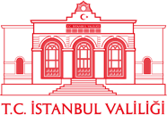

2023-1-EE01-KA220-ADU-000150753
Thank you for your attention
PARTNERS
Funded by the European Union. Views and opinions expressed are however those of the author(s) only and do not necessarily reflect those of the European Union or Estonian National Agency. Neither the European Union nor the granting authority can be held responsible for them.

