Slide 1



2023-1-EE01-KA220-ADU-000150753
TRAINING PROGRAMME
LEARNING UNIT 2: Creativity and Eco-Design through Ceramic Art and Heritage
Funded by the European Union. Views and opinions expressed are however those of the author(s) only and do not necessarily reflect those of the European Union or Estonian National Agency. Neither the European Union nor the granting authority can be held responsible for them.

Slide 2
LESSON 1: Exploring the Origins and Meaning of Ceramics and Initial Clay Work

Slide 3
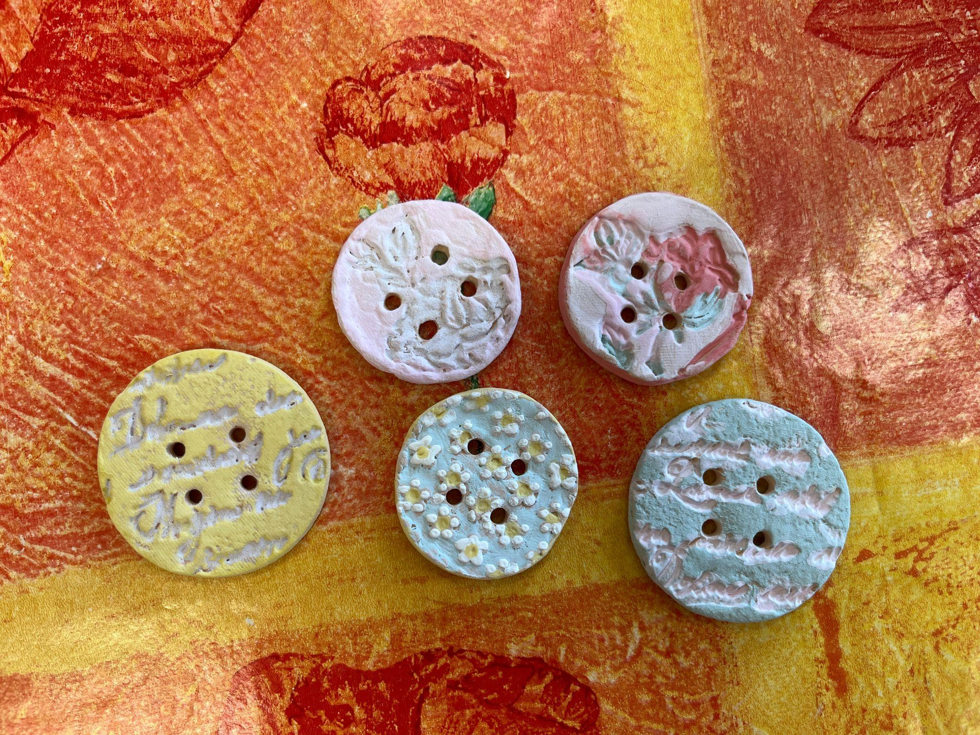
  Creative Interactive Activity: Making a Personal Lucky Charm from Clay
Present the creative task:
Invite the learners to make a personal lucky charm — a symbolic object shaped from clay.
This piece should reflect something meaningful to them: a wish, a protective sign, a shape that represents their story or mood. Show a few examples (abstract symbols, animals, hands, spirals, eyes, initials, etc.).
Let them know there’s no “right” way — the charm should reflect personal intuition and expression.
- Encourage learners to enjoy the tactile experience and not worry about perfection.
- Remind them to keep their object small (so it can be fired easily).

Slide 4
  Wrap-Up and Reflection
End the session with a reflective circle:
Invite participants to show their charms and briefly share what they created and why.
Ask guiding questions like:
What did you enjoy about working with clay?
Was there anything unexpected or challenging?
Can you share what inspired the design of your lucky charm?
How did you decide on the shape and patterns?
Were there any that you found particularly effective or challenging?
Was there anything about working with clay that surprised you or changed the way you think about crafting with natural materials?
In what ways does your lucky charm reflect your personal identity or cultural background, if at all?

Slide 5







2023-1-EE01-KA220-ADU-000150753
Thank you for your attention
PARTNERS
Funded by the European Union. Views and opinions expressed are however those of the author(s) only and do not necessarily reflect those of the European Union or Estonian National Agency. Neither the European Union nor the granting authority can be held responsible for them.

