Slide 1



2023-1-EE01-KA220-ADU-000150753
TRAINING PROGRAMME
LEARNING UNIT 2: Creativity and Eco-Design through Ceramic Art and Heritage
Funded by the European Union. Views and opinions expressed are however those of the author(s) only and do not necessarily reflect those of the European Union or Estonian National Agency. Neither the European Union nor the granting authority can be held responsible for them.

Slide 2
LESSON 1: Exploring the Origins and Meaning of Ceramics and Initial Clay Work

Slide 3
  OBJECTIVES OF THE LESSON
In this lesson, you will explore how to introduce learners to the world of ceramics in a way that is meaningful, engaging, and accessible. You’ll explore how to create a welcoming atmosphere, activate participants’ existing knowledge, and guide them through their first experience of working with clay.
By the end of this lesson, you will be able to:
Engage your participants in a warm-up activity that activates their prior knowledge and associations with ceramics.
Introduce the cultural and historical significance of ceramics in a way that is accessible and inspiring.
Facilitate a group discussion on the emotional and symbolic meaning of ceramics across different cultures.
Demonstrate basic clay handling and simple hand-building techniques.
Guide participants through the creation of a small personal clay object (lucky charm) that reflects their intention or identity.
Use this lesson as a foundation for building interest and confidence—both yours and your learners’—in using ceramics as a tool for learning, connection, and self-discovery.

Slide 4
  WARM-UP ACTIVITY: Unfinished sentences about ceramics
To activate learners’ curiosity and prior knowledge, begin the session with a simple but effective group task.
Step-by-step:
Divide participants into small groups (3–5 people).
Distribute a worksheet with unfinished statements about ceramics, such as:
  “The word keramos in Greek means…”
  “Ceramics is the first … in human history.”
  “Ceramics is around … years old.”
  “To turn clay into ceramics, the minimum firing temperature must be…”
  “There are … elements in ceramics.”
  “Top-quality ceramics is called…”
Give 10–15 minutes for group discussion. Encourage learners to guess, reflect, and exchange ideas. At this stage, all contributions are welcome.
Bring the groups back together and invite each team to share their answers.
As they share, provide clarification, corrections, and additional insights. Use this opportunity to introduce key facts about the history of ceramics — its origins, evolution through different cultures, functions in everyday life, and symbolic meaning. You can use images or short videos to enrich your storytelling and provide cultural or archaeological context.
This collaborative warm-up naturally leads learners into the topic while making them feel engaged, confident, and curious about what comes next.

Slide 5
  Ceramics Through Time and Culture
Throughout history, ceramics has played an important role in the development of different kind of societies all around the world, influencing the way people have built their houses, lived their lives and eaten their food.
Pottery was one of the earliest forms of human technology. The ability to shape and fire clay into durable vessels transformed daily life, enabling the storage and transportation of food and water. Over time, pottery evolved beyond its utilitarian function to become a medium for artistic expression and cultural identity.
The word keramos (κέραμος) in Ancient Greek means “potter's clay” or “burnt earth.” It gave rise to the word ceramics and refers to the material as well as the art of making objects from fired clay.
Ceramics is considered the first synthetic material created by humans. It predates metalworking and glassmaking and represents one of the earliest technological innovations — older than metal tools or written language. Archaeological evidence shows that pottery appeared independently in different parts of the world, with some of the oldest examples dating back over 20,000 years. For example, the Venus figurines from the Paleolithic era were made from fired clay well before the invention of pottery vessels.

Slide 6
  Ceramics Through Time and Culture
To transform soft clay into a durable ceramic object, it must be fired at a temperature of at least 600–700°C.
The finest and most delicate form of ceramics is called porcelain, valued for its strength and translucency. It was first developed in China and is made from kaolin clay fired at very high temperatures (over 1200°C).
Ceramics symbolically unite four elements:
Earth (the clay),
Water (to shape the clay),
Air (to dry it),
Fire (to harden it through firing).
Some traditions also include a fifth element – spirit or intention, reflecting the creator’s expression and meaning embedded in the object.
Over time, it evolved from a purely functional craft into a powerful medium of artistic expression and cultural identity. Ceramics became a way to tell stories, mark rituals, and express identity through colour, shape, and decoration. Every culture developed its own distinctive ceramic traditions, influenced by local materials, climate, and customs. Today, pottery continues to serve as a window into the values, stories, and creative spirit of people across generations and geographies.

Slide 7
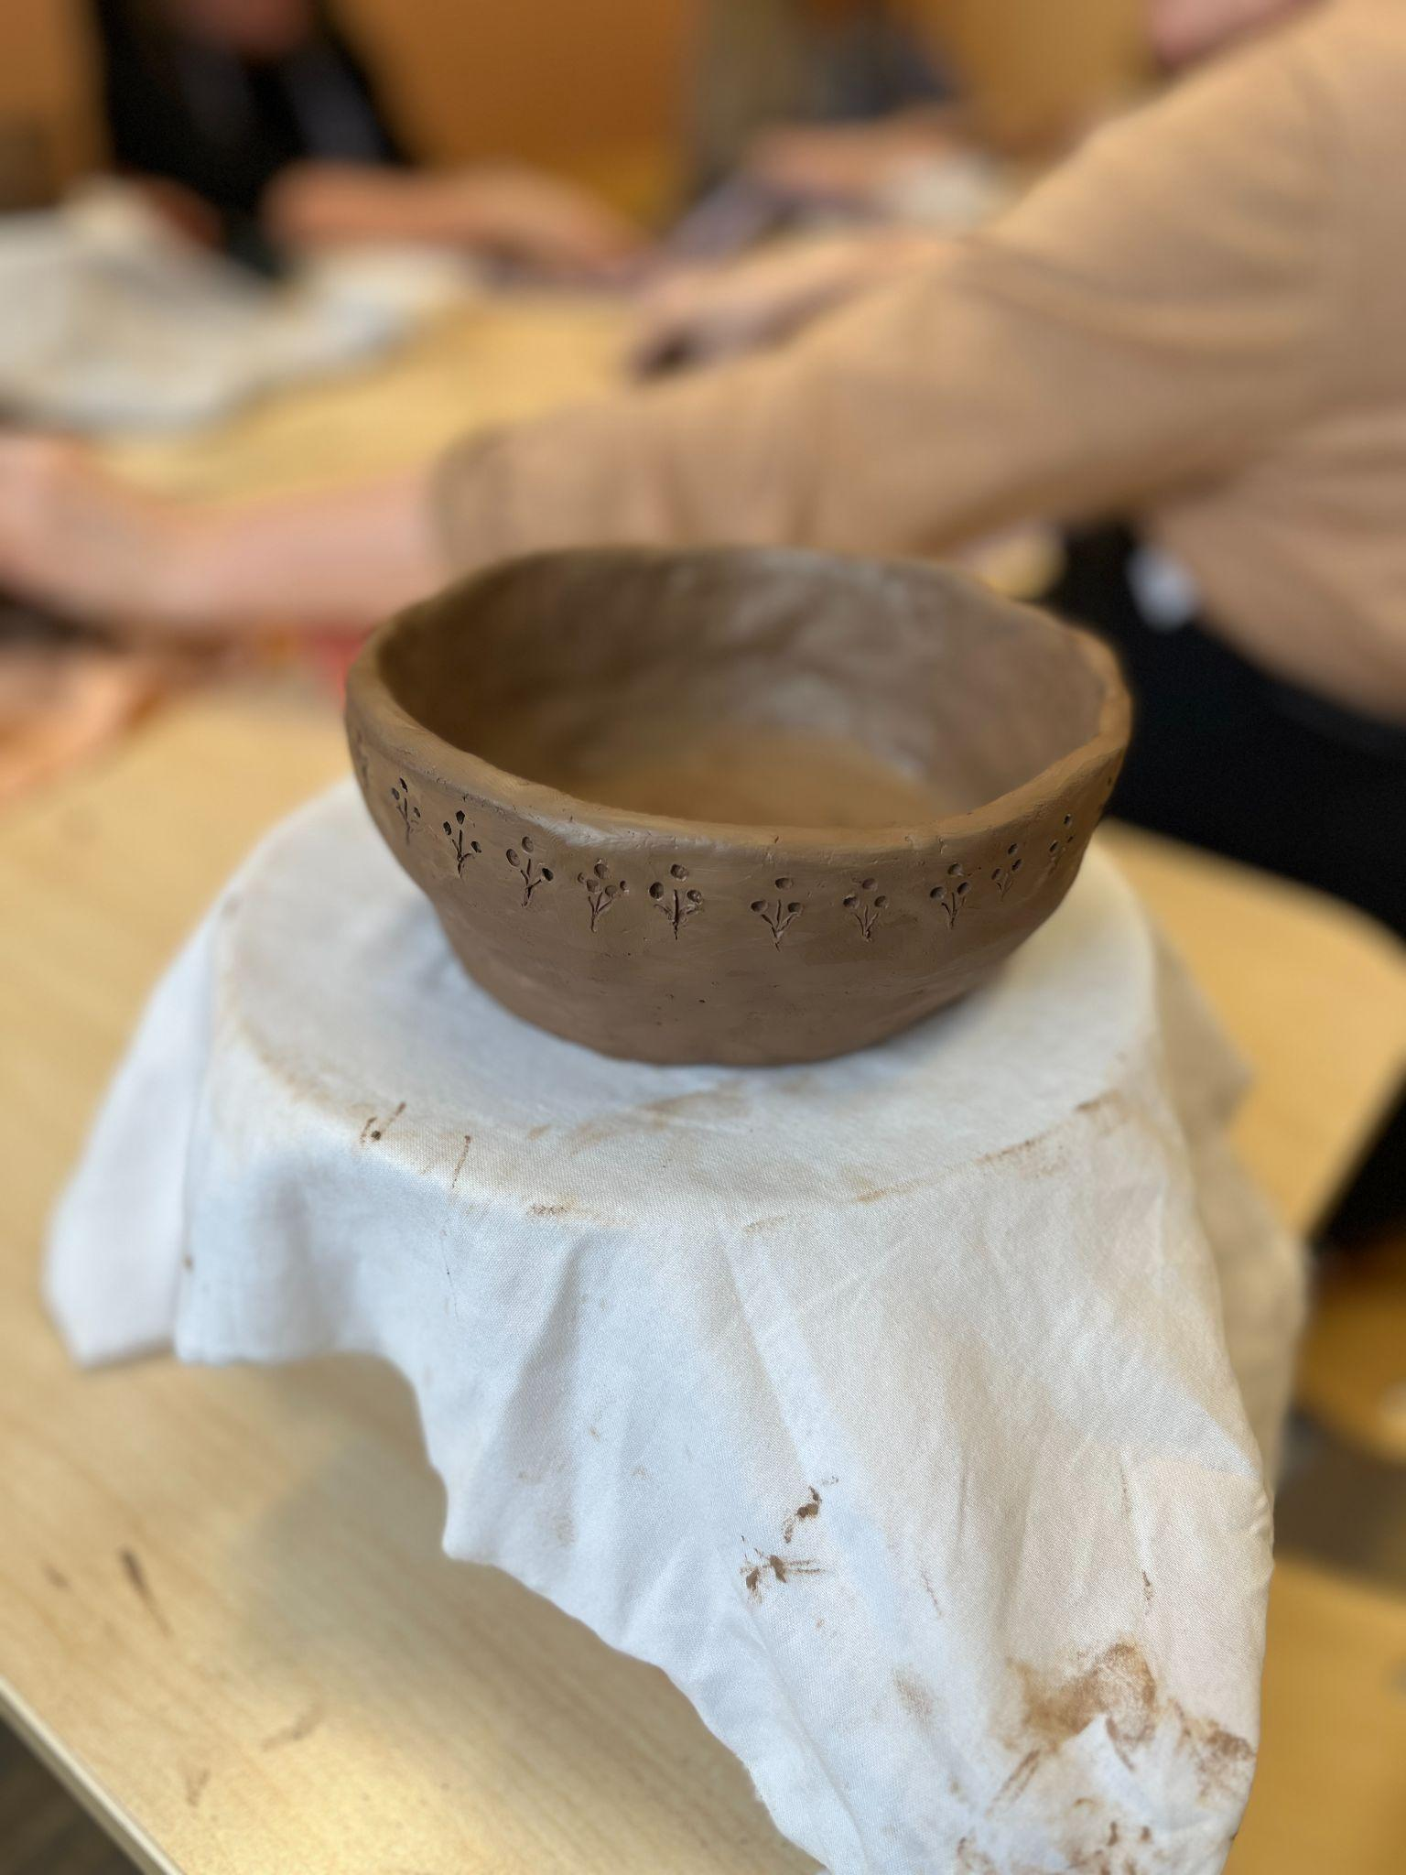
  Introduction to Clay
As you transition from the discussion to the practical part of the lesson, guide your group into the workshop area. Start by introducing the type of clay that will be used today and briefly explain how clay behaves (e.g. plasticity, drying, shrinking, etc.).
Explain that clay is a natural material made of fine-grained earth that becomes plastic when wet and hard when fired. There are different types of clay, each with its own properties:
Earthenware – Low-fire clay (firing temperature around 950–1100°C). Soft, porous, usually red or buff in color. Good for beginners.
Stoneware – Mid- to high-fire clay (firing temperature 1200–1300°C). Durable and waterproof after firing. Commonly grey, brown, or buff.
Porcelain – High-fire clay made from kaolin (firing temperature above 1200°C). White, smooth, and translucent after firing. Difficult to work with but produces fine results.
Choose a type of clay that suits your group’s needs. For beginners, earthenware is often the most accessible.

Slide 8
  Basic Tools
Show and explain the function of the essential tools used for making ceramic objects and pottery:
Rolling pin – for flattening clay into slabs
Rib tools (wooden or metal) – for smoothing and shaping
Modelling tools – for carving and detailing
Needle tool – for scoring or cutting
Sponge – for moistening and smoothing surfaces
Slip container – for attaching pieces of clay (slip is liquid clay used as glue)
Cutting wire – for slicing blocks of clay
Let participants handle the tools and explore how they feel.
Before beginning the main activity, demonstrate a few basic techniques:
Rolling and flattening the clay
Creating simple forms by pinching or coiling
Attaching clay pieces with slip
Adding simple surface texture
Keep your demonstration short and engaging. Make sure everyone can see you or use a camera + projector if the group is large.

Slide 9







2023-1-EE01-KA220-ADU-000150753
Thank you for your attention
PARTNERS
Funded by the European Union. Views and opinions expressed are however those of the author(s) only and do not necessarily reflect those of the European Union or Estonian National Agency. Neither the European Union nor the granting authority can be held responsible for them.

