Slide 1



2023-1-EE01-KA220-ADU-000150753
TRAINING PROGRAMME
LEARNING UNIT 2: Creativity and Eco-Design through Ceramic Art and Heritage
Funded by the European Union. Views and opinions expressed are however those of the author(s) only and do not necessarily reflect those of the European Union or Estonian National Agency. Neither the European Union nor the granting authority can be held responsible for them.

Slide 2
LESSON 2: Designing a Functional Object Inspired by Local Ceramic Heritage

Slide 3
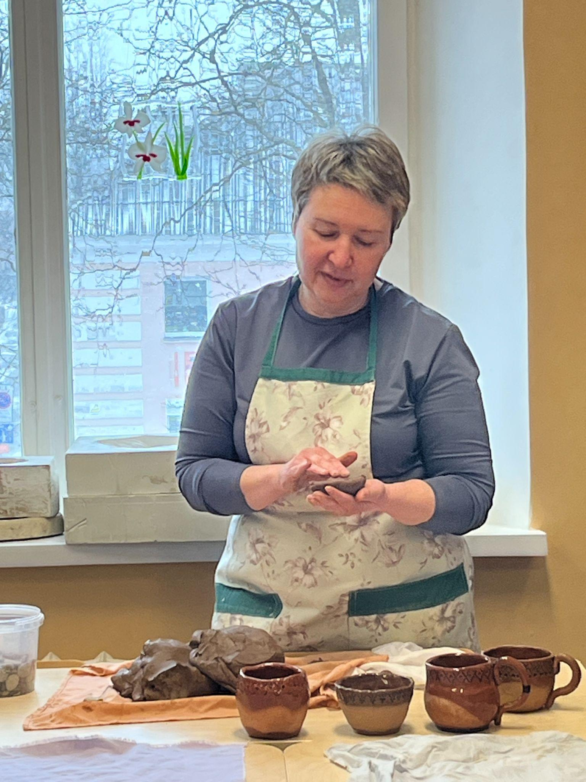
  Creative Activity: Designing and Shaping a Functional Object from Clay
Objective:
In this part of the session, learners will begin shaping their own functional ceramic object — a cup, bowl, or small vase — inspired by traditional Narva Culture pottery. The goal is to combine historical references with personal creativity and to deepen understanding of form, function, and meaning in ceramic design.
Materials Needed:
Clay (suitable for hand-building)
Basic pottery tools: wooden ribs, loop tools, modeling sticks, sponges
Natural materials (e.g., dried plants, shells) for texture and decoration
Sketching paper and pencils (for quick reference sketches if needed)
Aprons or protective coverings
Water bowls, boards or mats for working on
Instructions and Approach:
Begin by encouraging participants to recall the distinctive features of Narva Culture ceramics:
Thick-walled vessels
Simple, functional forms
Hand-pressed textures (fingertips, comb-like patterns, pits)
Natural materials mixed into the clay

Slide 4
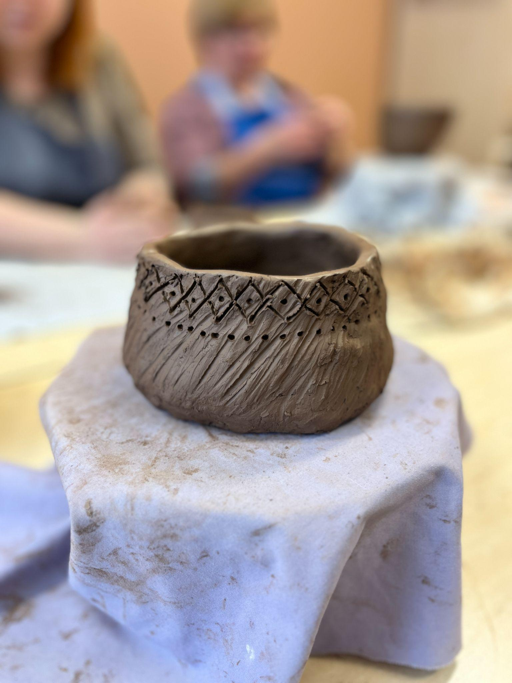
  Creative Activity: Designing and Shaping a Functional Object from Clay
Let learners choose what kind of object they want to create — something they could use in daily life. It might be a cup they’d enjoy using for tea, a bowl for their kitchen, or a vase for their windowsill. Ask them to think not only about how it looks, but also:
What role will it play in their home or life?
What message or emotion do they want it to carry?
How might they integrate both tradition and personal expression into its shape and decoration?
Hand-building Guidelines:
Use only hand-building techniques (no pottery wheels) to stay close to the ancient methods. Guide participants to work slowly and mindfully, focusing on building thick walls to mirror the solidity of Narva-style ceramics. Encourage them to press patterns or textures using simple tools, their fingers, or natural elements — leaves, twigs, seeds — which reflect eco-design principles.
Remind participants that imperfections are part of the handmade charm and that the process matters as much as the result. Move around to provide technical support, help with joining parts securely, and encourage experimentation.
Create a warm, supportive environment where each person’s unique vision is welcomed and respected.

Slide 5
Sharing and Reflection
To complete the session, arrange a gallery walk where participants display their work-in-progress pieces. Each participant explains their creative process and the choices they made.
To support this reflective moment, you may use some guiding questions:
What inspired your design, and how did it change along the way?
Which heritage elements were important for you to include?
How did you express your personal style or story?
What did you discover about working with clay or designing something functional?
How do you feel when looking at your object now?
Encourage an open dialogue, where learners can also ask questions to one another. This fosters a collaborative spirit and builds confidence in expressing creative ideas.
Summarize the day’s achievements, emphasizing how each participant has uniquely combined ancient and modern techniques. Discuss the next steps for firing and preparing the works for the final session.
Preview the upcoming glazing techniques that participants will learn, encouraging them to think about colors and finishes that might enhance their pieces.

Slide 6







2023-1-EE01-KA220-ADU-000150753
Thank you for your attention
PARTNERS
Funded by the European Union. Views and opinions expressed are however those of the author(s) only and do not necessarily reflect those of the European Union or Estonian National Agency. Neither the European Union nor the granting authority can be held responsible for them.

