Slide 1




2023-1-EE01-KA220-ADU-000150753
TRAINING PROGRAMME
LEARNING UNIT 2: Creativity and Eco-Design through Ceramic Art and Heritage
Elaborated by:
Funded by the European Union. Views and opinions expressed are however those of the author(s) only and do not necessarily reflect those of the European Union or Estonian National Agency. Neither the European Union nor the granting authority can be held responsible for them.

Slide 2
LESSON 3: The Art of Ceramic Design and Decoration

Slide 3
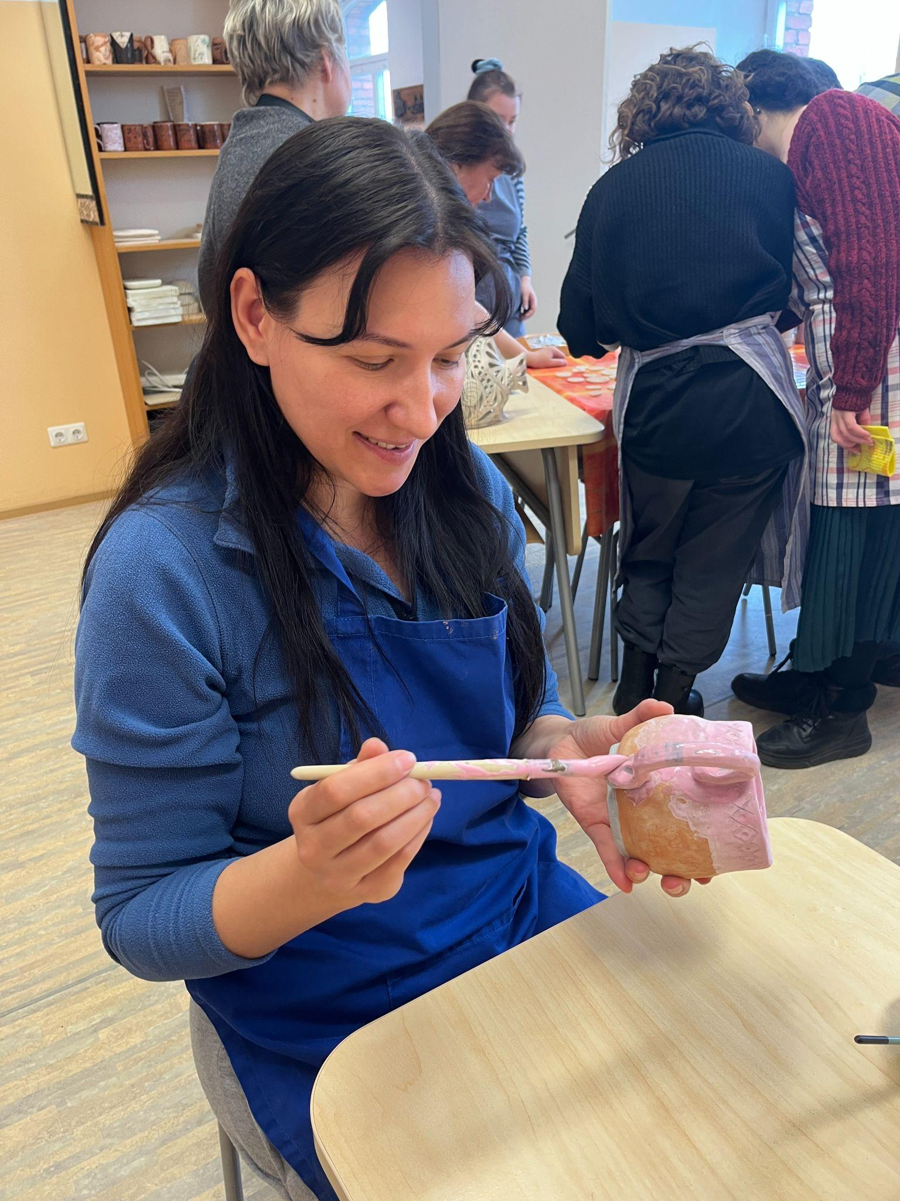
  Interactive Activity: Practical Glazing Workshop
Objectives:
Observe how glazing changes the look, feel, and strength of a ceramic piece
Apply simple, accessible glazing techniques using brushes and wooden sticks.
Support personal expression and individual style through mindful experimentation with glazes.
Encourage peer learning and shared reflection during the creative process.
Materials Needed:
A selection of glazes in natural colours (matte, glossy, transparent or opaque)
Basic glazing tools: soft brushes, wooden sticks, sponges
Water containers, cloths, gloves, aprons or protective table coverings
Shelves or trays for drying glazed pieces before firing
Process:
Now that the forms are ready, it’s time to bring them to life with colour and finish. In this part of the session, learners experiment with glazes using simple, tactile techniques like brushing or applying with wooden sticks — a method inspired by the handmade aesthetics of Narva Culture ceramics.

Slide 4
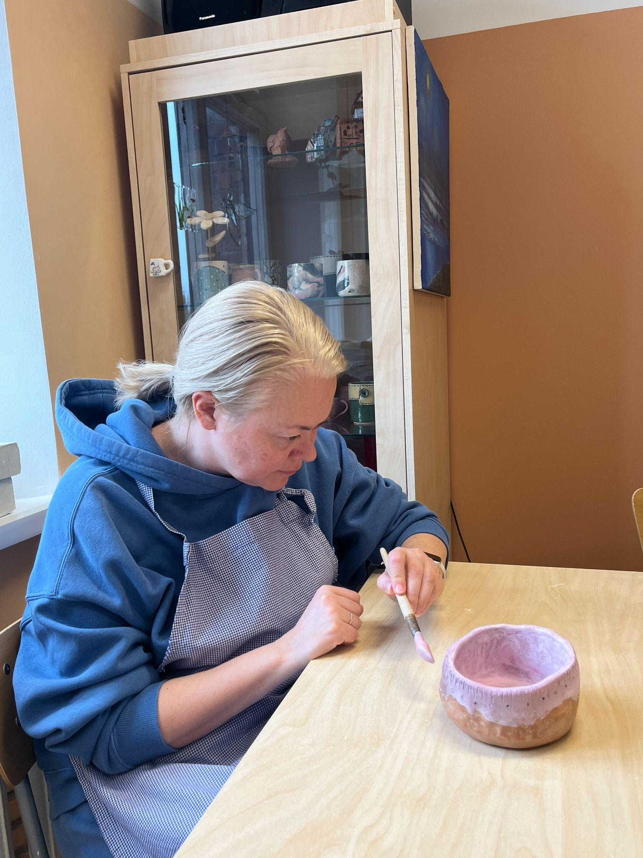
  Interactive Activity: Practical Glazing Workshop
Provide a selection of glazes in a few natural tones (matte or glossy) and explain how different finishes can change the look and feel of the object. Encourage participants to think about contrast, texture, and personal meaning as they choose colours and patterns.
Invite learners to explore freely, layering or combining glazes, adding small details or symbols. Support a calm and focused atmosphere — music or soft conversation can help maintain a meditative flow. This is also a great moment for peer exchange: participants can walk around, observe each other’s work, and offer kind, curious feedback.
Once finished, help everyone place their pieces in the drying area, ready for final firing.

Slide 5
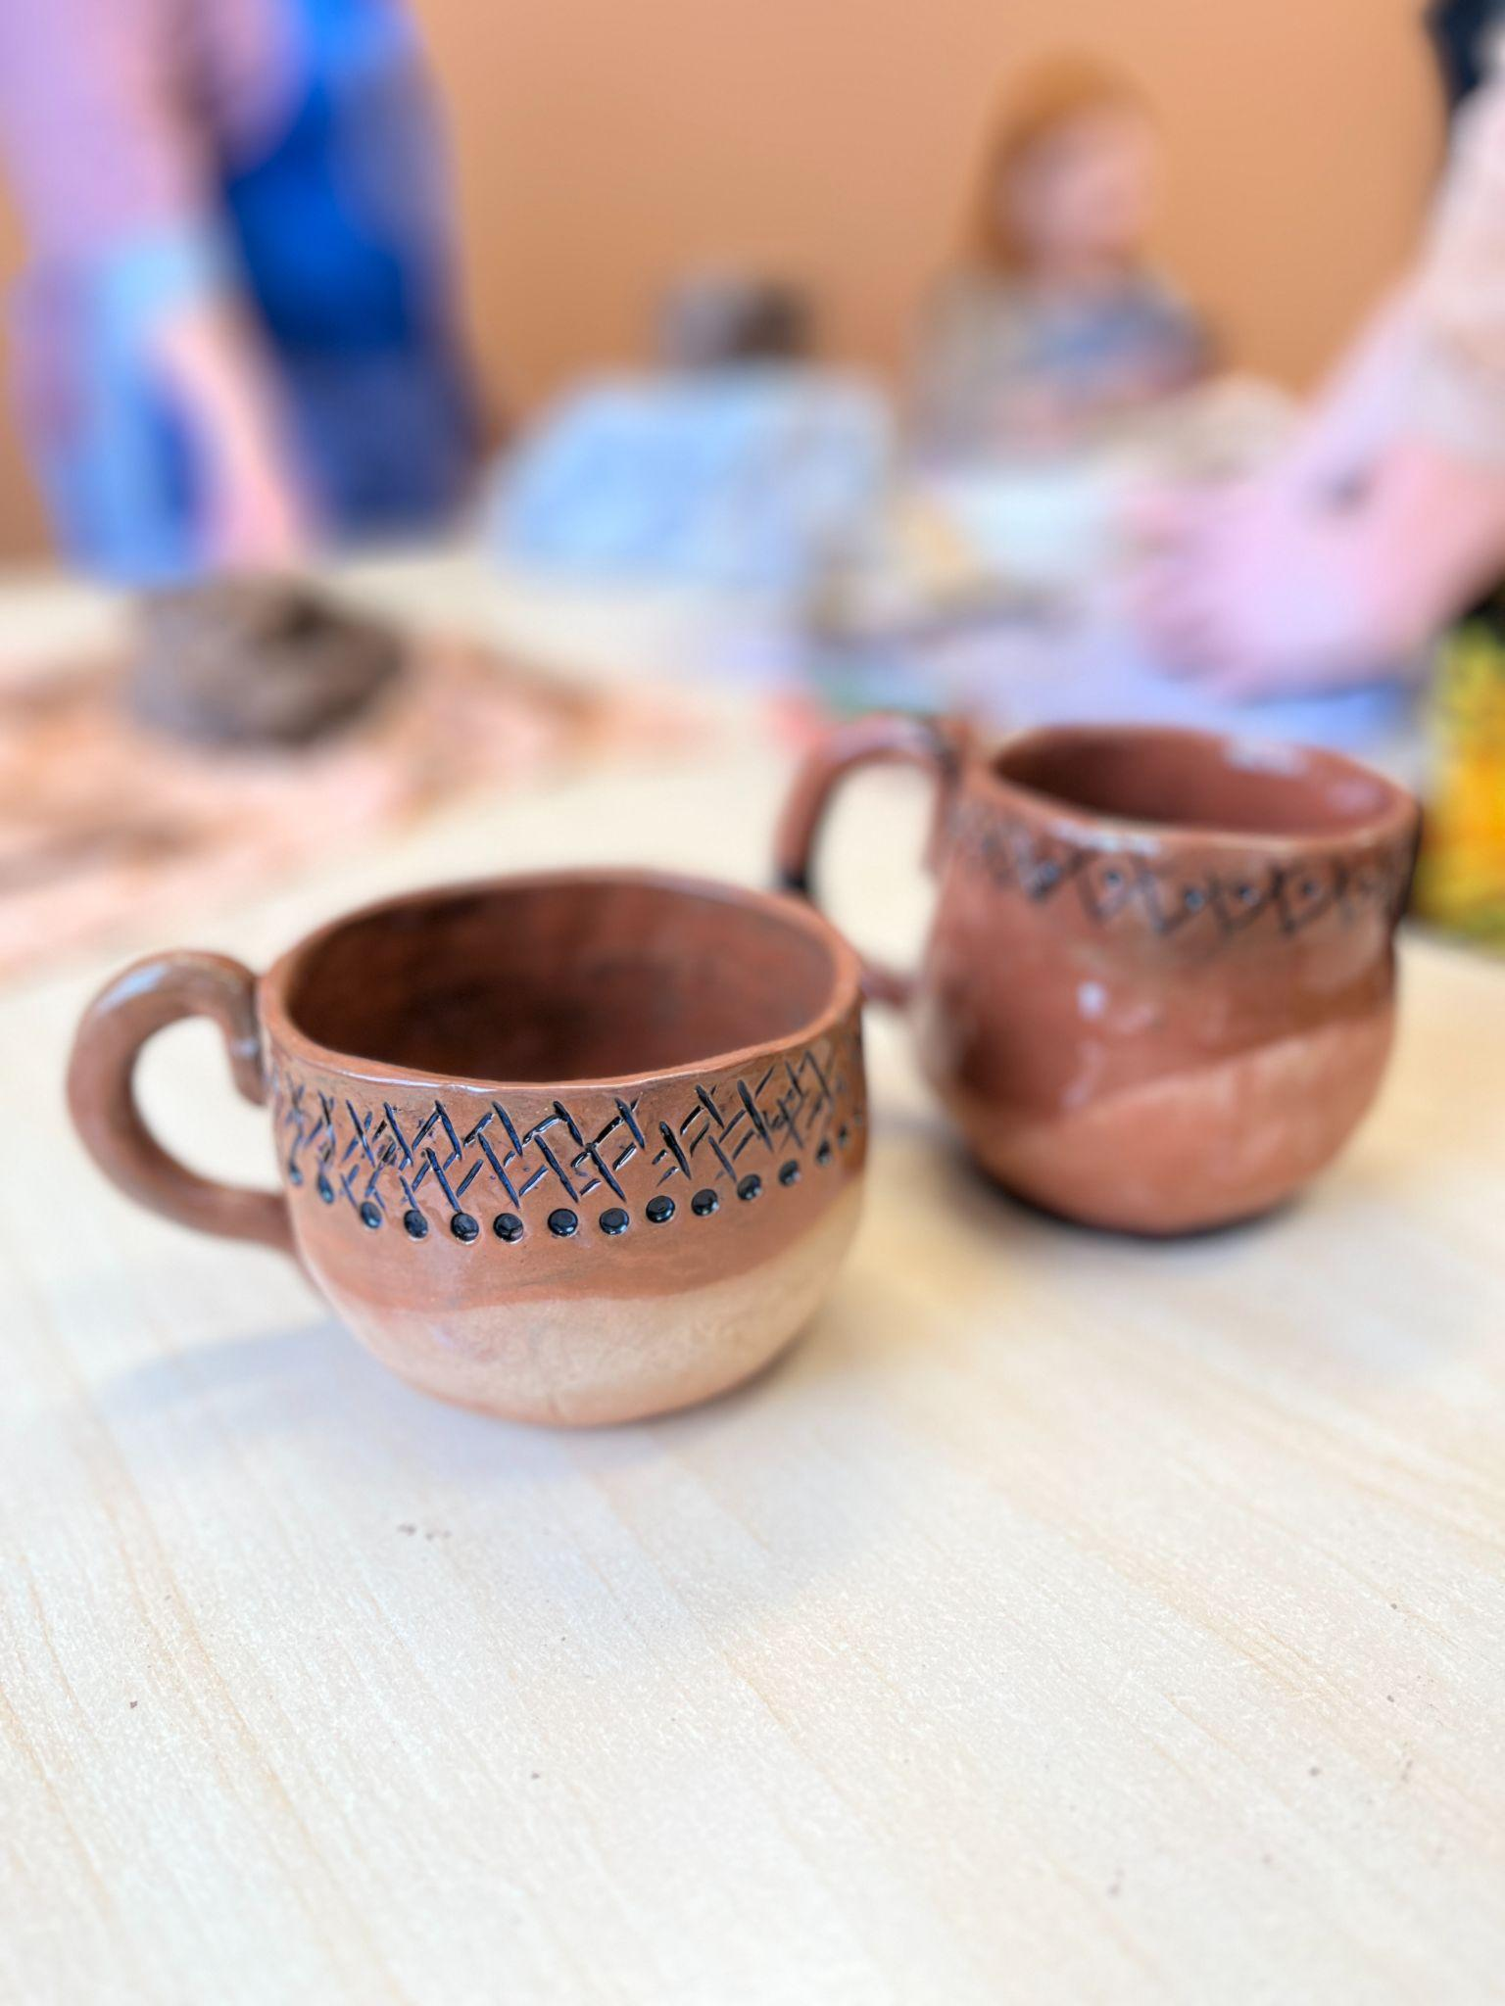
  Discussion and Reflection
Reflect on the experience of transforming your ceramic pieces with glaze. Discuss what you found challenging and what techniques or colors you found most effective. This reflection helps solidify the skills you’ve learned and prepares you for further ceramic projects, enhancing both your technical abilities and creative expression.
Questions for Group Discussion:
Which glazing technique did you choose to use and why?
How did this technique help you achieve the desired effect on your ceramic piece?
Which colors did you select for your glaze, and how do you feel they contributed to the final appearance of your piece?
Were there any color combinations or effects that worked particularly well?

Slide 6
Feedback Circle and the Course Wrap-UP
To close the learning unit, create a warm and supportive space where participants can reflect on what they’ve done, how they felt during the process, and what this experience has meant to them personally.
You can do this in a group circle, or individually with drawing, writing, or storytelling — depending on your group’s needs and comfort level. Instead of formal feedback, focus on personal expression and emotional reflection.
You might use a few simple guiding questions like:
What was your favourite moment in these sessions?
What did you feel when you touched the clay for the first time?
Which object did you enjoy making the most, and why?
Do you feel more confident in your creativity now?
How would you describe your ceramic object to a friend or family member?
What did you learn about yourself through working with your hands?

Slide 7






2023-1-EE01-KA220-ADU-000150753
Thank you for your attention
PARTNERS
Funded by the European Union. Views and opinions expressed are however those of the author(s) only and do not necessarily reflect those of the European Union or Estonian National Agency. Neither the European Union nor the granting authority can be held responsible for them.

