Slide 1



2023-1-EE01-KA220-ADU-000150753
TRAINING PROGRAMME
LEARNING UNIT 3: Entrepreneurship
Funded by the European Union. Views and opinions expressed are however those of the author(s) only and do not necessarily reflect those of the European Union or Estonian National Agency. Neither the European Union nor the granting authority can be held responsible for them.

Slide 2
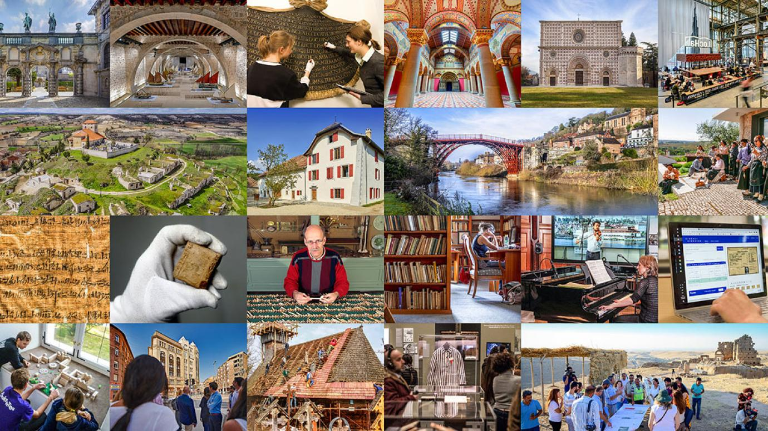
LESSON 1:
Understanding heritage and its entrepreneurial potential

Slide 3

  Interactive Activity: Mapping Local Heritage (1/2)
Objective:
The aim of this activity is to enhance students' understanding and appreciation of local cultural and natural heritage. By identifying and discussing heritage sites, students will explore the role these sites play in community identity and economic opportunities for entrepreneurship.
Materials Needed:
- Printed maps of the local area (one for each group)
- Markers, pens, and stickers for marking sites
- Reference materials (brochures, books, or online resources about local heritage)
- Presentation materials (paper, markers, or digital tools if available)
Procedure:
- Briefly explain the objective of the activity and the importance of heritage in community and economic development.
- Divide students into small groups (4-5 students per group).
- Provide each group with a printed map of the local area and the marking materials.
- Ask each group to identify and mark sites of cultural and natural heritage on the map. Encourage them to use reference materials to ensure accuracy.
Source: Freepik, by macrovector
https://www.freepik.com/free-vector/creative-people-flat-design-concept-with-human-hands-holding-brushes-drawing-little-persons-involved-art-music-dancing-vector-illustration_37421460.htm#fromView=search&page=1&position=3&uuid=0d99e143-8f99-442d-ba97-4ed4e83f8ea4

Slide 4
  Interactive Activity: Mapping Local Heritage (2/2)
- Mark cultural heritage sites (e.g., historical buildings, museums, traditional markets) with one color/sticker and natural heritage sites (e.g., parks, nature reserves, lakes) with another.
- Each group prepares a brief presentation about the sites they identified, explaining why these sites are significant to the local community and how they could be leveraged for entrepreneurial ventures.
- Groups take turns presenting their maps and discussing the significance of each site. Allow 3-4 minutes per group.
- After each presentation, facilitate a short Q&A session to encourage discussion and deeper understanding.
Source: Freepik, by macrovector
https://www.freepik.com/free-vector/creative-people-flat-design-concept-with-human-hands-holding-brushes-drawing-little-persons-involved-art-music-dancing-vector-illustration_37421460.htm#fromView=search&page=1&position=3&uuid=0d99e143-8f99-442d-ba97-4ed4e83f8ea4

Slide 5

  Discussion and Reflection
Questions for Group Discussion:
- Why are the identified cultural heritage sites important to our community?
- How do these sites contribute to our community’s identity and history?
- What kinds of businesses could be developed around these heritage sites?
- How could these entrepreneurial ventures benefit the local economy and community?
- How can the local community be involved in the preservation and promotion of these heritage sites?
- What role can students play in advocating for and protecting our local heritage?
Conclusion:
- Summarize key points from the presentations and discussions.
- Highlight the importance of heritage in fostering a sense of identity and community.
- Encourage students to think creatively about how heritage can be a foundation for entrepreneurial ventures that benefit both the economy and society.
This activity not only helps students recognise and appreciate local heritage but also inspires them to think about innovative ways to engage with and preserve these important sites through entrepreneurship.
Source,Freepik, free image by pch.vector
https://www.freepik.com/free-vector/people-talking-arguing_9176206.htm#fromView=search&page=1&position=32&uuid=9ec0301a-dddf-4d25-a241-a5349c9e3205

Slide 6







2023-1-EE01-KA220-ADU-000150753
Thank you for your attention
PARTNERS
Funded by the European Union. Views and opinions expressed are however those of the author(s) only and do not necessarily reflect those of the European Union or Estonian National Agency. Neither the European Union nor the granting authority can be held responsible for them.

