Slide 1



2023-1-EE01-KA220-ADU-000150753
TRAINING PROGRAMME
LEARNING UNIT 3: Entrepreneurship
Funded by the European Union. Views and opinions expressed are however those of the author(s) only and do not necessarily reflect those of the European Union or Estonian National Agency. Neither the European Union nor the granting authority can be held responsible for them.

Slide 2
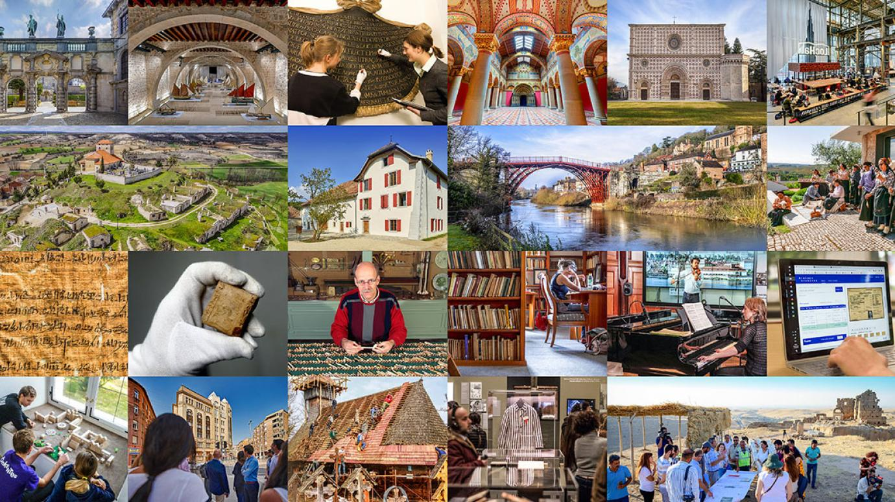
LESSON 1:
Understanding heritage and its entrepreneurial potential

Slide 3
  INTRODUCTION TO HERITAGE (1/2)
Defining Cultural and Natural Heritage
Cultural Heritage
Definition: Cultural heritage refers to the legacy of tangible artifacts and intangible attributes of a group or society inherited from past generations.
Examples: Monuments, artifacts, manuscripts, and traditions like music, dance, and festivals.
Importance: Represents a society’s history, values, and achievements, serving as a bridge between past, present, and future.
Natural Heritage
Definition: Natural heritage encompasses natural features, geological and physiographical formations, and areas with significant scientific, conservation, or aesthetic value.
Examples: National parks, wildlife reserves, landscapes, and natural formations like waterfalls and mountains.
Importance: Provides insight into the earth’s history, supports biodiversity, and offers ecological and recreational benefits.

Slide 4
  INTRODUCTION TO HERITAGE (2/2)
The Importance of Heritage Preservation
Heritage Preservation
Cultural Significance: Protects the identity and continuity of communities, fostering a sense of belonging and pride.
Educational Value: Serves as a tool for learning and research, offering insights into human history, culture, and achievements.
Economic Benefits: Attracts tourism, creating jobs and supporting local economies.
Environmental Protection: Natural heritage sites play a crucial role in conservation efforts and biodiversity maintenance.
Role in Fostering Community and Identity
Community Bonding: Shared heritage promotes unity and solidarity within communities.
Identity Formation: Heritage shapes individual and collective identities, influencing how people see themselves and their place in the world.
Cultural Exchange: Preservation encourages intercultural dialogue and understanding, fostering global peace and cooperation.
Conclusion: Preserving both cultural and natural heritage is essential for maintaining our collective memory, supporting diverse ecosystems, and fostering resilient, cohesive communities.

Slide 5
  HERITAGE AND ENTREPRENEURSHIP (1/3)
Understanding Entrepreneurship
Entrepreneurship:
  Definition: Entrepreneurship is the process of designing, launching, and running a new business or enterprise. It involves identifying opportunities, innovating, and taking on financial risks to achieve profits and growth.
  Key Elements:
    Innovation: Creating new products, services, or processes.
    Risk-Taking: Investing resources with uncertain outcomes.
    Proactiveness: Anticipating and acting on market opportunities.
Importance in Economic Development:
Job Creation: Entrepreneurs create new businesses, which generate employment.
Innovation and Competition: Drives technological advancements and improves market efficiency.
Economic Growth: Contributes to GDP and fosters economic dynamism.
Social Impact: Addresses societal challenges through innovative solutions and corporate social responsibility initiatives.

Slide 6
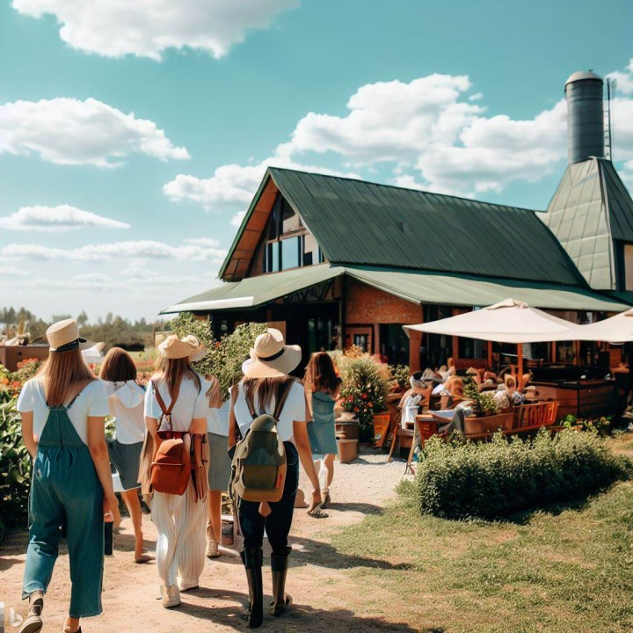

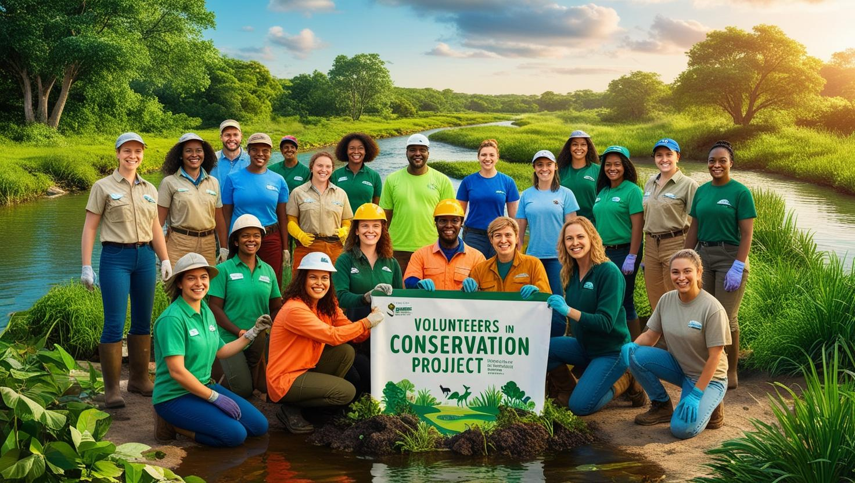
  HERITAGE AND ENTREPRENEURSHIP (2/3)
Leveraging Heritage in Entrepreneurship
Cultural Heritage-Based Ventures:
Tourism: Developing heritage sites into tourist attractions (e.g., guided tours, heritage hotels).
Crafts and Artisanship: Reviving traditional crafts and selling handmade products (e.g., textiles, pottery).
Culinary Arts: Promoting traditional cuisines and local food products.
Natural Heritage-Based Ventures:
Eco-Tourism: Creating sustainable travel experiences that highlight natural landscapes and wildlife.
Agritourism: Combining agriculture and tourism to offer farm stays, local produce, and rural experiences.
Conservation Projects: Initiatives that focus on preserving natural habitats while providing educational and volunteer opportunities.
Ai Generated images

Slide 7


  HERITAGE AND ENTREPRENEURSHIP (3/3)
The Impact of Heritage Entrepreneurship
Benefits
Economic Development: Drives local economies by creating jobs and attracting investment.
Cultural Preservation: Helps safeguard and promote cultural and natural heritage.
Community Empowerment: Engages local communities, fostering pride and participation in cultural activities.
Sustainable Practices: Encourages environmentally and socially responsible business models.
Challenges
Funding and Investment: Securing financial resources for heritage projects can be difficult.
Market Access: Reaching broader markets while maintaining authenticity.
Regulation and Bureaucracy: Navigating legal frameworks and preservation regulations.
Sustainability: Balancing commercial success with the preservation of heritage sites and traditions.
Conclusion: Heritage entrepreneurship offers a unique pathway to economic growth and cultural preservation. By leveraging cultural and natural heritage, entrepreneurs can create innovative, authentic, and sustainable ventures that benefit both the economy and society.

Slide 8
  Best practice on successful heritage-based business
‘Pueblos con Encanto’ (Charming Villages) Programme
Sustainable rural tourism in Spain is being promoted through different initiatives and programmes that encourage the conservation of the environment, cultural heritage and the local economy.
Among the most successful initiatives in this field is the ‘Pueblos con Encanto’ programme, which aims to enhance and promote tourism in small rural towns in Spain.
In this context, rural accommodations are taking various measures to minimise their environmental and social impact and to promote sustainability in rural tourism:
Adopting sustainable practices in their daily management, such as the use of renewable energies, reduction of water and energy consumption, recycling and waste management.
Offering sustainable tourism activities and experiences, such as hiking, cycling and ornithological tourism, which allow visitors to connect with nature and get to know the rural environment better in a responsible and conscious way.
Collaboration with local conservation and development projects, supporting local communities and promoting the preservation of local culture and traditions.
Obtaining internationally recognised sustainability certifications, such as the European Ecolabel or the Green Key certification, which assure guests of accommodation with high standards of sustainability and commitment to the environment and society.

Slide 9
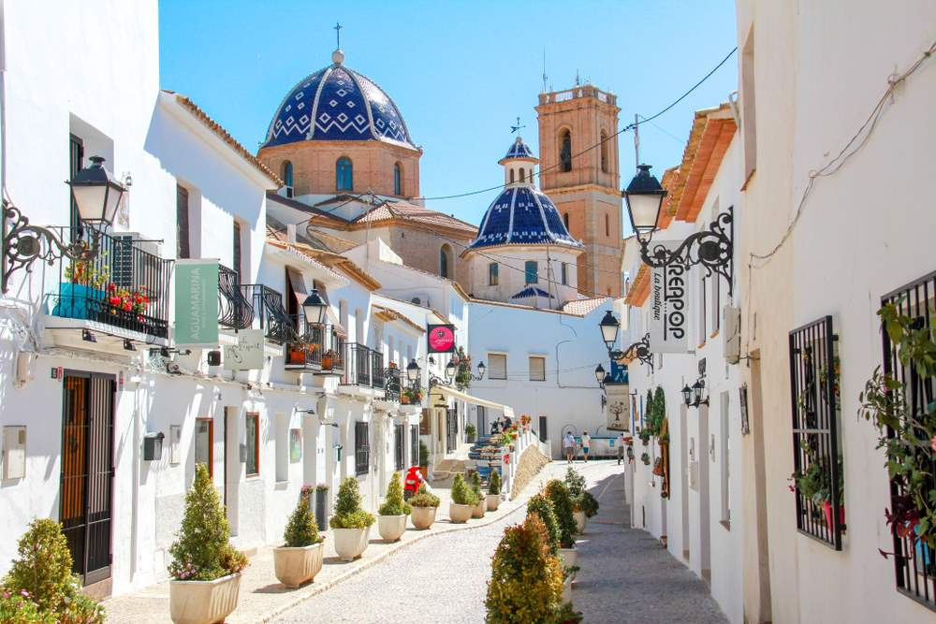
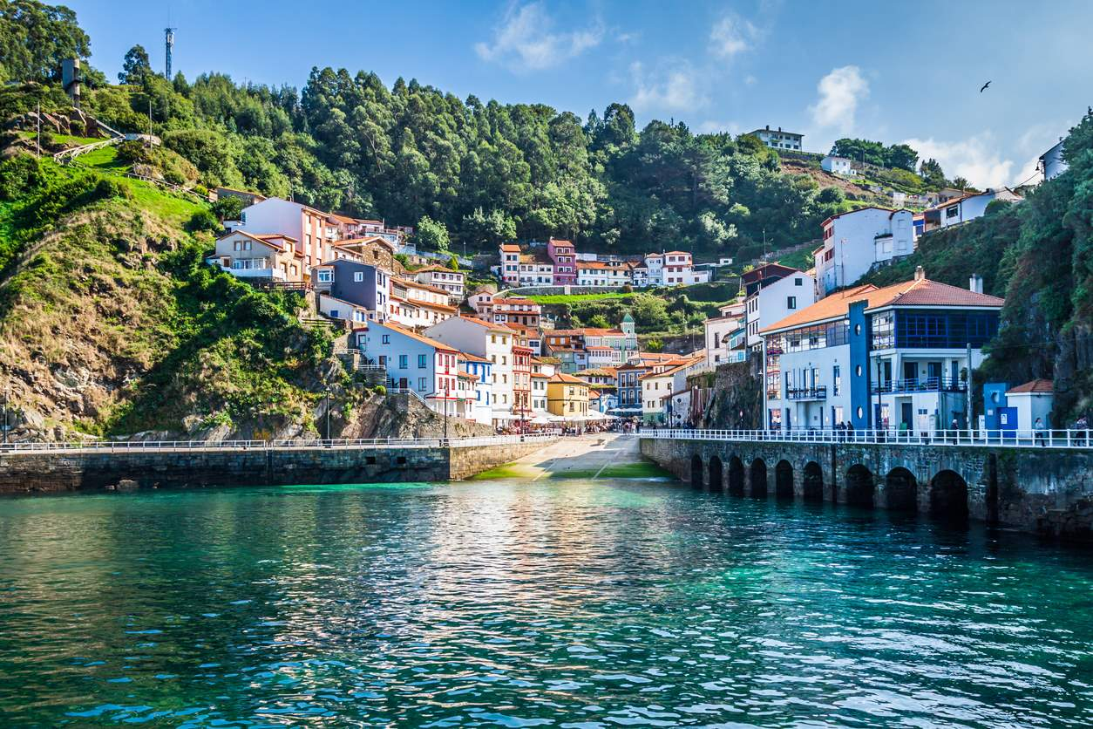
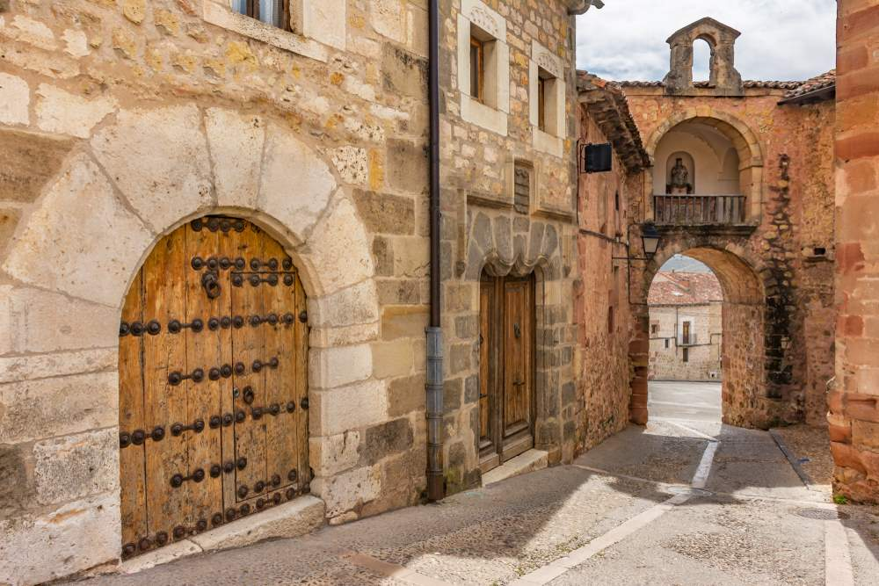
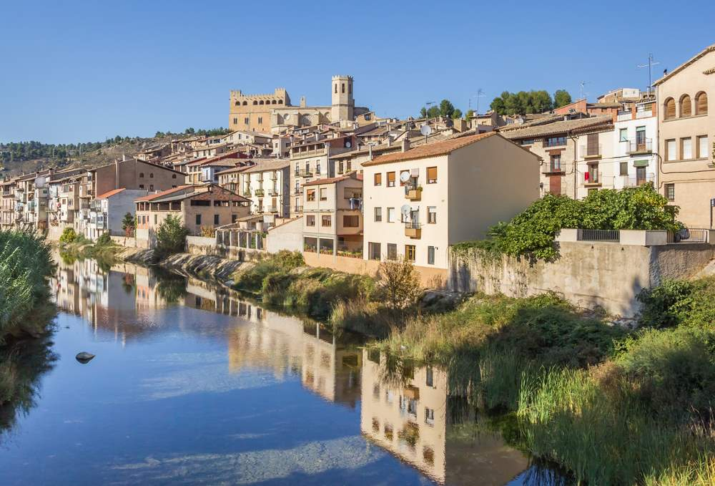
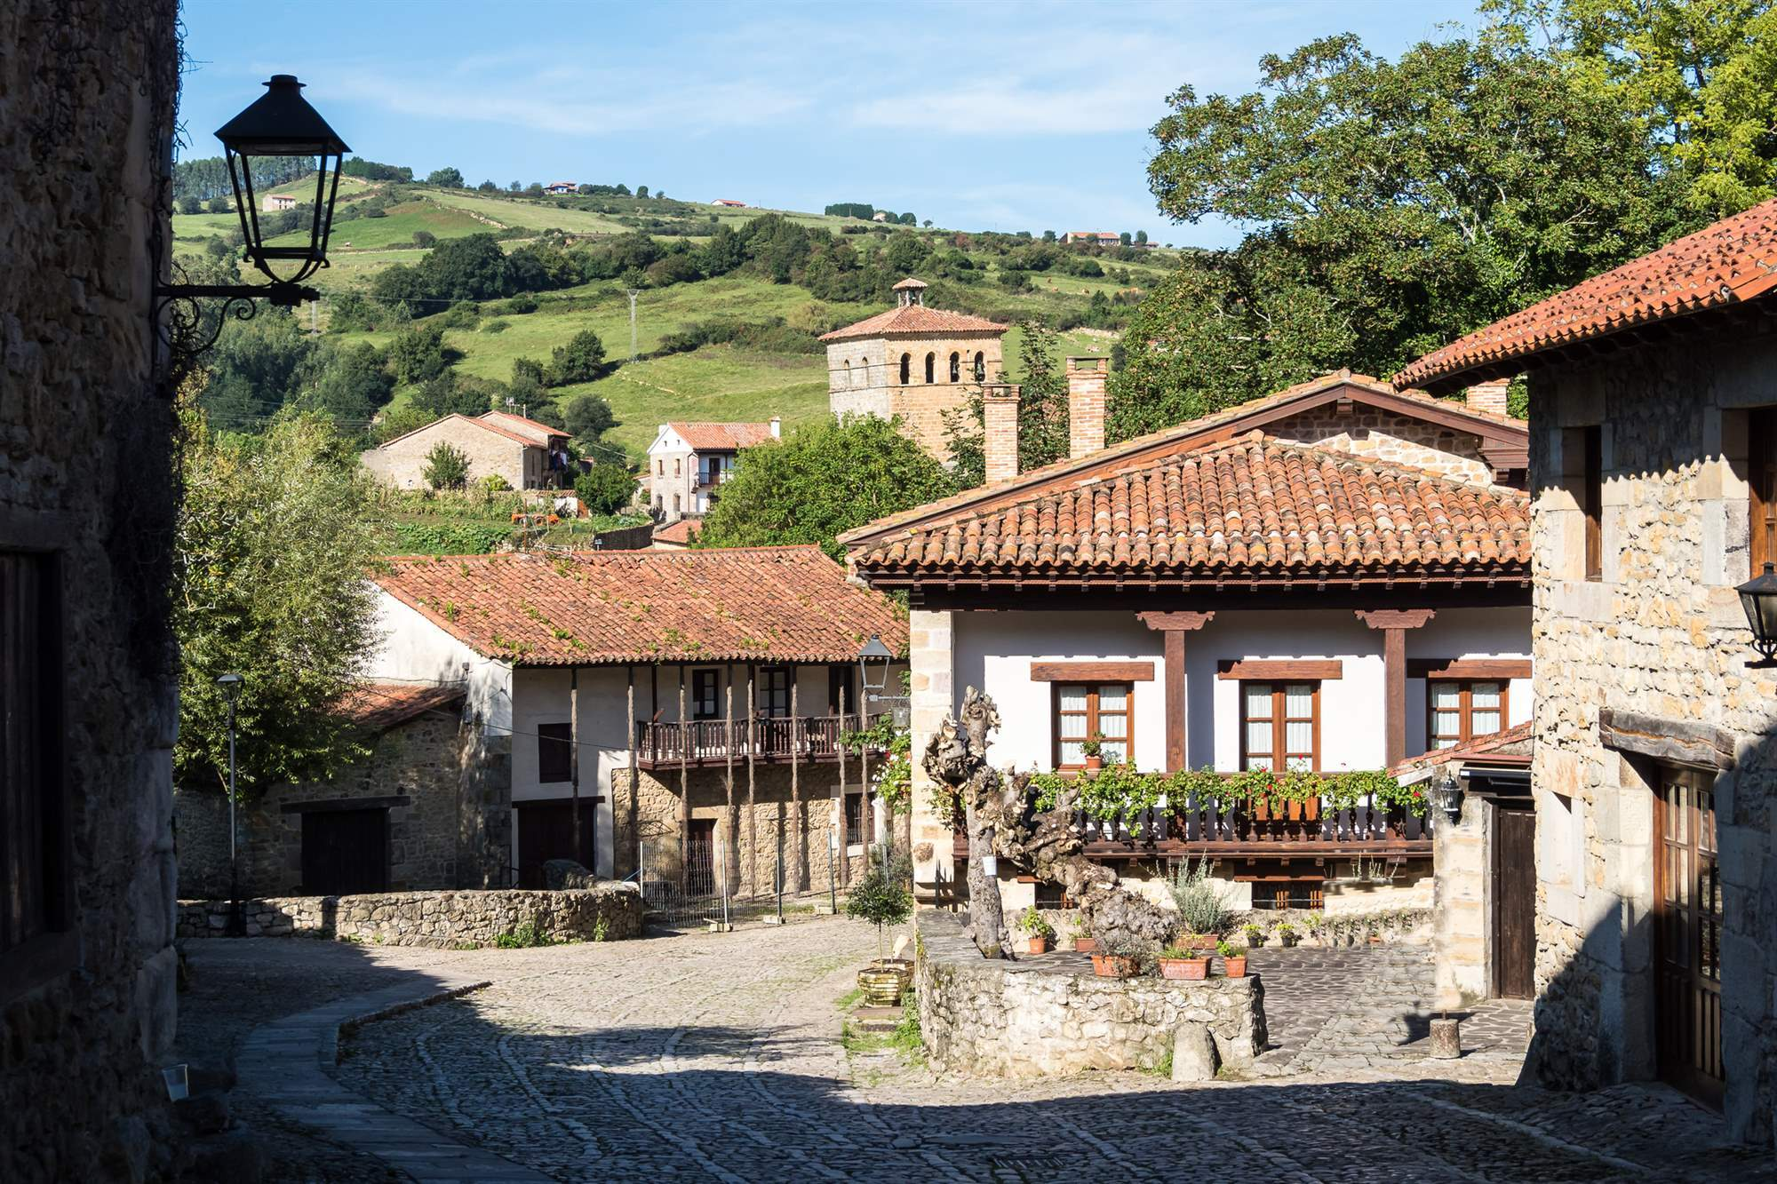
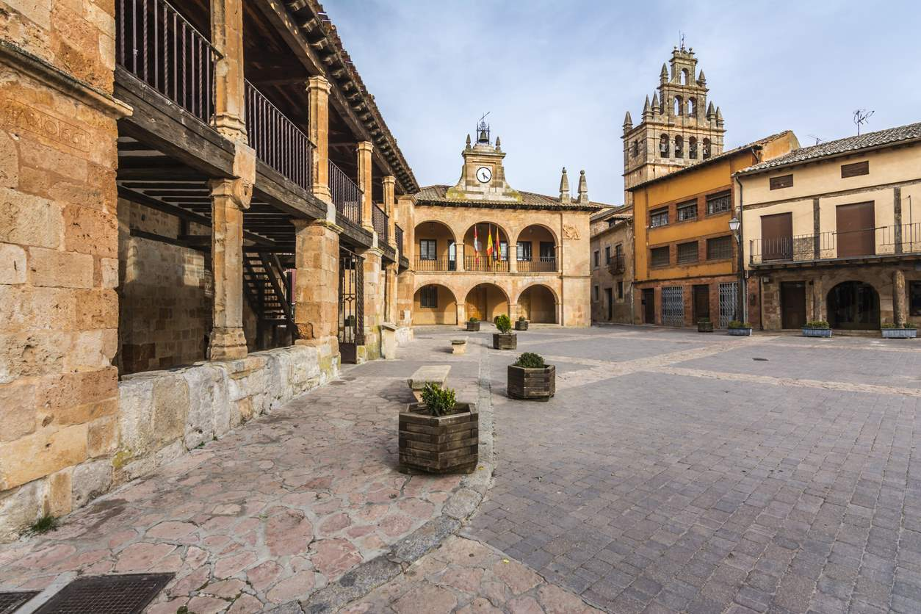
  Best practice on successful heritage-based business
‘Pueblos con Encanto’ (Charming Villages) Programme
Altea (Alicante)
Cudillero (Asturias)
Sigüenza (Guadalajara)
Valderrobres (Teruel)
Santillana del Mar (Cantabria)
Ayllón (Segovia)
Source: iStock

Slide 10







2023-1-EE01-KA220-ADU-000150753
Thank you for your attention
PARTNERS
Funded by the European Union. Views and opinions expressed are however those of the author(s) only and do not necessarily reflect those of the European Union or Estonian National Agency. Neither the European Union nor the granting authority can be held responsible for them.

