Slide 1



2023-1-EE01-KA220-ADU-000150753
TRAINING PROGRAMME
LEARNING UNIT 4: Intercultural and Intergenerational communication
Funded by the European Union. Views and opinions expressed are however those of the author(s) only and do not necessarily reflect those of the European Union or Estonian National Agency. Neither the European Union nor the granting authority can be held responsible for them.

Slide 2
Lesson 1: Introduction

Slide 3

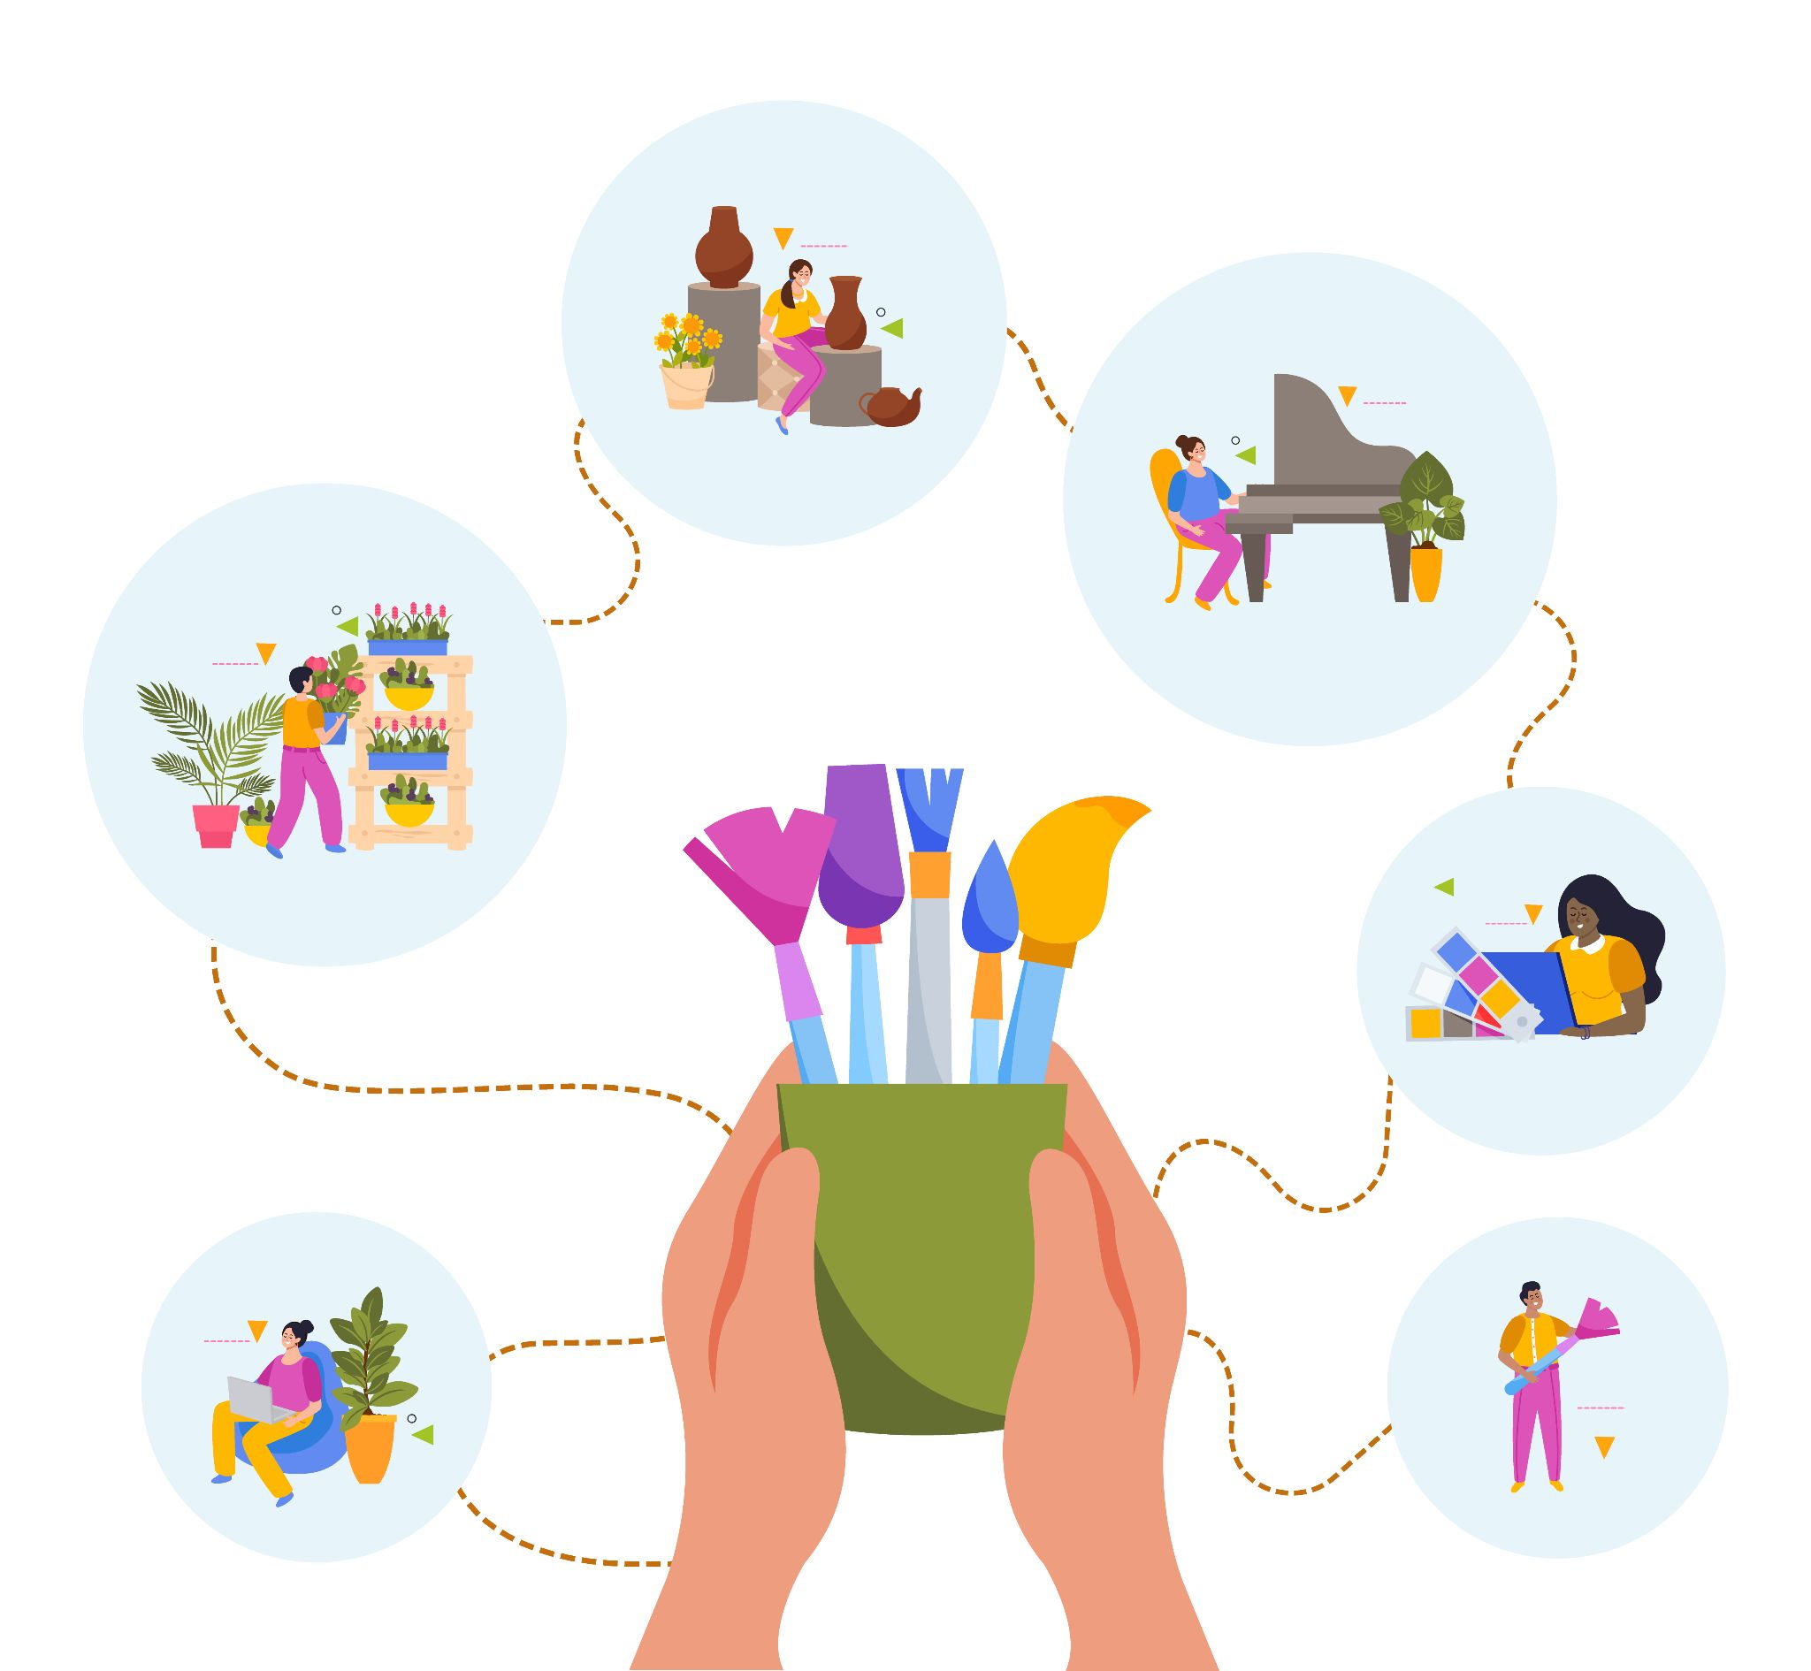
  Interactive Activity 1) “European Citizen Passport”
‘European Citizen’ Passport
This is a creative activity: participants are asked to build creativity, European Citizen Passport. Here in addition to their personal data, they shall describe themselves by entering information about their country, their culture, their artistic and historical heritage, etc. They may also express themselves graphically and creatively.
Material required: Projector and screen, Internet access, Whiteboard and markers, Handouts with key concepts.
Participants may create their passport alone or in small groups. This last option is better in order to stimulate creativity and it may be helpful in case of participants with a common origin, language or culture.
https://www.freepik.com/free-vector/passport-with-flight-tickets-white-background_24459631.htm#fromView=search&page=1&position=7&uuid=1ecf90dc-5acd-42af-978b-3a79b3ede379
Source: Freepik, by macrovector
https://www.freepik.com/free-vector/creative-people-flat-design-concept-with-human-hands-holding-brushes-drawing-little-persons-involved-art-music-dancing-vector-illustration_37421460.htm#fromView=search&page=1&position=3&uuid=0d99e143-8f99-442d-ba97-4ed4e83f8ea4

Slide 4

  Interactive Activity 2: Movie
Watching a movie
This activity is a calming activity but it may be useful for the discussion that may arise from it. It consist in watching a short movie. For Italy the movie may be ‘Zoran il mio nipote scemo’ “Zoran my dumb nephew”(link to the movie).
The movie shall face the problems and issues of intercultural or intergenerational communication.
After the video will follow a discussion on the main topics.
The trainers shall stimulate the discussion trying to include everyone and collecting the different points of view.
Trainer may use a screen with markers to create a bubble graph with the collected points of view.
Material required: Projector and screen, Internet access, Whiteboard and markers.

Slide 5
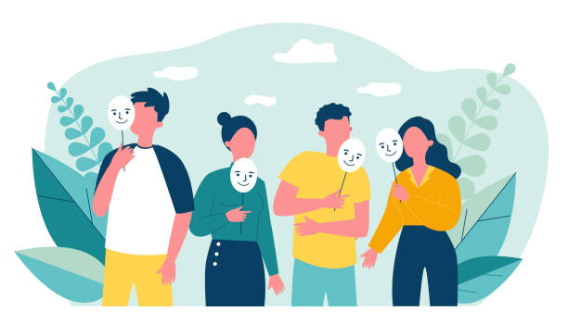
  Interactive Activity 3 Role play: guess the origin
Guess the origin
In this activity the group shall be divided in small groups of 4/5 people each.
The premise is that no one knows each other's geographical origin.
Each person has to tell an episode from his or her life, describe an object,
a dish that refers to elements of his or her cultural heritage (in the morning I
went to pray in the mosque....at lunch we ate bread and panelle) and the
others have to guess where he or she comes from.
Material required: Projector and screen, Internet access, Whiteboard and markers.
(*) In two groups: 1st group: The hosts: display pictures of works of art or cultural heritage from different countries (the Colosseum, the Eiffel Tower....). Each image or group of images refers to one or more people in the group from that place. Group 2: travelers are asked which of these monuments strikes them and which they would like to visit on a future trip. Based on the indicated image, the person(s) from the first group of hosts give information about the place and the associated heritage.

Slide 6
  Interactive Activity 4 Role play: where would you like to travel?
Where would you like to travel?
In this activity the group has to be divided in two groups: 1st group: The hosts and the travelers.
The hosts shall display each a collection of 4/5 pictures, works of art or cultural heritage representing their country (the Colosseum, the Eiffel Tower....). There will be so more collections of images.
The travelers shall choose, from the pictures, which country they would like to visit in their next trip.
Based on the indicated image, the travelers will host by the hosts that shall bring them around in their country describing and showing their natural and cultural heritage.
Material required: Projector and screen, Internet access, Whiteboard and markers.
This activity is connected with lesson 2 and with the building of the Parish Map.

Slide 7

  Discussion and Reflection
Questions for Group Discussion:
Please add 5 to 6 questions
Did you ever meet any issues in communication? (in multicultural, intercultural, cross-cultural )
Which are in your opinion other obstacles in communication and why?
Do you think modern technologies represent an obstacle or a chance for communication ?
Which way of communication is better in the transmission of cultural and natural heritage? (verbal, graphical, musical…)
Do you think is possible a communication between long distance generations?
Conclusion:
The street of communication is a never ending path. Communication has to change and adapt to express new concept, ideas, feelings and emotions related to the new societies. The challenge is to be able to communicate the heritage of the past, to preserve their identities without creating barriers with different cultures.
Source,Freepik, free image by pch.vector
https://www.freepik.com/free-vector/people-talking-arguing_9176206.htm#fromView=search&page=1&position=32&uuid=9ec0301a-dddf-4d25-a241-a5349c9e3205

Slide 8







2023-1-EE01-KA220-ADU-000150753
Thank you for your attention
PARTNERS
Funded by the European Union. Views and opinions expressed are however those of the author(s) only and do not necessarily reflect those of the European Union or Estonian National Agency. Neither the European Union nor the granting authority can be held responsible for them.

