Slide 1



2023-1-EE01-KA220-ADU-000150753
TRAINING PROGRAMME
LEARNING UNIT 4: Intercultural and Intergenerational communication
Funded by the European Union. Views and opinions expressed are however those of the author(s) only and do not necessarily reflect those of the European Union or Estonian National Agency. Neither the European Union nor the granting authority can be held responsible for them.

Slide 2
Lesson 1: Introduction

Slide 3
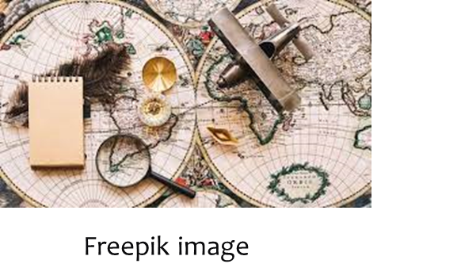
Intercultural and Intergenerational communication
Introduction to Unit 4
Aim of the Unit
To understand the interaction between intergenerational and intercultural communication as a means for a shared and broad approach to cultural and natural heritage
The Unit 4 is composed by 2 lessons for a total of 5 hours:
LESSON 1 - The cultural value of differences
LESSON 2 - Parish Maps as a tool for discovering cultural and natural heritage by highlighting differences
The Unit foresees:
•taught classes/lectures
•group work
•exercises/drills
•educational outings

Slide 4

LEARNING UNIT 4: Intercultural and Intergenerational communication
LESSON 1: The cultural value of differences

Slide 5

The cultural value of differences
Theoretical topics:
Lesson 1 will address 4 topics of utmost relevance:
Communication: Define the concept of communication and the different communication codes and processes.
Intergenerational Communication: definition and issues.
Intercultural, multicultural and cross cultural communication: Differences and issues.
Communication and heritage: Highlight the role of the intergenerational and intercultural communication in the enhancement of the cultural and natural heritage.

Slide 6

Communication
  TITLE…
Understanding:
What is communication?
Why is it important
  in personal, social and professional life?
  in the tourism sector?
  What is the process of communication?

Slide 7
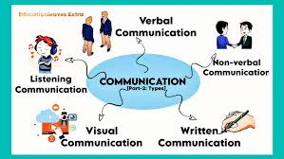
Communication
  TITLE…
Communication is the act of transferring information from one place to another. It is the transmission of meaning from one person to another or to many people, whether verbally or non verbally.

Slide 8
Elements of Circular Communication
Communication
  TITLE…
Communication is a circular process and its outcome is always a change of the parties involved in the process. The main elements that characterize the communication as a circular system are:
MESSAGE: Meanings (content and relationship) to be sent to the interlocutor
CODE: Languages, signs, symbols used during the communicative exchange
DECODING: Operation of attribution of signs, symbols, languages to the mental meanings to be communicated
CHANNEL: Means through which the message passes
FEEDBACK: Return information to the issuer
CONTEXT: Environment in which the communicative exchange takes place
DISTURBS: Information not consistent with the message

Slide 9
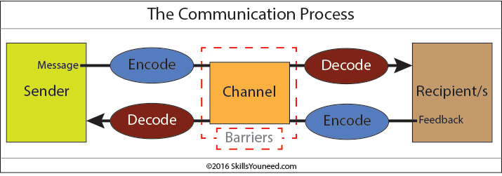
Communication
  TITLE…
How does communication work?
A message or communication is sent by the sender through a communication channel to a receiver, or to multiple receivers.
The sender must encode the message (the information being conveyed) into a form appropriate to the communication channel, and the receiver(s) then decodes the message to understand its meaning.

Slide 10
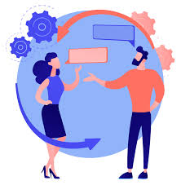

  TITLE…
Communication: content and relationship
The transfer of a message activates the exchange of information content and at the same time starts a relationship between people.
Content and relationship influence each other and condition the achievement of the PURPOSE and OBJECTIVES of the communication.

Slide 11
Not everything that is communicated gets to the recipient:
Communication
  TITLE…
You mean 100
You actually say 80
The receivers hears 50
He/She understands 30
He/She remembers 20
Misunderstandings can occur at any stage of the communication process!

Slide 12
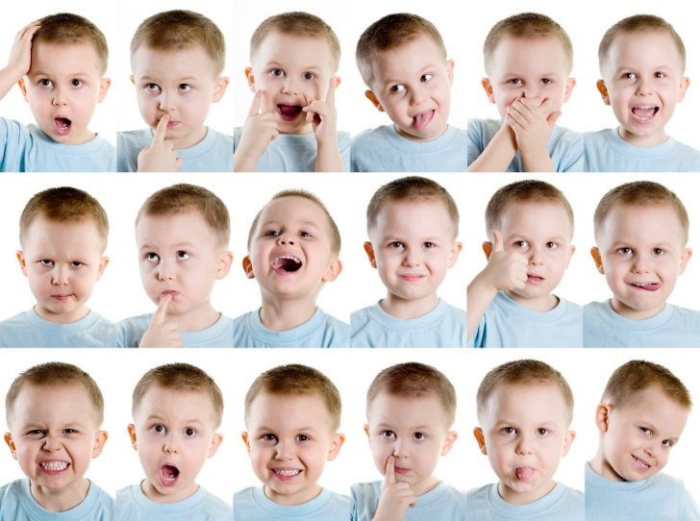
Categories of Communication
Communication
  TITLE…
Spoken or Verbal Communication: face-to-face, telephone, radio or television and other media.
Non-Verbal Communication: body language, gestures, how we dress or act - even our scent.
Written Communication: letters, e-mails, books, magazines, the Internet or via other media.
Visualizations: graphs and charts, maps, logos and other visualizations can communicate messages

Slide 13
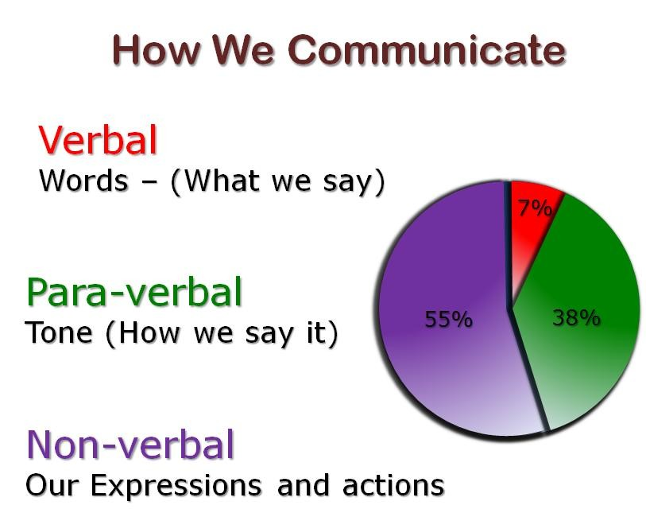
Communication
  TITLE…

Slide 14
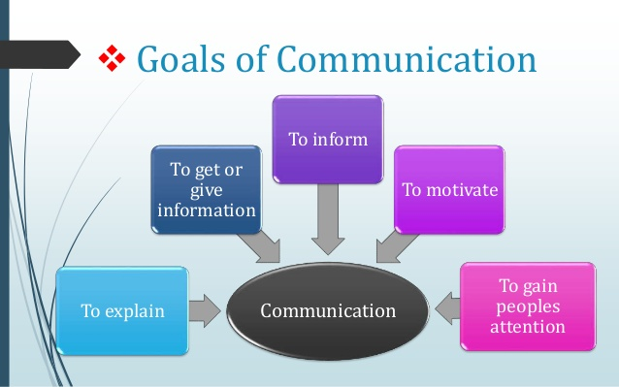
Goals of Communication
  TITLE…
Communication: content and relationship
Setting your goal is the first in the communication process.
Before wondering what to say, it is important to know:
WHAT DO I WANT TO ACHIEVE?

Slide 15
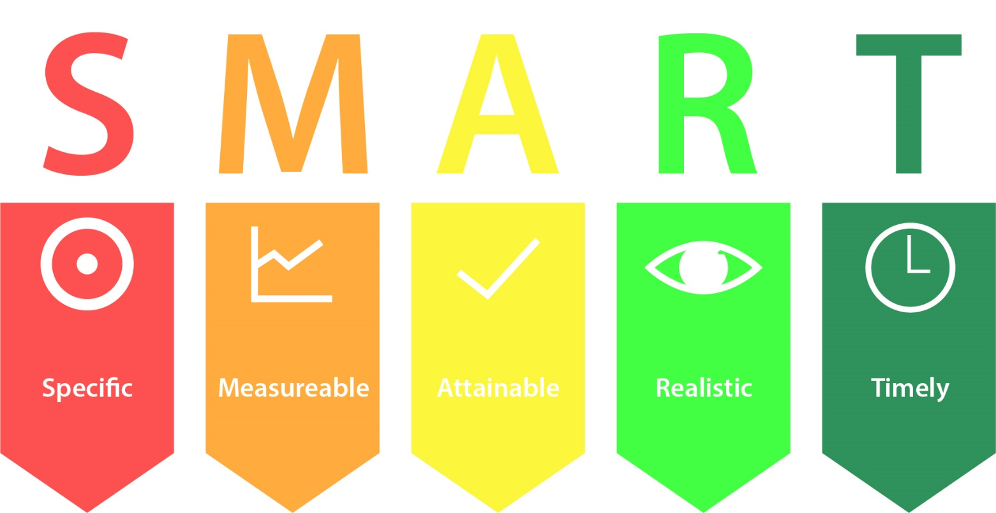
Goals of Communication
  TITLE…
Communication: content and relationship
The objective of communication is the expression of the result you want to achieve in interaction.
The objective must be:

Slide 16
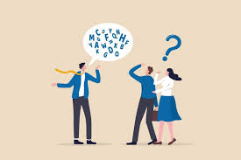
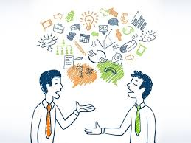
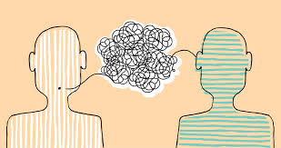
Common Barriers to Effective Communication
  TITLE…
Communication: content and relationship
The use of jargon. Over-complicated, unfamiliar and/or technical terms.
Emotional barriers and taboos. Some people may find it difficult to express their emotions and some topics may be completely 'off-limits' or taboo. Taboo or difficult topics may include, but are not limited to, politics, religion, disabilities (mental and physical), sexuality and sex, racism and any opinion that may be seen as unpopular.
Lack of attention, disinterest, distractions, or irrelevance of topic to the receiver.
Differences in perception and viewpoint.
Physical disabilities such as hearing problems or speech impairment.

Slide 17
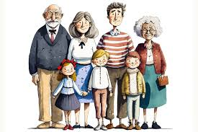
  Intergenerational communication
Intergenerational communication refers to the connection between individuals of different age groups (generations), with the aim of promoting mutual understanding and knowledge exchange.
For generation is meant a group of individual of a same age group or cohort.
A generation is not only related to age, but as well to the cultural environment, the technological knowledge and the communication habits. These elements may present slight or strong differences arriving to be the opposite one of the other.
The generational differences are due to impactful events, advancements, evolvements, change in values or social norms.
These differences have a strong impact on the ways of communication.

Slide 18
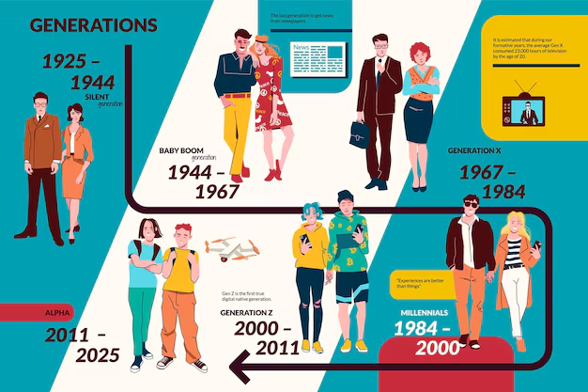
  Intergenerational communication
In 2023, five or more generations are coexisting simultaneously: Traditionalists (Silent Generation), Baby Boomers, Generation X, Millennials (GenY), and GenZ.
Freepik image
Conflicts, misunderstandings and lack of communication are often the result of the differences between the different generations.

Slide 19
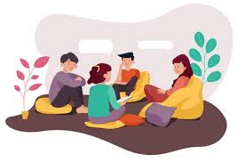
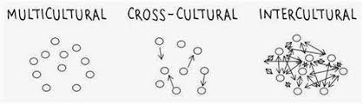
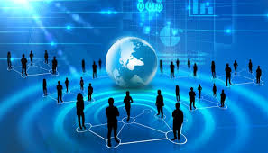
  Multicultural, Intercultural, cross-cultural communication
Intercultural communication is about the exchange between individuals from different cultures. For culture is meant the ideas, customs, and social behavior of a particular people or society.(from Oxford Languages)
Multicultural communication happens between people with different cultural backgrounds including different o ethnicities, and religions.
Cross-cultural communication, goes a step further than intercultural communication, and occurs between people who have significant cultural and social differences. It happens between people coming from different cultural backgrounds and is so the communication happens across cultures.

Slide 20
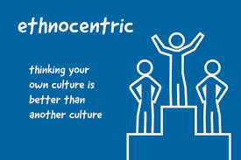
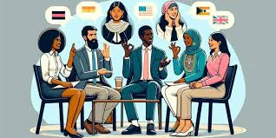
  Multicultural, Intercultural, cross-cultural communication
The main issues affecting these three forms of communications are mainly three:
1) Language 2) cultural barriers 3) ethnocentrism.
1) Language can be a problem when the sender and receiver do not speak or understand a common language.
2) Cultural barriers are represented by the tendency of people to filter their thoughts and experiences through the lens of their own culture. Each individual is exposed to different cultures, customs, beliefs that influence how they interact and see the world. This often leads to misunderstandings and miscommunication.
3) Ethnocentrism is represented by an increasing evaluation of other cultures through the lens of one’s own culture. This leads to preconception, stereotypes that alter the communication.

Slide 21
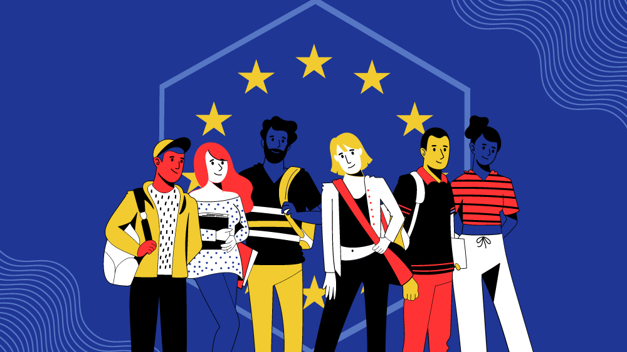
  Best practice on intercultural communication
As a best practice we chose to mention the project PISH: Problem-Based Learning, Intercultural Communications and STEM in Higher Education. PISH was co financed by the European Pogramme Erasmus Plus in the field of intercultural communication for peer-to-peer activities of the students STEM (Science, Technology, Engineering and Mathematics) in the Insitutes of High Instruction.
The links to the project are the following: https://www.facebook.com/PISHproject/
Un progetto europeo per favorire la comunicazione interculturale (asnor.it)

Slide 22

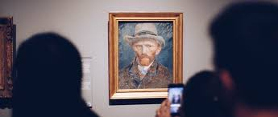
Communication and heritage
Communication and heritage, are two concepts strongly linked one to another.
Communication is the ability to share ideas, feelings, emotions through different means: words, sounds, images etc.…. is the basis of all human contact.
Heritage is the sum of traditions, practices, knowledge of a particular country, society, or group of people that exist from the past and continues to be important.
Heritage is learned, transmitted and preserved through communication.

Slide 23
Communication and heritage
In relation to cultural and natural heritage,
Intergenerational communication is crucial for the transfer of traditions, stories, practices and knowledge that are often passed on from one generation to the next.
Intercultural communication, facilitates the integration of different perspectives and worldviews, creating opportunities for mutual enrichment.

Slide 24







2023-1-EE01-KA220-ADU-000150753
Thank you for your attention
PARTNERS
Funded by the European Union. Views and opinions expressed are however those of the author(s) only and do not necessarily reflect those of the European Union or Estonian National Agency. Neither the European Union nor the granting authority can be held responsible for them.

