Slide 1



2023-1-EE01-KA220-ADU-000150753
TRAINING PROGRAMME
LEARNING UNIT 4: Intercultural and Intergenerational communication
Funded by the European Union. Views and opinions expressed are however those of the author(s) only and do not necessarily reflect those of the European Union or Estonian National Agency. Neither the European Union nor the granting authority can be held responsible for them.

Slide 2
LESSON 2:
Parish Maps as a tool for discovering cultural and natural heritage by highlighting differences

Slide 3
Introduction
In lesson 1 we examined the meaning, principles and processes of intergenerational and intercultural communication.
In lesson 2 we will explore how we can better use intergenerational and intercultural communication in the knowledge and preservation of natural and cultural heritage

Slide 4
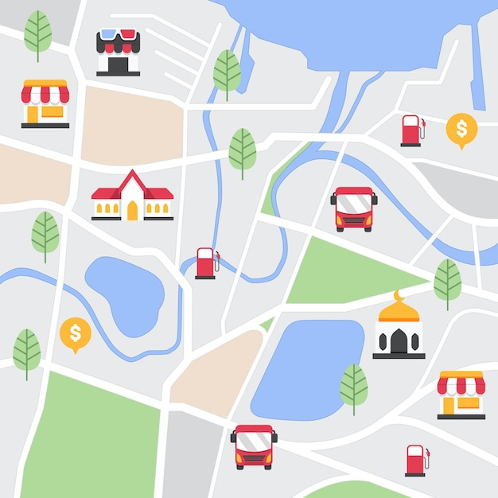
Introduction
Topics
Lesson 2 will address the following topics of utmost relevance:
Parish Maps (concept, history and meaning)
How to develop a Parish Map
Discussion about a Best Practice
Creation of a Parish Map
Freepik image

Slide 5
Introduction
As we discussed in the previous lesson
Intergenerational communication refers to the connection between individuals of different age groups, with the aim of promoting mutual understanding and knowledge exchange.
This communication is crucial for the transfer of traditions, stories, practices and knowledge that are often passed on from one generation to the next.
For example, older people can pass on their life experiences and connection with the territory to younger generations, who can then reinterpret and repropose these traditions in a contemporary way.
Intercultural communication is about the exchange between individuals from different cultures. In a global context, it is crucial to promote understanding between different communities and to address challenges related to cultural diversity.
Intercultural communication facilitates the integration of different perspectives and worldviews, creating opportunities for mutual enrichment.
For example, different cultural groups can share knowledge about places, conservation practices and how they interpret the significance of natural heritage, fostering a collective and inclusive approach to its valorisation.
These intergenerational and intercultural exchanges can foster the preservation and renewal of heritage, enabling new generations and new citizens to maintain a link with the cultural and natural roots of their territory and to act on it from other points of view.

Slide 6
Introduction
What methods and tools can we use to foster these exchanges and enhance the heritage of an area?
Intercultural communication
Intergenerational communication
Parish Map
knowledge and valorisation of heritage

Slide 7
Parish Map
It is a tool with which the inhabitants of a specific place are given the possibility to represent the heritage, the landscape, the knowledge in which they recognize themselves and that they wish to pass on to the new generations.
It highlights the way in which a local community sees, perceives, gives value to its territory, to its memories, to it transformations, to its existing reality and how they would like it to be in the future.

Slide 8
Parish Map
It consists in a cartographic representation, or in any other product or issue, in which the community identifies itself with.
Based on the assumption that one dose not appreciate what one does not know, a parish map, built together with those who live in the territory, allows to rediscover the real value of places and to regain all the information (often overlooked or considered to be little significant by the cartographic or the official documents) embedded in the territory, and offers the opportunity to choose what to include and what to leave out from the representation of a community. and therefore from the building of an itinerary
It can be used to build itineraries.

Slide 9
Parish Map
The concept of Parish Maps was born in the early '80s in England thanks to an intuition of Common Ground, a no profit organization, which firstly chose to work on local heritage comprehension and promotion through the active and creative involvement of the community of reference.
This approach consists in giving particular attention to the local aspects, in passing on specific and unwritten knowledge of each place, in recording and guiding the changes, in using the different individual capacities, in highlighting the relationships and interdependence between people and places, and bringing out a set of factors besides the uniqueness.

Slide 10
Parish Map
Why Parish Maps?
Please go to https://www.commonground.org.uk/places-people-parish-maps-%e2%80%a8by-sue-clifford/
https://www.commonground.org.uk/places-people-parish-maps-%e2%80%a8by-sue-clifford/
Making a Parish Map is about creating a community expression of values, and about beginning to assert ideas for involvement, it is about taking the place in your own hands.
We are trying to focus on locality, the smallest arena in which life is played out. The territory to which you feel loyalty, which has meaning to you, about which you share some knowledge, for which indignance and protectiveness is easily roused, the neighbourhood of which you have the measure, which in some way helps to shape you.
Knowing your place, taking some active part in its upkeep, passing on wisdom, being open to ideas, people, development, change but in sympathy with nature and culture which have brought it this far, will open the doors of dissent. But conversation, tolerance and the passing on of memories, are civil sing forces. Whatever the forms of knowledge we shall need for the next millennium, humanity and imagination must take a high priority in organising them.
In making a Parish Map you can come together to hold the frame where you want it to be, you can throw light on the things which are important to you, and you may find courage to speak with passion about why all this matters.

Slide 11
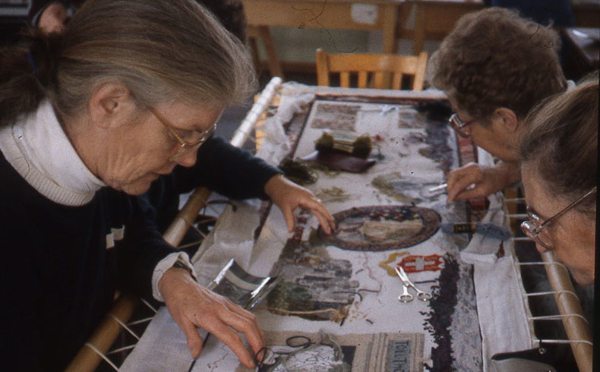
Developing a Parish Map
So, the Parish Map is built through group work, or rather: community work.
The citizens of an area (nationals or new citizens, young and old) can be involved either directly in the construction itself or through interviews to learn about the history of the place, the legends, the needs ...
Image from https://www.commonground.org.uk/places-people-parish-maps-%e2%80%a8by-sue-clifford/

Slide 12
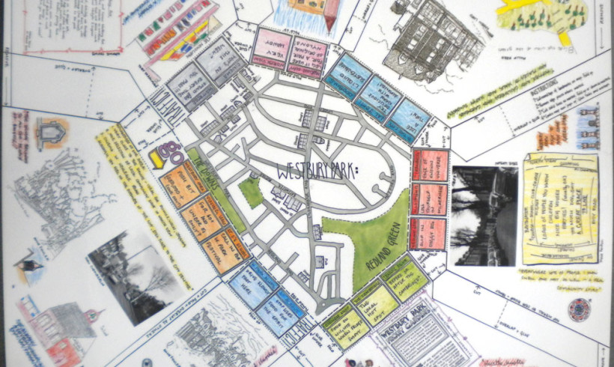
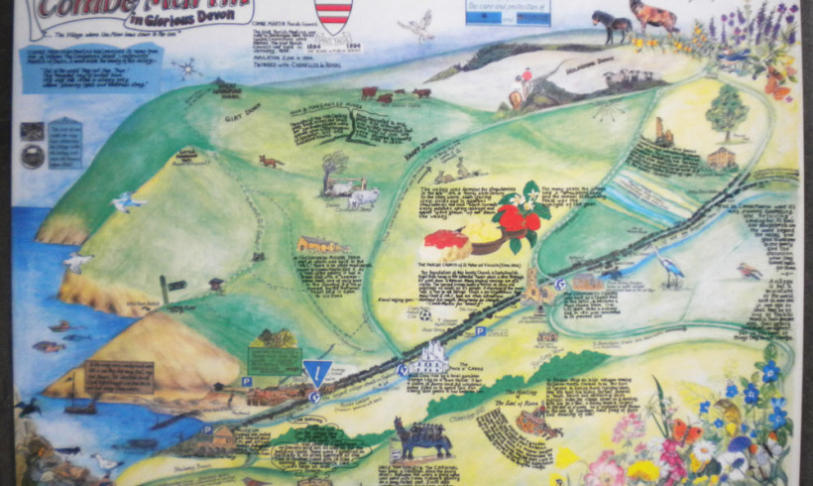
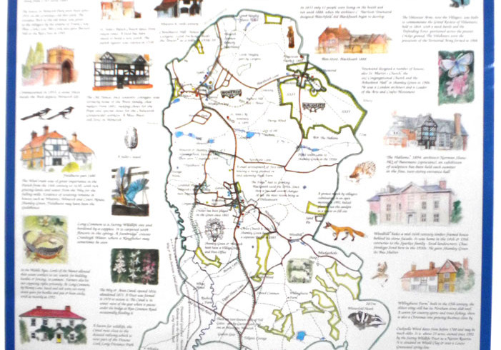
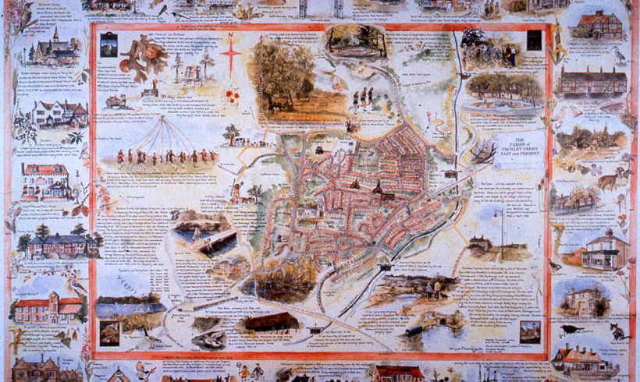
Developing a Parish Map
Some examples of Parish Maps
Images from https://www.commonground.org.uk/places-people-parish-maps-%e2%80%a8by-sue-clifford/

Slide 13
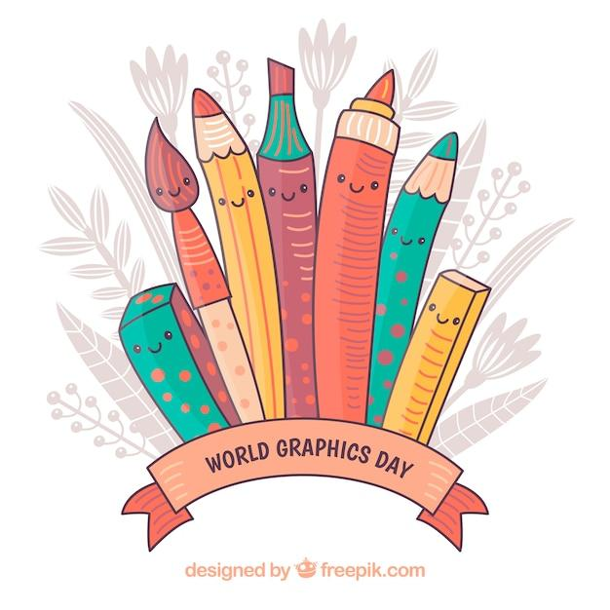


Developing a Parish Map
We can use a simple Google map showing only the roads and references for the legend and then ‘work’ it out
or
create it on a 70x100 sheet (or even larger)
In both cases we can then insert images, photos, stories, etc.

Slide 14
Developing a Parish Map
It is also possible to build an interactive map, i.e. a digital map, which can contain images, video or audio.
There are many programmes that allow the creation of interactive maps.
Among the free ones we can mention Google Maps and GoogleEart, which have the advantage of being very popular among users.
Among the paid ones we can mention ThingLink, which allows us to create very complex maps in a simple way, but whose cost is not affordable for everyone.

Slide 15
Developing a Parish Map
The concrete creation of a Parish Map starts off by asking a few questions:
Where are we?
What makes this place different from others?
Which ingredients is it made up of?
What is important on a personal and collective level, and why?
Which are the natural qualities of the place?
And the individual knowledge?
How can we share this knowledge?
What style do we use, and in which way do we draw and build the map?

Slide 16
Developing a Parish Map
Search
Take care
Ask
Know
Gather
Involve
Choose
Build
Put together
Draw
Mend
Narrate
Correlate
Imagine

Slide 17
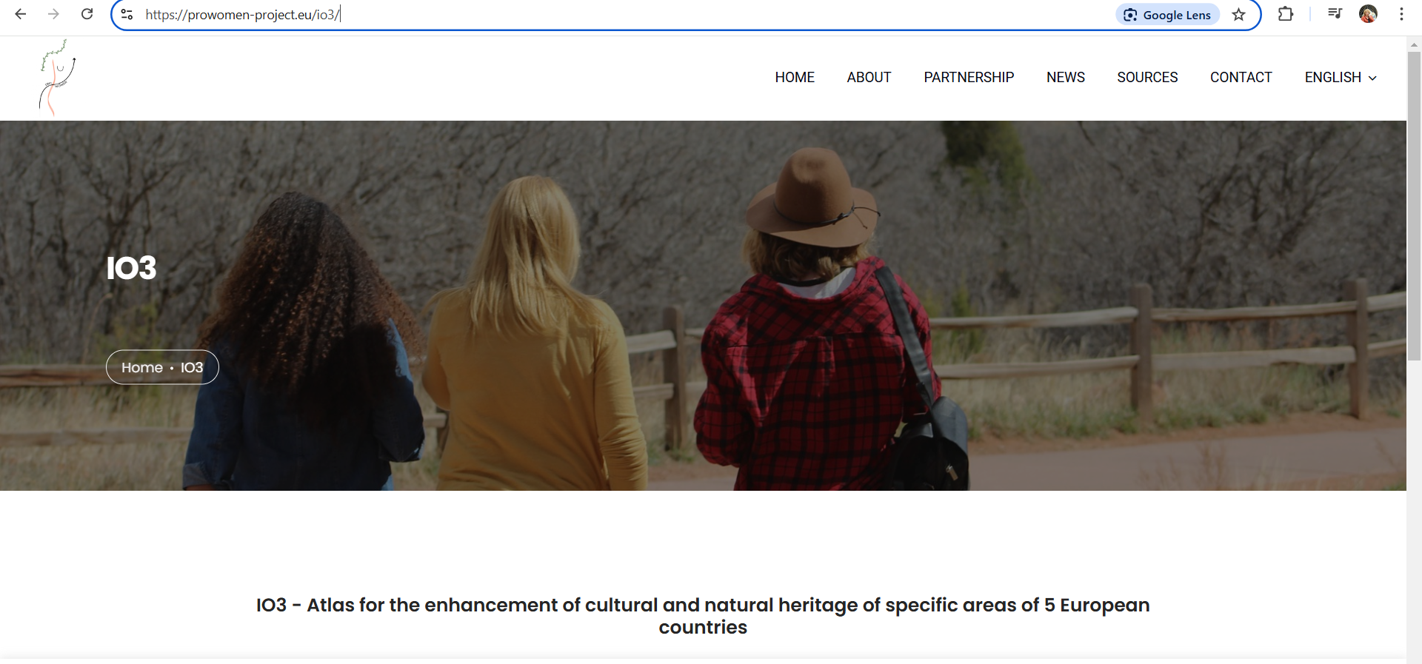
Best practice
As a best practice we have chosen to cite one of our previous projects: Pro-Women. Up-skilling Itineraries for Women as New Cultural Promoters to Enhance Territorial Heritage
It was co financed by the European Programme Erasmus Plus in the field of Adult Education.
With this project, we successfully experimented with Parish Maps and developed many itineraries for the enhancement of cultural and natural heritage, and at the end we produced the Atlases
https://prowomen-project.eu/io3/

Slide 18







2023-1-EE01-KA220-ADU-000150753
Thank you for your attention
PARTNERS
Funded by the European Union. Views and opinions expressed are however those of the author(s) only and do not necessarily reflect those of the European Union or Estonian National Agency. Neither the European Union nor the granting authority can be held responsible for them.

