Slide 1



2023-1-EE01-KA220-ADU-000150753
TRAINING PROGRAMME
LEARNING UNIT 5: Sustainability
Funded by the European Union. Views and opinions expressed are however those of the author(s) only and do not necessarily reflect those of the European Union or Estonian National Agency. Neither the European Union nor the granting authority can be held responsible for them.

Slide 2
LESSON 1: CULTURAL HERITAGE AND SUSTAINABLITY

Slide 3
  Interactive Activity (1/4)
Objective:
The purpose of this activity is to support learners to understand the key concepts of cultural heritage. Also helping the learners to view cultural and natural heritage as valuable resources for sustainable development and explore how heritage tourism, traditional ecological knowledge, sustainable agriculture, and eco-cultural enterprises can generate economic opportunities, promote local livelihoods, and support community development while preserving cultural and natural assets.
Materials Needed:
- White Board
- Markers
- Poster boards, cartoons
- Internet
Procedure:
Ask students what they know about cultural and natural heritage. Write down their answers on the board. Briefly explain the concepts. Cultural heritage and natural heritage. Discuss why it's important to preserve both cultural and natural heritage for future generations.

Slide 4
  Interactive Activity (2/4)
The class should be divided into small pairs. The trivia questions are to be presented in a sequential manner. Each group is given an opportunity to respond to the question or to compete to be the first to indicate that they wish to respond. The following sample trivia questions are provided for illustrative purposes:
i- Please state the name of the most common traditional dish in our village.
ii- Which festival is celebrated in accordance with a specific custom, such as dancing or food sharing?
iii- What was the predominant occupation in the village 50 years ago?
iv- What materials were traditionally employed in the construction of residential buildings in the village?
v- Please describe the musical and dance traditions observed at village celebrations.
After mentioning the example of best practice “Take Me to Your Village” on presentation file about cultural heritage, please divide the students into small groups comprising three to five participants. Each group should be assigned a specific area or topic related to village traditions. Examples of suitable topics include:
Group1- The subject of architecture.
Group 2-The next topic for discussion is agriculture.
Group 3-The daily routine and responsibilities of the local population.
Group 4: A local song that is not popular nowadays.

Slide 5
  Interactive Activity (3/4)
Section 3- The group of the last activity should continue. In the listening triangles activity, learners work together in groups of three: a speaker, a questioner and a note-taker.
- The speaker elucidates the topic (or expresses their opinion on an issue) in accordance with the instructions provided by the instructor. The questioner listens attentively and requests elucidation or supplementary detail. The note-taker observes this process and provides feedback to both the speaker and the questioner.
Each group will do some research on the following aspects of local cultural heritage. After the research these groups should do a short presentation related to their questions.
Group 1 - What is it and why is it significant?
Possible Answer: Local heritage is a link between people and their history, a reminder of their community's journey, its struggles and its achievements. Understanding this history helps future generations learn from the past, creating a community that respects and values its roots.

Slide 6
  Interactive Activity (4/4)
Group 2 - What are the challenges it faces that threaten to preserve it?
Possible Answer: Urban expansion often leads to the destruction of cultural heritage. Apart from urban expansion, heritage sites can be damaged by rising temperatures, extreme weather and natural events. Air, water and soil pollution affect both cultural monuments and natural ecosystems. Unfortunately, heritage sites can be worn out and damaged by large numbers of visitors. Because of inadequate funding hinders proper maintenance and conservation efforts. Wars and civil unrest lead to deliberate or accidental destruction of heritage. Items are often stolen, and sites are defaced or damaged.
Group 3 and 4 - How can sustainable practices help conserve it?
Possible Answer: In the context of environmentally conscious construction practices, there is a growing emphasis on the use of eco-friendly building materials. The use of sustainable, non-invasive materials for repairs or modifications is an effective means of maintaining the structural integrity of heritage sites without causing any additional harm.

Slide 7
  Interactive Activity (3/3)
Section 4- Give groups handout example which is on Annex 1, you can see the handout there. Groups will create a mini-awareness scheme (community resilience, identity preservation, and social cohesion,) promoting the importance of preserving their chosen heritage. The scheme could include:
A poster: It will be a creative poster with images and key messages about the heritage and how it can be protected. Also, a catchy slogan that encourages people to learn about cultural heritage and preserve it.
Call to action: Practical suggestions on how people can contribute to the sustainability of local cultural heritage (e.g. support local artisans, visit sites responsibly, learn about traditional practices). (See Annex 2)
After the preparation of these products, every group should present their products to the class.

Slide 8
  Discussion and Reflection 1/2
Questions for Group Discussion:
What are the reasons for preserving cultural heritage, including languages, monuments, and traditions? What are the reasons for preserving natural heritage, including national parks, ecosystems, and wildlife? It would be beneficial to consider the ways in which cultural and natural heritage contribute to the formation and expression of a community's identity.
  Possible Answer: Cultural heritage provides a sense of identity and belonging for individuals and communities. It connects people to their past, present, and future.
  Possible Answer: Shared cultural heritage can strengthen social bonds and foster a sense of community so it promotes understanding and tolerance between different groups. Apart from this, Cultural heritage can contribute to economic development through tourism, creative industries, and cultural exports.
What are the most significant threats to cultural heritage? To illustrate, how might urbanization or globalization impact traditional cultures? What are the principal threats to natural heritage? Consider the impact of environmental issues such as climate change, deforestation and pollution.
  Possible Answer: As people migrate to urban areas, they may abandon traditional livelihoods and knowledge systems. This can lead to the erosion of unique cultural practices and skills. Wars and conflicts can cause widespread destruction of cultural heritage sites, including religious buildings, museums, and archaeological sites.
  Possible Answer: Climate change can lead to increased frequency and intensity of natural disasters, such as floods, droughts, and storms, which can damage or destroy cultural heritage sites. The illegal trade in cultural artifacts can lead to the loss of important cultural objects and the depletion of cultural heritage.

Slide 9
  Discussion and Reflection 1/2
Conclusion:
The learners were introduced to a variety of heritage sites and the reasons why they are of significance not only at the local level but also on a global scale. Furthermore, learners came to understand that ensuring the preservation of these valuable heritage sites and traditions for future generations hinges on the implementation of sustainable practices.
It is also important to emphasise the connection between local and global actions. Students should understand that local initiatives contribute to a global movement. The protection of a single cultural practice, monument, or ecosystem can inspire similar efforts worldwide, thereby contributing to the creation of a sustainable future for all.
The learners presented creative posters that highlighted the issues facing their selected heritage sites and proposed solutions that were both thoughtful and realistic. They demonstrated an understanding of the ways in which challenges such as climate change, over-tourism, pollution, and a lack of awareness can impact the preservation of heritage.

Slide 10
  Discussion and Reflection 2/2
The projects demonstrated that raising awareness is an effective strategy. The learners were made aware of their individual responsibility to assist in the protection of our heritage. This may be achieved by supporting sustainable tourism, advocating for conservation efforts or educating others about the importance of heritage sites.
It is recommended that students be encouraged to consider how they might promote sustainability and heritage preservation in their own communities. This may entail participation in local clean-up events, support for eco-friendly businesses, or the dissemination of information on social media for the purpose of raising awareness.
Reflection
Please use Annex 2 for the reflection session. You can distribute it to learners after you print or adapt it to a Google Form.

Slide 11
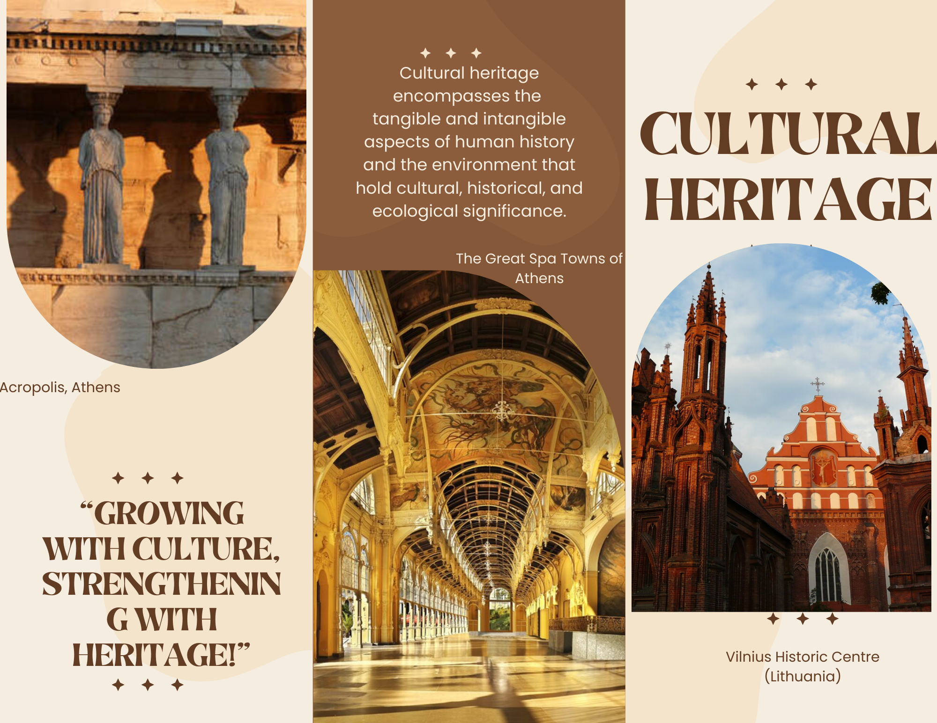
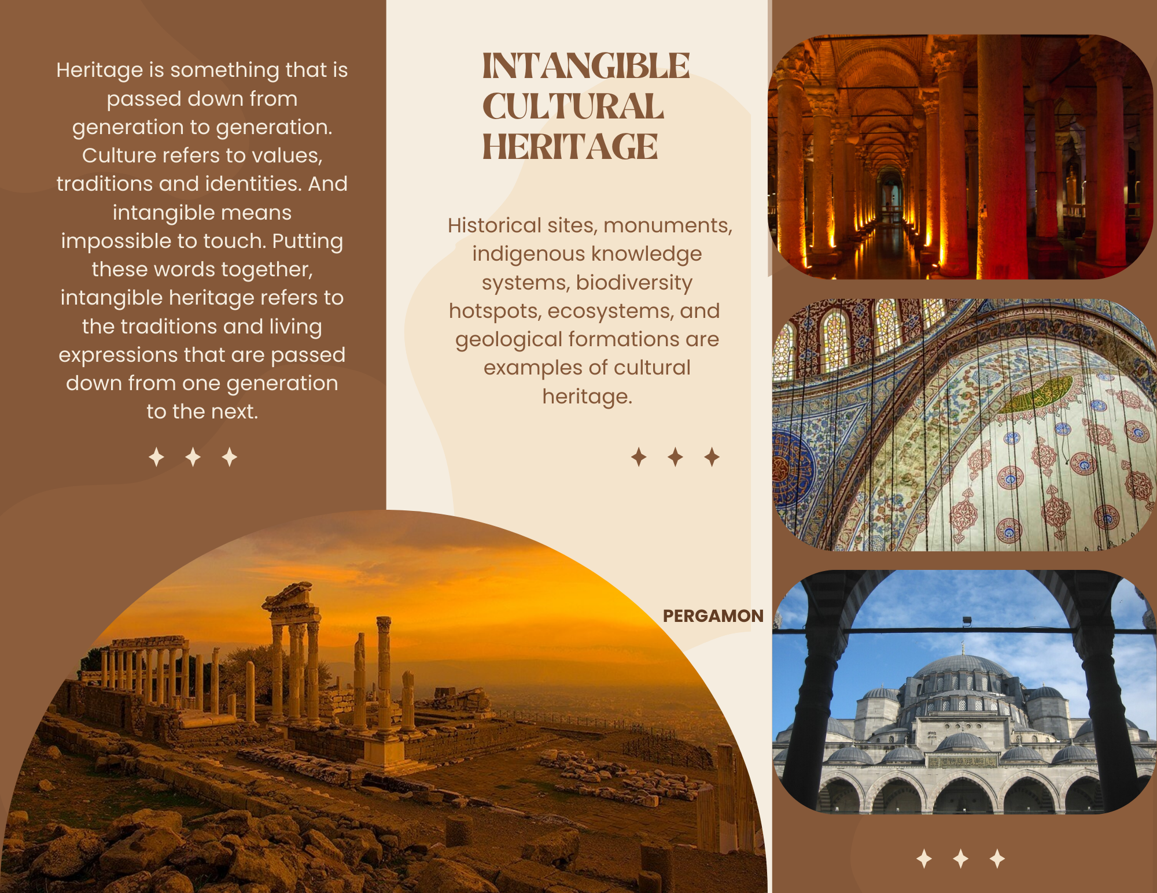
  Apprendix 1
Here is the Canva link.

Slide 12





  Apprendix 2 For Call to Action
Subject Knowledge: Call to Action
Language
Goals
Be clear on the goal you're trying to achieve. Some examples of possible purposes include:
Raise awareness about the importance of preserving cultural heritage. Promote sustainable practices in cultural heritage conservation. Inspire participation in community-driven heritage projects.
."..
Urgency Collective Benefit
Values
Use powerful, action-oriented language. Your product should encourage immediate action. Use strong, direct verbs that motivate people to take the next step. Instead of passive language, opt for more engaging calls to action, such as:
- Make Your Mark Heritage.
- Invest in Heritage, Invest in Ourselves.
Whether it's community, history, the environment or future generations, focus on what people value most. This emotional connection can help increase engagement:
"Your support today can protect tomorrow's cultural heritage"
People are more likely to act if they feel a sense of urgency. Highlight the potential consequences of inaction and the benefits of acting now. This can be framed in terms of both cultural and environmental loss:
"Time is running out - our cultural treasures are vanishing. Act now to preserve them".
Let people know how they'll personally benefit or be rewarded for taking part. This could be through personal achievement, collective pride or societal recognition:
"Help secure our shared history - become part of something bigger than yourself.
"Together we can create a sustainable future by honoring our cultural past".
01
02
03
05

Slide 13
  Apprendix 3 - Reflection Form 1/2
Reflection Form
Summarize the key insights gained about the cultural heritage of our village today.
2 - Please provide a brief account of one or two aspects of the activity that you found particularly intriguing.
3 - Circle your emotional state during the activity.
Excited, Curious, Confused, Bored
4 - How did you feel during the activity?
a- I was excited to participate in the activity.
b- I was curious about the content of the activity.
c- I was not interested in the subject.

Slide 14
  Apprendix 3 - Reflection Form 2/2
Reflection Form
Was the activity easy to follow for you? Please circle.
a-The instructions were unambiguous and readily comprehensible.
b- The material was satisfactory, but it could be presented in a more lucid manner.
c- I found it difficult to comprehend.
Please indicate which aspect of the activity you found most enjoyable.
In order to optimise future iterations of this activity, what modifications could be made?

Slide 15







2023-1-EE01-KA220-ADU-000150753
Thank you for your attention
PARTNERS
Funded by the European Union. Views and opinions expressed are however those of the author(s) only and do not necessarily reflect those of the European Union or Estonian National Agency. Neither the European Union nor the granting authority can be held responsible for them.

