Slide 1



2023-1-EE01-KA220-ADU-000150753
TRAINING PROGRAMME
LEARNING UNIT 5: Sustainability
Funded by the European Union. Views and opinions expressed are however those of the author(s) only and do not necessarily reflect those of the European Union or Estonian National Agency. Neither the European Union nor the granting authority can be held responsible for them.

Slide 2
LESSON 1: CULTURAL HERITAGE AND SUSTAINABLITY

Slide 3
  DEFINITIONS & KEY CONCEPTS I
1.1. Definition of Cultural Heritage
Cultural and natural heritage encompasses the tangible and intangible aspects of human history and the environment that hold cultural, historical, and ecological significance.
Historical sites, monuments, indigenous knowledge systems, biodiversity hotspots, ecosystems, and
geological formations are examples of cultural heritage.
Cultural and natural heritage reflects the richness and diversity of human civilization and the natural world, contributing to social cohesion, identity formation, and ecological balance.

Slide 4
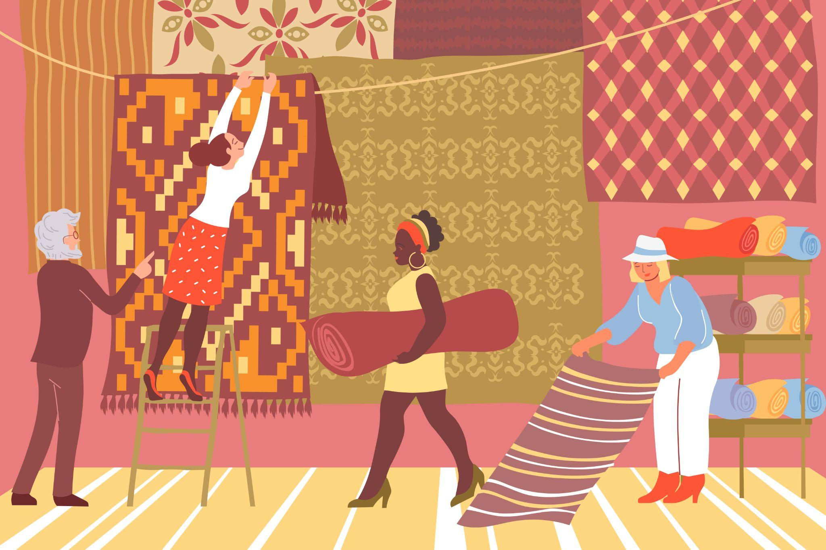
  DEFINITIONS & KEY CONCEPTS II
1.2. Intangible cultural heritage
Intangible cultural heritage includes the practices, knowledge and expressions that communities recognise as part of their cultural identity, as well as the objects and spaces associated with them. Passed down through generations, this heritage adapts over time, reinforcing identity and respect for cultural diversity.
Source: Freepick
Heritage is something that is passed down from generation to generation. Culture refers to values, traditions and identities. And intangible means impossible to touch. Putting these words together, intangible heritage refers to the traditions and living expressions that are passed down from one generation to the next.
It can be thought of as 'living heritage'. Examples include community gatherings, oral histories, songs, knowledge of natural spaces, healing traditions, foods, holidays, beliefs, cultural practices, craft skills, farming and ranching methods, traditional seafaring, cooking and wine-making skills, and so on. Elements of this heritage are an integral part of life in both rural and urban areas and among indigenous people. Intangible cultural heritage is "at once traditional, contemporary and living". It is inclusive, representative and community-based.

Slide 5
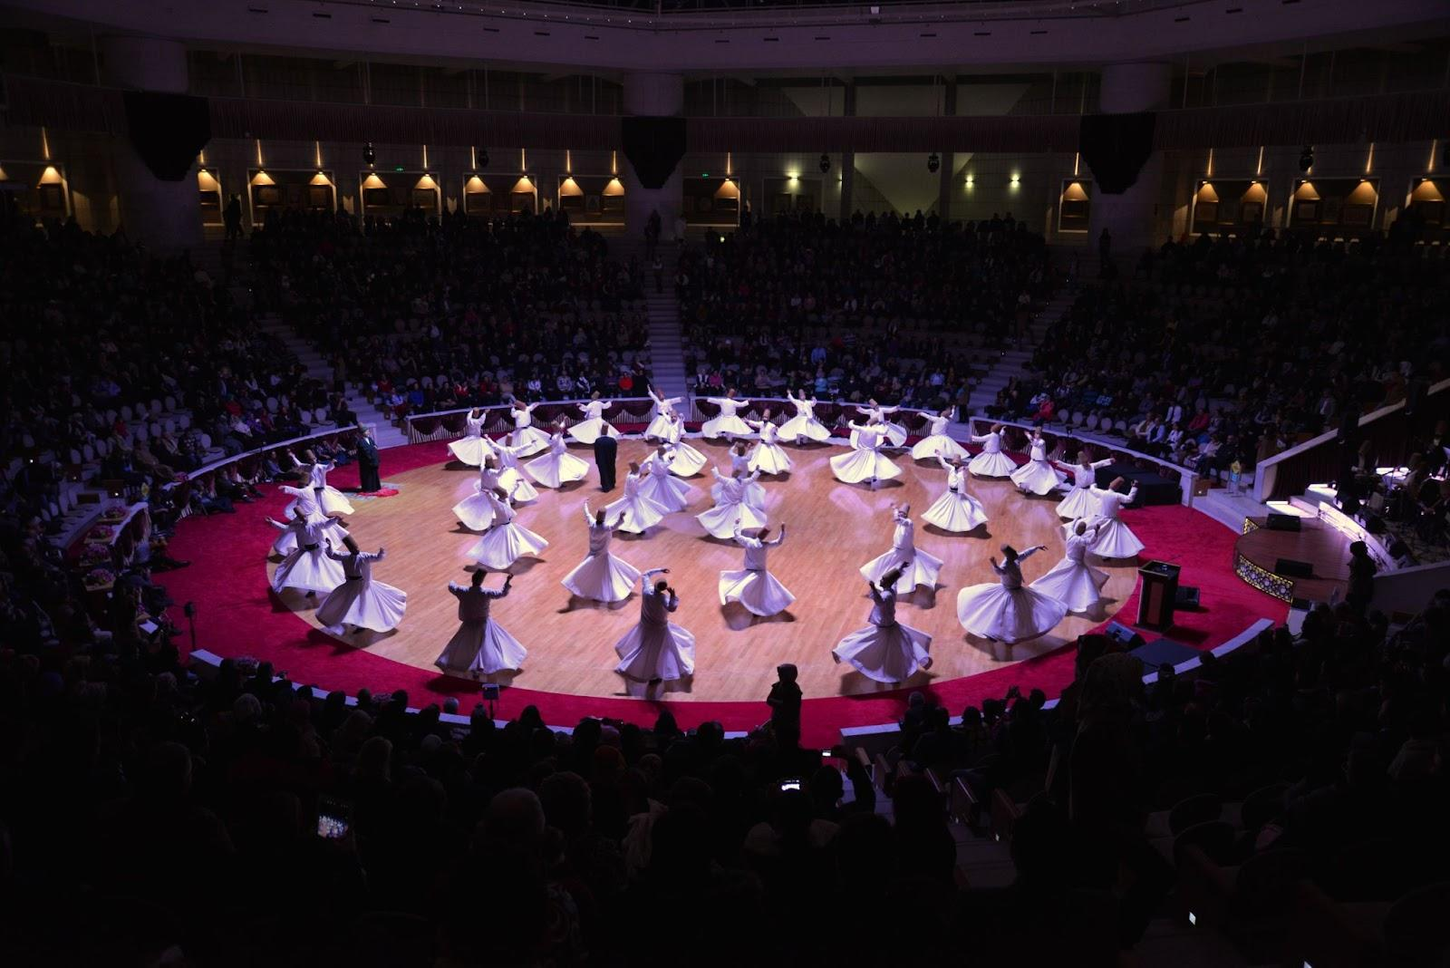
  DEFINITIONS & KEY CONCEPTS III
1.2. Intangible cultural heritage
The 2003 UNESCO Convention emphasises the need to safeguard these cultural expressions for future generation. Types of Intangible Heritage,to help people understand intangible cultural heritage, the UNESCO Convention describes it in terms of broad categories.
Oral traditions and expressions: This can include proverbs, riddles, stories, legends, myths, epic songs and poems, spells, chants, songs and more.
Performing arts: This can include music, dance and drama, mime, songs and other forms of artistic expression that are passed down from generation to generation. Social practices, rituals and festivals. These are the activities that structure the life of communities and are shared by members - for example, initiation rites, funeral ceremonies, seasonal carnivals and harvest celebrations.
Turkish National Commission for UNESCO

Slide 6
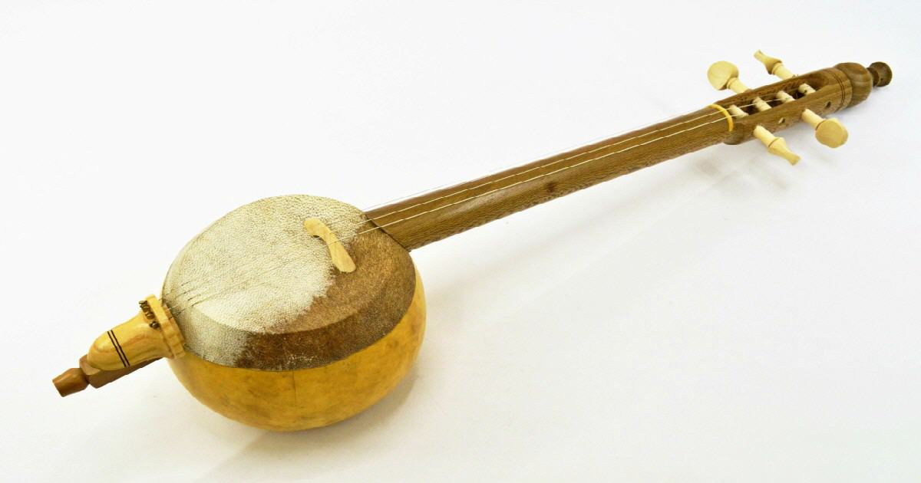
  DEFINITIONS & KEY CONCEPTS III
Knowledge and practices related to nature and the universe: These refer to know-how and skills that communities have developed through interaction with their natural environment, and may be expressed through language, memory, spirituality or worldviews. Traditional methods of architecture, agriculture, animal husbandry and cuisine are among the related elements.
Traditional craftsmanship: This may sound 'tangible', but it really refers to the skills and knowledge involved in the craft, rather than the products themselves. Examples include pottery, woodwork, jewellery and gemstones, embroidery, rug-making, musical instruments, weaving and cloth-making.
Source: Freepick

Slide 7
  DEFINITIONS & KEY CONCEPTS IV
1.2. Sustainable Development
Sustainable development seeks to balance economic growth, environmental protection, and social equity to ensure the well-being of present and future generations.
Environmental conservation, social inclusion, economic prosperity, intergenerational equity, and cultural preservation are the principles of sustainability.
Sustainable development is significant because sustainable development promotes harmony between human activities and the natural environment, addressing global challenges such as climate change, biodiversity loss, poverty, and inequality.

Slide 8
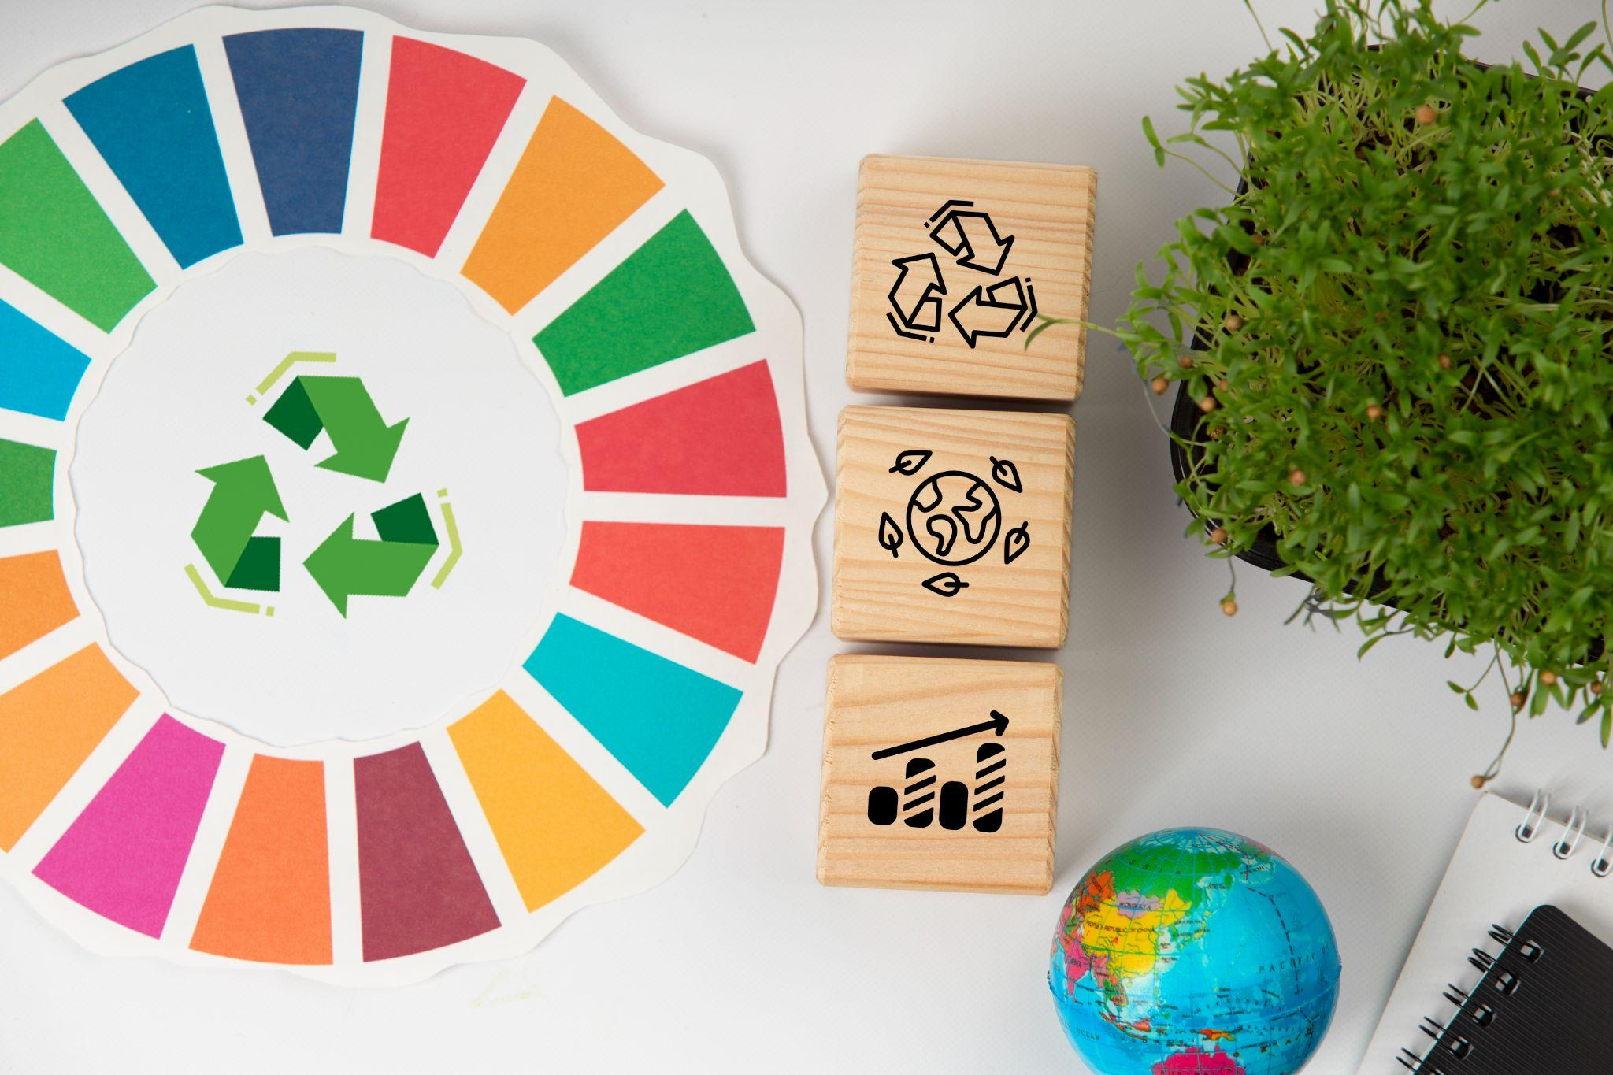
  DEFINITIONS & KEY CONCEPTS V
The Sustainable Development Goals (SDGs)
The Sustainable Development Goals (SDGs), also known as the Global Goals, were adopted by the United Nations in 2015 as a universal call to action to end poverty, protect the planet, and ensure that by 2030 all people enjoy peace and prosperity. There are 17 SDGs with various aims such as :
  Goal 9 Industry, innovation and infrastructure: To make sure that we reduce waste and make and use products in a way that protects the environment
  Goal 10 Reduced Inequalities: Reduce inequality within and among countries
  Goal 11 Sustainable cities and communities: To make sure that everyone has a clean, safe place to live and cities,towns and villages are improved in a way that protects the environment
  Goal 13 Climate Action: Take urgent action to combat climate change and its impacts
  Goal 15 Life on land: To make sure that we protect all the different land environments and animals
Source: Freepick

Slide 9
  DEFINITIONS & KEY CONCEPTS VI
1.3. Interrelation
Recognize the interconnectedness between cultural and natural heritage conservation and sustainable development goals.
Understand how preserving cultural heritage contributes to community resilience, identity preservation, and social cohesion, while conserving natural heritage supports ecosystem services, biodiversity conservation, and climate resilience.
Heritage as a Resource: View cultural and natural heritage as valuable resources for sustainable development.
Explore how heritage tourism, traditional ecological knowledge, sustainable agriculture, and eco-cultural enterprises can generate economic opportunities, promote local livelihoods, and support community development while preserving cultural and natural assets.

Slide 10
  Best practice - Take Me in Your Village 1/2
Take Me in Your Village
The project “Take me in your village” is by Veronica Yossifova from Gabrovo has grown especially popular. The main idea of the project is older people who live in villages welcome young people from cities. This mobility aims to narrow the gap between young and old people and to continuation of customs, values and traditions.
Gabrovo municipality had the idea from national essay competition, the essay named as My ideas for Bulgaria 2013. More than 70 people had the encouragement to be a part of this project and only 30 people who are aged between 15 and 29 had chance to spend five days in a village during the summer.
Young people will also be able to meet the wealth of Bulgarian folklore, learn how to sing and dance and take part in the reenactment of different rural traditions and rituals. One of the most popular things last year was the regional cooking traditions.

Slide 11
  Best practice - Take Me in Your Village 2/2
Take Me in Your Village
The Gabrovo Municipality applies the principles and ideas of the Agenda 21 for culture, implementing a coordinated range of cultural activities and programs, including the Strategy for Culture 2014- 2024; the municipal program on culture, the bid to become European Capital of Culture in 2014; participation in the Pilot Cities program, membership of the UNESCO Creative Cities Network, etc.
The initiative “Take Me in Your Village” falls entirely within the scope of these policies with its aim to explore, preserve and promote the living cultural heritage of the rural settlements of Gabrovo, by transferring knowledge, skills, practices, as well as understandings, perceptions, sensitivity from the elderly to the young.
The project effectively develops an original approach by bringing together the elderly villagers and the urban youth, who live and work together in the natural environment of the villages, as “grandparents for rent” and “grandchildren to lend”.

Slide 12
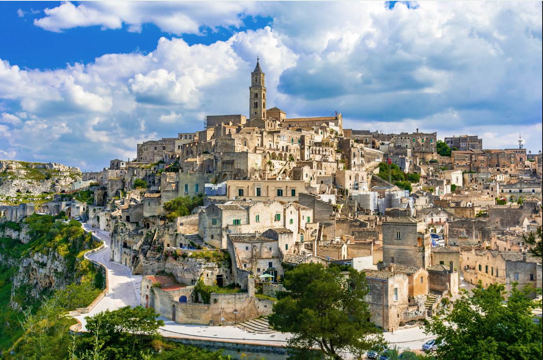
  SOME DEFINITIONS & CONCEPTS 1/2
EUROPEAN CAPITAL OF CULTURE 2019, MATERA, BASILICATA, ITALY
Cultural heritage provides the basis for debate concerning the present and the future in Matera and in Europe. Matera, which has been designated the future European Capital of Culture for 2019, has set itself the objective of assuming a pioneering role in a movement aimed at dismantling the barriers to culture, particularly through the utilisation of new technologies and the facilitation of learning. The programme's approach is characterised by a vibrant and innovative artistic sensibility, coupled with an inclusive policy that seeks to integrate those who are frequently excluded from cultural activities into a unified project framework, rather than creating parallel project lines.
Source: Freepick

Slide 13
  SOME DEFINITIONS & CONCEPTS 2/2
RED STAR LINE MUSEUM, ANTWERP, FLANDERS, BELGIUM
In 2004, the Antwerp City Council resolved to transform the former premises of the Red Star Line shipping company into a commemorative site. The three former warehouses, which had previously served as control stations for passengers seeking to emigrate to the New World, were restored, and the new Red Star Line Museum opened in September 2013. Until recently, it was the sole migration museum on the European mainland housed in the original departure halls. The museum also serves to emphasise that heritage is not solely confined to the built environment, but encompasses the rich tapestry of local, intangible cultures.
HERITAGE IN THE WHITE PAPER ON CULTURE, TERRASSA, CATALONIA, SPAIN
The White Paper on Culture represents an attempt to consolidate and give visible expression to the tangible and intangible heritage of the city of Terrassa, in order to reinforce the sense of community, cultural identity and visibility. The document that resulted from this process was informed by a series of debates, working groups and an overarching commitment to reinforce the role of cultural initiatives in the cityscape.

Slide 14







2023-1-EE01-KA220-ADU-000150753
Thank you for your attention
PARTNERS
Funded by the European Union. Views and opinions expressed are however those of the author(s) only and do not necessarily reflect those of the European Union or Estonian National Agency. Neither the European Union nor the granting authority can be held responsible for them.

