Slide 1



2023-1-EE01-KA220-ADU-000150753
TRAINING PROGRAMME
LEARNING UNIT 6: Networking
Funded by the European Union. Views and opinions expressed are however those of the author(s) only and do not necessarily reflect those of the European Union or Estonian National Agency. Neither the European Union nor the granting authority can be held responsible for them.

Slide 2
LESSON 1: WHAT NETWORKING IS?

Slide 3
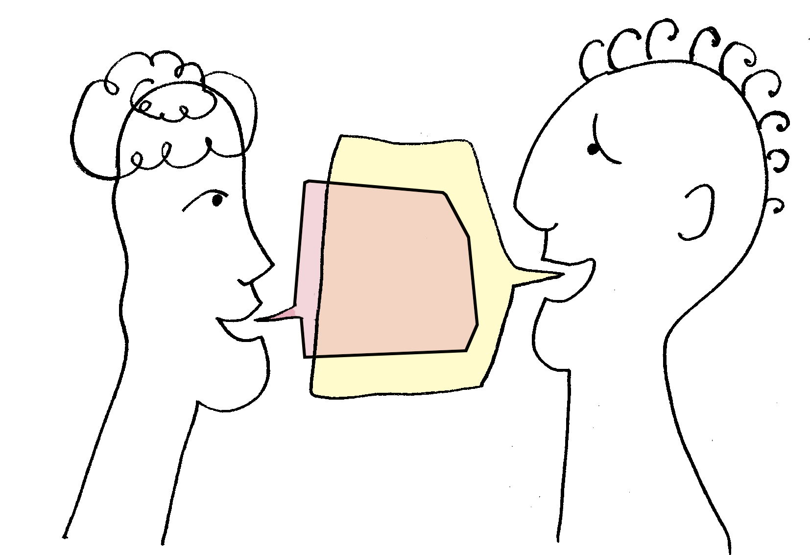
  DEFINITION OF NETWORKING
Networking is the process of connecting with other people in your field or industry. This can be done in person, through online platforms, or by attending events or workshops.
Networking is the process of making connections and building relationships. These connections can provide you with advice and contacts, which can help you make informed career decisions.
Networking is the action of interacting with others to exchange information and develop professional or social contacts.

Slide 4
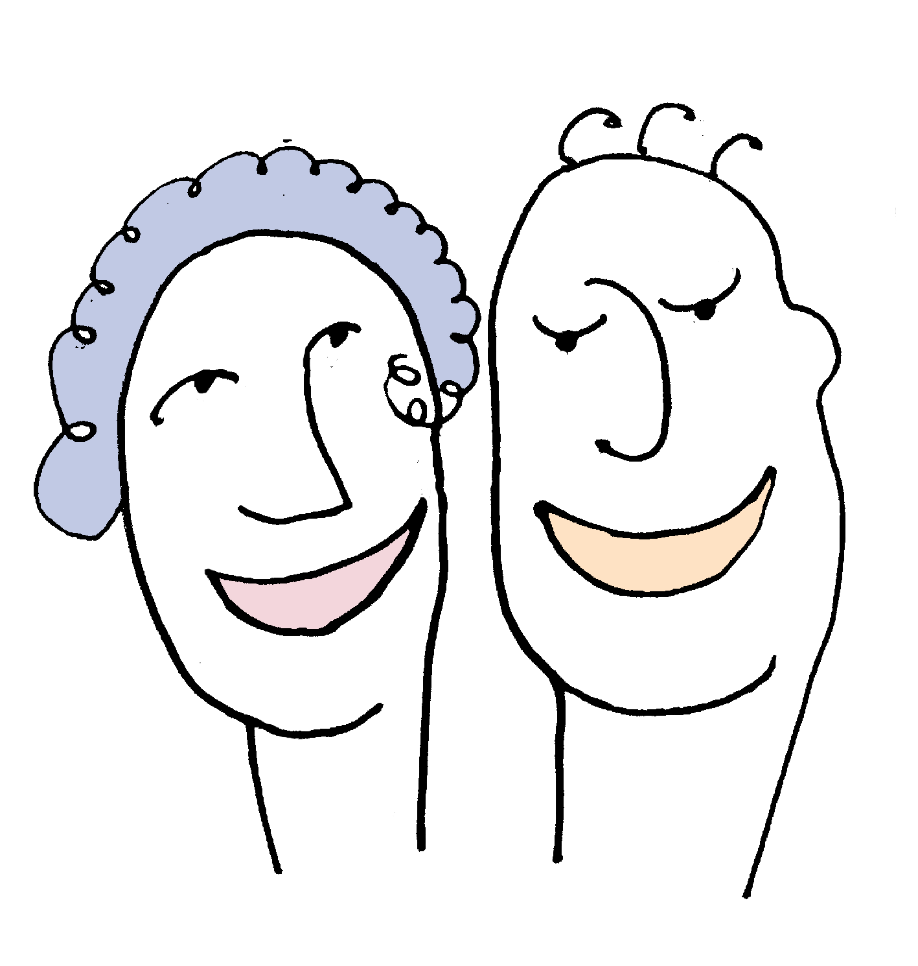
  DEFINITION OF NETWORKING
Networking can be beneficial for both individuals and businesses. For individuals, it can help you build relationships, learn new information and make connections that lead to new opportunities.
Networking can help to generate new leads, and create opportunities for collaboration. Regardless of why you choose to network, the important thing is to be authentic and genuine in your interactions. When done correctly, networking can be a powerful tool for building relationships and achieving success.

Slide 5

  NETWORKING
Benefits of networking
Networking is the lifeblood of success. It’s are strategic tool that opens doors to new opportunities.
Build your self-confidence
Raise your professional profile
Gain a different perspective
Get an answer to every question
Grow your personal brand
Build your confidence
Develop lasting relationships
Get career advice and support

Slide 6

  NETWORKING SKILLS
Basic networking skills
Active listening
is more than just hearing, is the ability to focus on what the speaker is saying;
Communication
networking gives you a chance to communicate your ideas to others and explain your potential to them;
Positivity
is the attitude, outlook, and mindset you have when interacting with others;
Interpersonal skills
showing genuine interest in others, and maintaining positive relationships;
Presentation
the abilities necessary for creating and delivering a compelling presentation that effectively communicates information and ideas;
Public speaking
the art of communicating effectively with a small or large audience.

Slide 7

  THE HERITAGE AND NETWORKING
Heritage shapes how people identify with the places they live, work and play. Yet a role for heritage is frequently missing in conversations and plans for how we want places to develop into the future.
At a time when government is devolving more power to cities and local authorities, heritage must be seen as a fundamental place differentiator: a strategic asset that enriches the social and economic potential of places across the COUNTRY.
Heritage assets and heritage activities play a fundamental role in reshaping our landscapes, cityscapes and identities. Our research explains how citizens, organisations, businesses and different tiers of government can use the potential of heritage to sustain distinct local identities and support places to thrive and prosper.
It is recommended that heritage organisations, large and small, become more open and better connected – both within and between organisations; within and beyond the heritage sector. This will help proactive heritage citizens to become heritage creators, participants and collaborators in the management and use of heritage – something that is already evident in many countries. We want to see a broad, inclusive and dynamic heritage model that delivers valuable, visible social impact. This is called “networked heritage”.

Slide 8
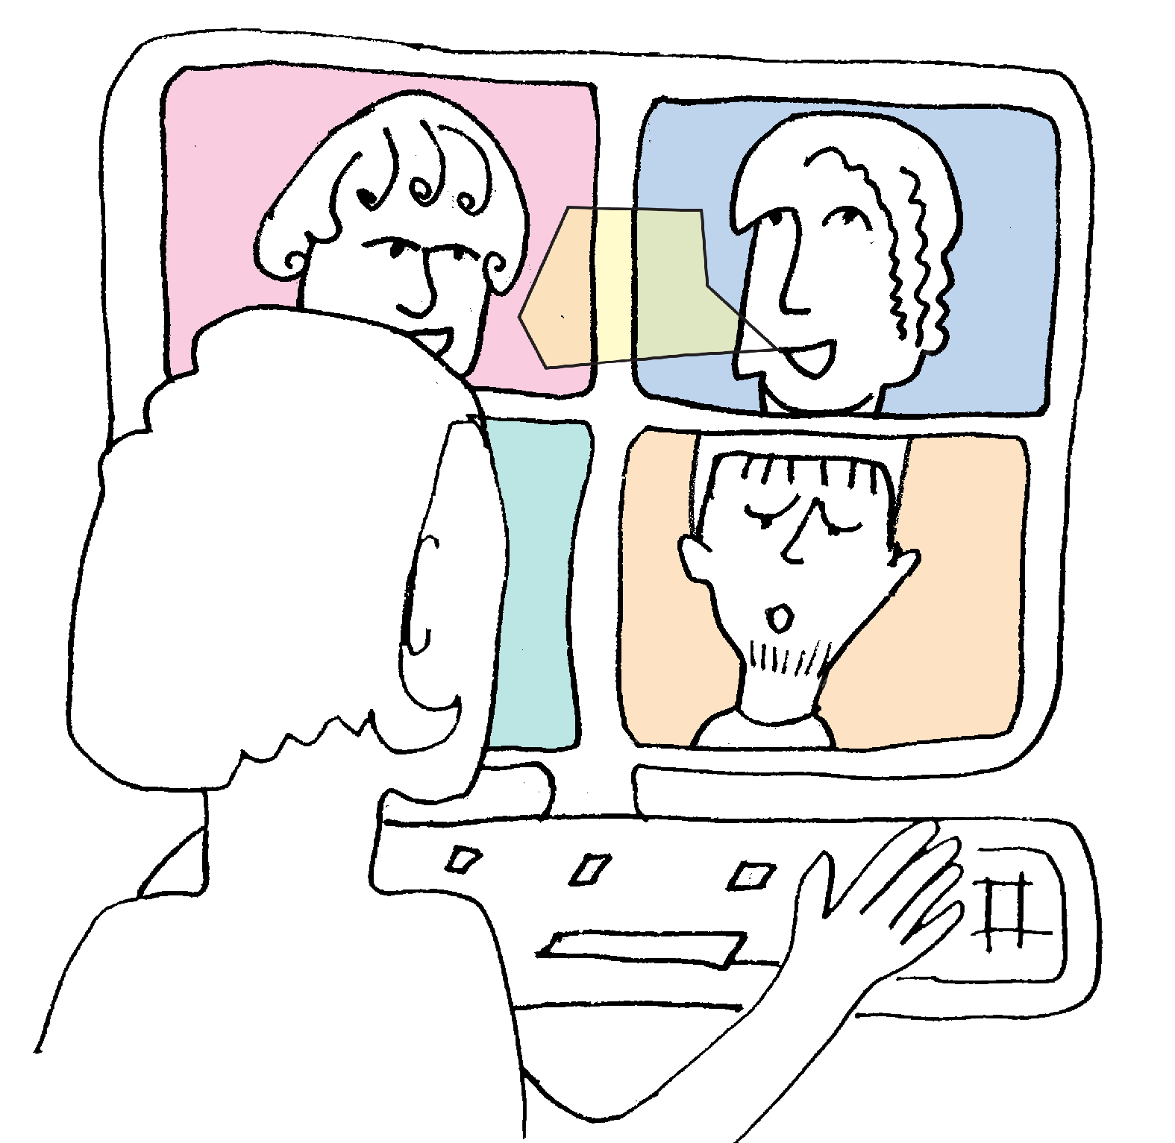
  THE HERITAGE AND NETWORKING
Heritage - importance for the sense and functioning of place
Heritage shapes how people identify with the places they live, work and play. Yet a role for heritage is frequently missing in conversations and plans for how we want places to develop into the future.
At a time when government is devolving more power to cities and local authorities, heritage must be seen as a fundamental place differentiator: a strategic asset that enriches the social and economic potential of places across the COUNTRY.
Heritage assets and heritage activities play a fundamental role in reshaping our landscapes, cityscapes and identities. Our research explains how citizens, organisations, businesses and different tiers of government can use the potential of heritage to sustain distinct local identities and support places to thrive and prosper.
It is recommended that heritage organisations, large and small, become more open and better connected – both within and between organisations; within and beyond the heritage sector. This will help proactive heritage citizens to become heritage creators, participants and collaborators in the management and use of heritage – something that is already evident in many countries. We want to see a broad, inclusive and dynamic heritage model that delivers valuable, visible social impact. This is called “networked heritage”.

Slide 9
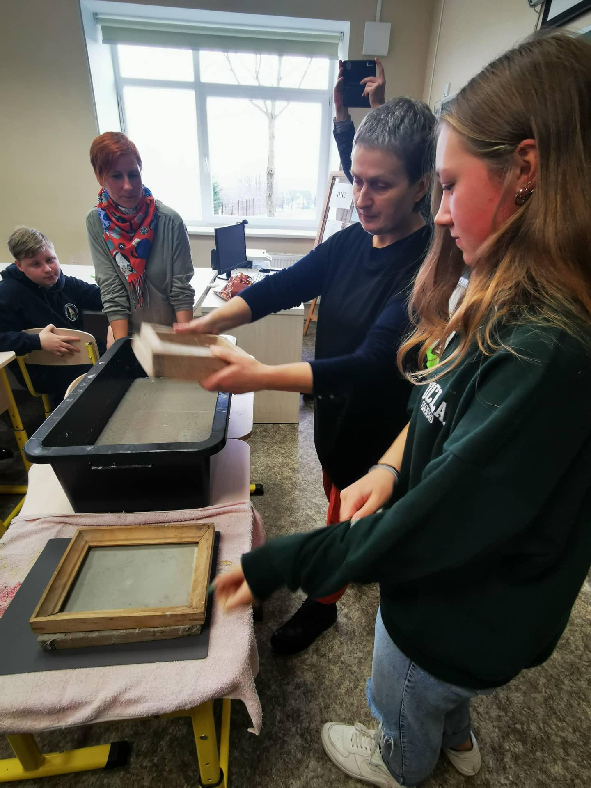
  Best practice
Example 1 of creative workshops for youth, involving cultural heritage at Children's summer creative camp "I draw Lithuania"
The issue of employment of surrounding rural communities, school-age children and especially youth, during the summer holidays always remains very relevant.
The “Melkis” village eco-community association decided to undertake a project that would ensure children a meaningful vacation in nature and provide new long-term impressions and skills. It was also intended to bring together neighbouring multi-ethnic communities for one goal - to get to know each other, reveal cultural commonalities and differences, and develop love for their country and its culture. Most of the activities were carried out on a voluntary basis.

Slide 10
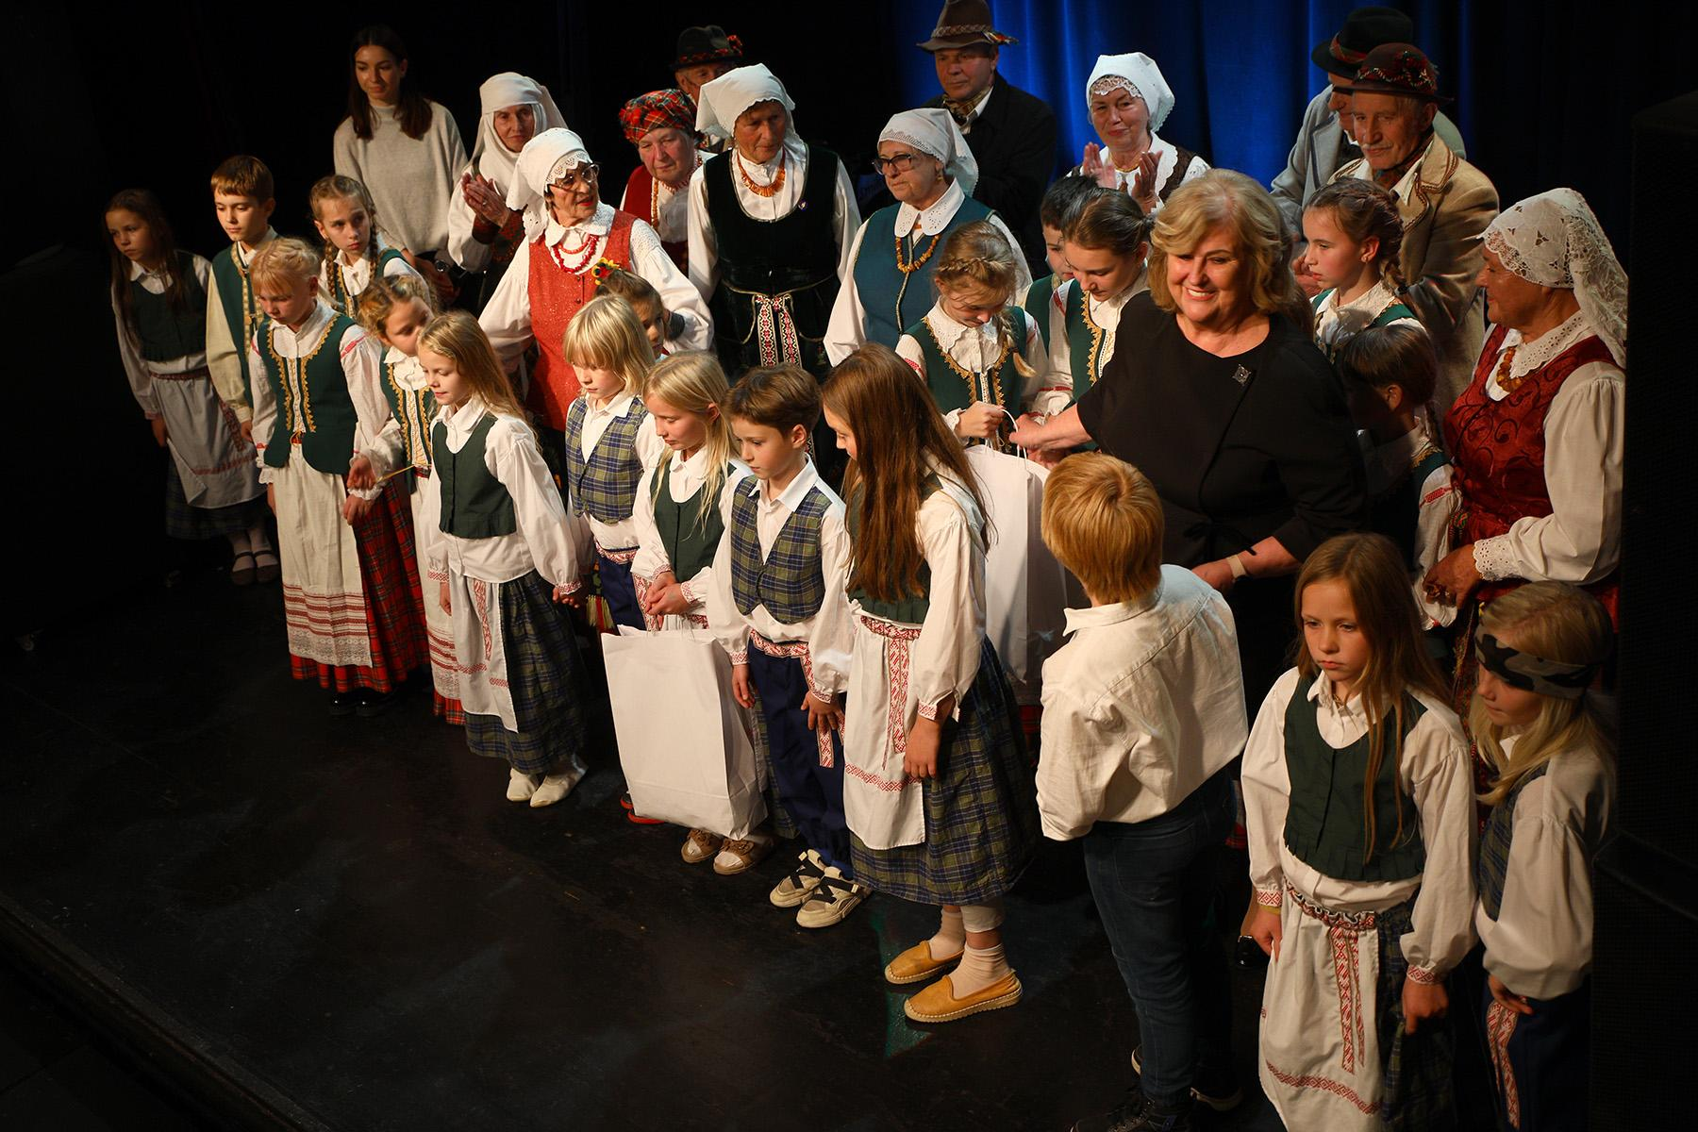
  Best practice
Example 2 of creative workshops for youth, involving cultural heritage in Children's summer creative camp "I draw Lithuania"
The main goal of the project "Children's Summer Creative Plein Air "Meadow Plants - a Source of Creativity" is to develop an understanding of the culture of nearby ethnic communities, the personal and social mutual responsibility of the plein air participants, to form benevolent communication skills and to get acquainted with the world of plants and means of artistic expression.
The plein air was dedicated to the 100th anniversary of the birth of Eugenija Šimkūnaitė, a habilitated doctor of biological sciences. E. Šimkūnaitė studied and scientifically described medicinal plants, was able to compare the experience of Lithuanian herbalism and folk medicine. Dr. E. Šimkūnaitė devoted her entire life to the study of medicinal plants, folk medicine, and local history. Therefore, the proposed theme of the plein air is "Meadow Plants - a Source of Creativity". In this way, the aim is to encourage Lithuanian society to become interested in medicinal plants, folk medicine, discover the benefits of art therapy by drawing nature, and delve into a variety of drawing and other artistic representation techniques (paper cutting, embroidery, and others).

Slide 11







2023-1-EE01-KA220-ADU-000150753
Thank you for your attention
PARTNERS
Funded by the European Union. Views and opinions expressed are however those of the author(s) only and do not necessarily reflect those of the European Union or Estonian National Agency. Neither the European Union nor the granting authority can be held responsible for them.

