Slide 1



2023-1-EE01-KA220-ADU-000150753
TRAINING PROGRAMME
LEARNING UNIT 6: Networking
Funded by the European Union. Views and opinions expressed are however those of the author(s) only and do not necessarily reflect those of the European Union or Estonian National Agency. Neither the European Union nor the granting authority can be held responsible for them.

Slide 2
LESSON 2: Heritage and networking as civic benefits

Slide 3
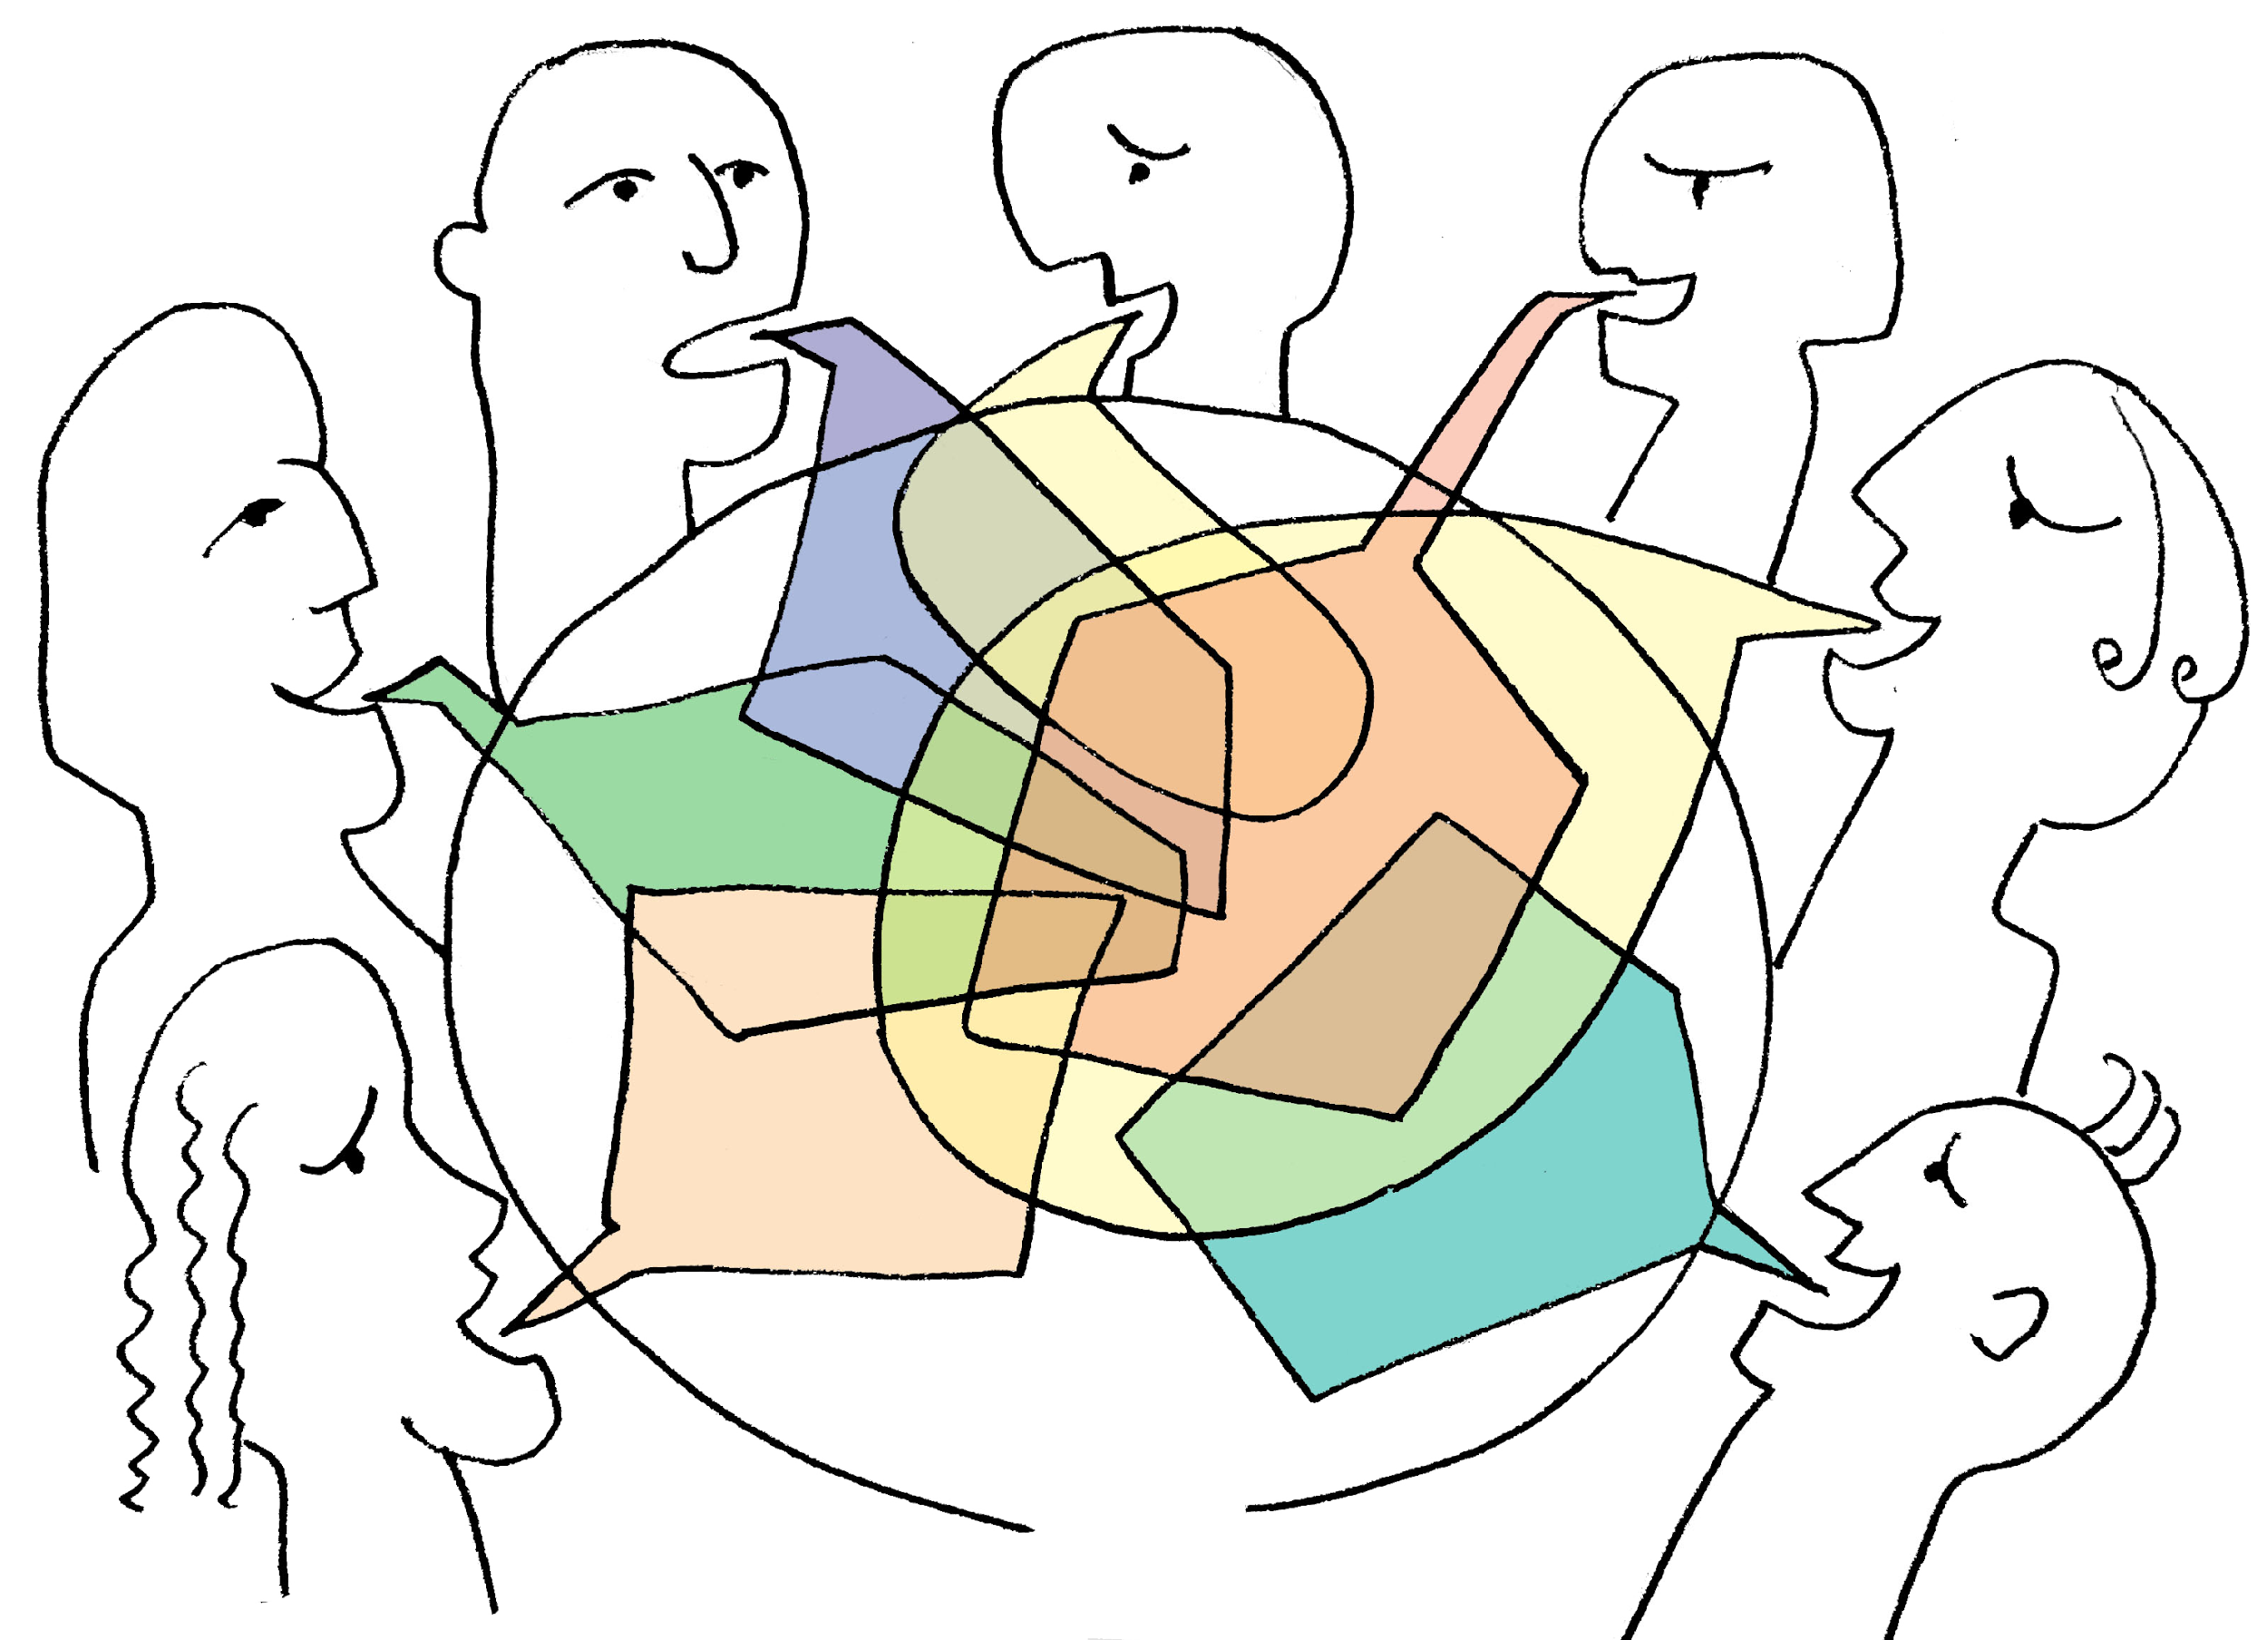
  Activity: EXERCISE “SOCIAL CAFE" METHOD
Objective: a method which makes use of an informal cafe setting for participants to explore an issue by discussing it in small table groups.
A Philosophy of „Social Café“ has provided a safe, neutral space for different communities to share information about their beliefs in relation to themes decided by local residents.
Materials Needed: Handouts, internet access, projector and screen, paper, teoretical content if necessary
Method explanation: „A Social Cafe“ is a structured conversational process for knowledge sharing in which groups of people discuss a topic at several small tables like those in a cafe. Some degree of formality may be retain to make sure that everyone gets a chance to speak. Although pre-defined questions should be agreed upon at the beginning, outcomes or solutions are not decided in advance. The assumption is that collective discussion can shift people's conceptions and encourage collective action Events need to have at least twelve participants, but there is no upper limit.

Slide 4
  Activity: EXERCISE “SOCIAL CAFE" METHOD
To play Social Cafe, organize the entire group of players into smaller groups of three or four members. Then, assign each group a specific topic to discuss or problem to solve. This might be a concept that relates to networking a hypothetical scenario or a question about personal experience. After each group has a topic of conversation, allow 20 minutes for group discussions to take place.
Once the time ends, instruct players to mix up their groups and sit with different people, then repeat the process as many times as you want to allow players to get to know everyone taking part.

Slide 5

  Discussion and Reflection
Questions for Group Discussion:
What measures might be taken at the individual, community, or governmental level to guarantee the sustainability of heritage sites?
2. What methods can be used to leverage technologies for heritage preservation and protection .
3. What should be the relationship between communities and state institutions in creating and promoting heritage value.
Please summarize the main points in this lesson.

Slide 6
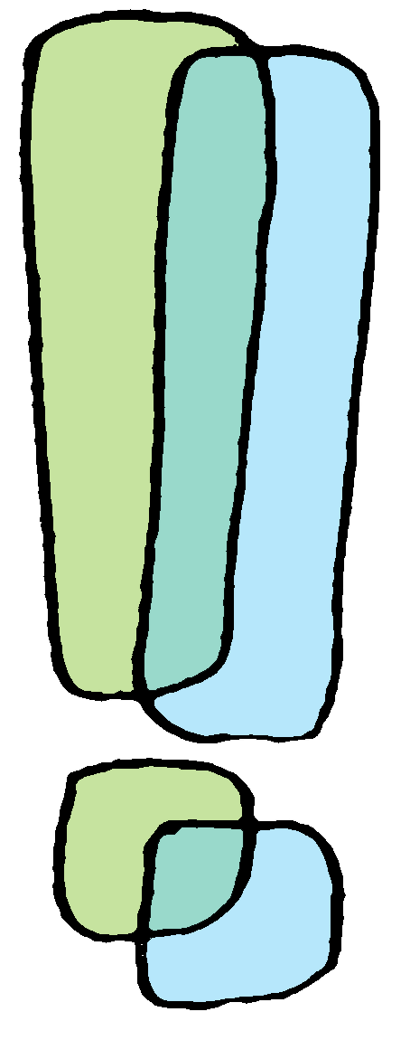
  Discussion and Reflection
Conclusions:
The aim of this presentation is to familiarize with the concept of heritage, to explore the significance of ethno-cultural and natural heritage, highlighting their role in shaping the collective identity of regions, preserving historical and environmental context.
The learners understood that the preservation of valuable heritage sites and traditions for future generations depends on the implementation of sustainable practices in building connections between community members and with other communities.
Learners presented creative works that highlighted the problems faced by their chosen heritage sites and proposed thoughtful and realistic solutions. They demonstrated an understanding of how challenges such as lack of communication between community members, lack of connections between different generations, different social classes and ethnic communities, and lack of awareness can affect heritage preservation.
Without sustainable practices, there is a high risk that heritage areas will not develop further, will degrade or even disappear.

Slide 7







2023-1-EE01-KA220-ADU-000150753
Thank you for your attention
PARTNERS
Funded by the European Union. Views and opinions expressed are however those of the author(s) only and do not necessarily reflect those of the European Union or Estonian National Agency. Neither the European Union nor the granting authority can be held responsible for them.

