Slide 1



2023-1-EE01-KA220-ADU-000150753
TRAINING PROGRAMME
LEARNING UNIT 6: Networking
Funded by the European Union. Views and opinions expressed are however those of the author(s) only and do not necessarily reflect those of the European Union or Estonian National Agency. Neither the European Union nor the granting authority can be held responsible for them.

Slide 2
LESSON 2: Heritage and networking as civic benefits

Slide 3
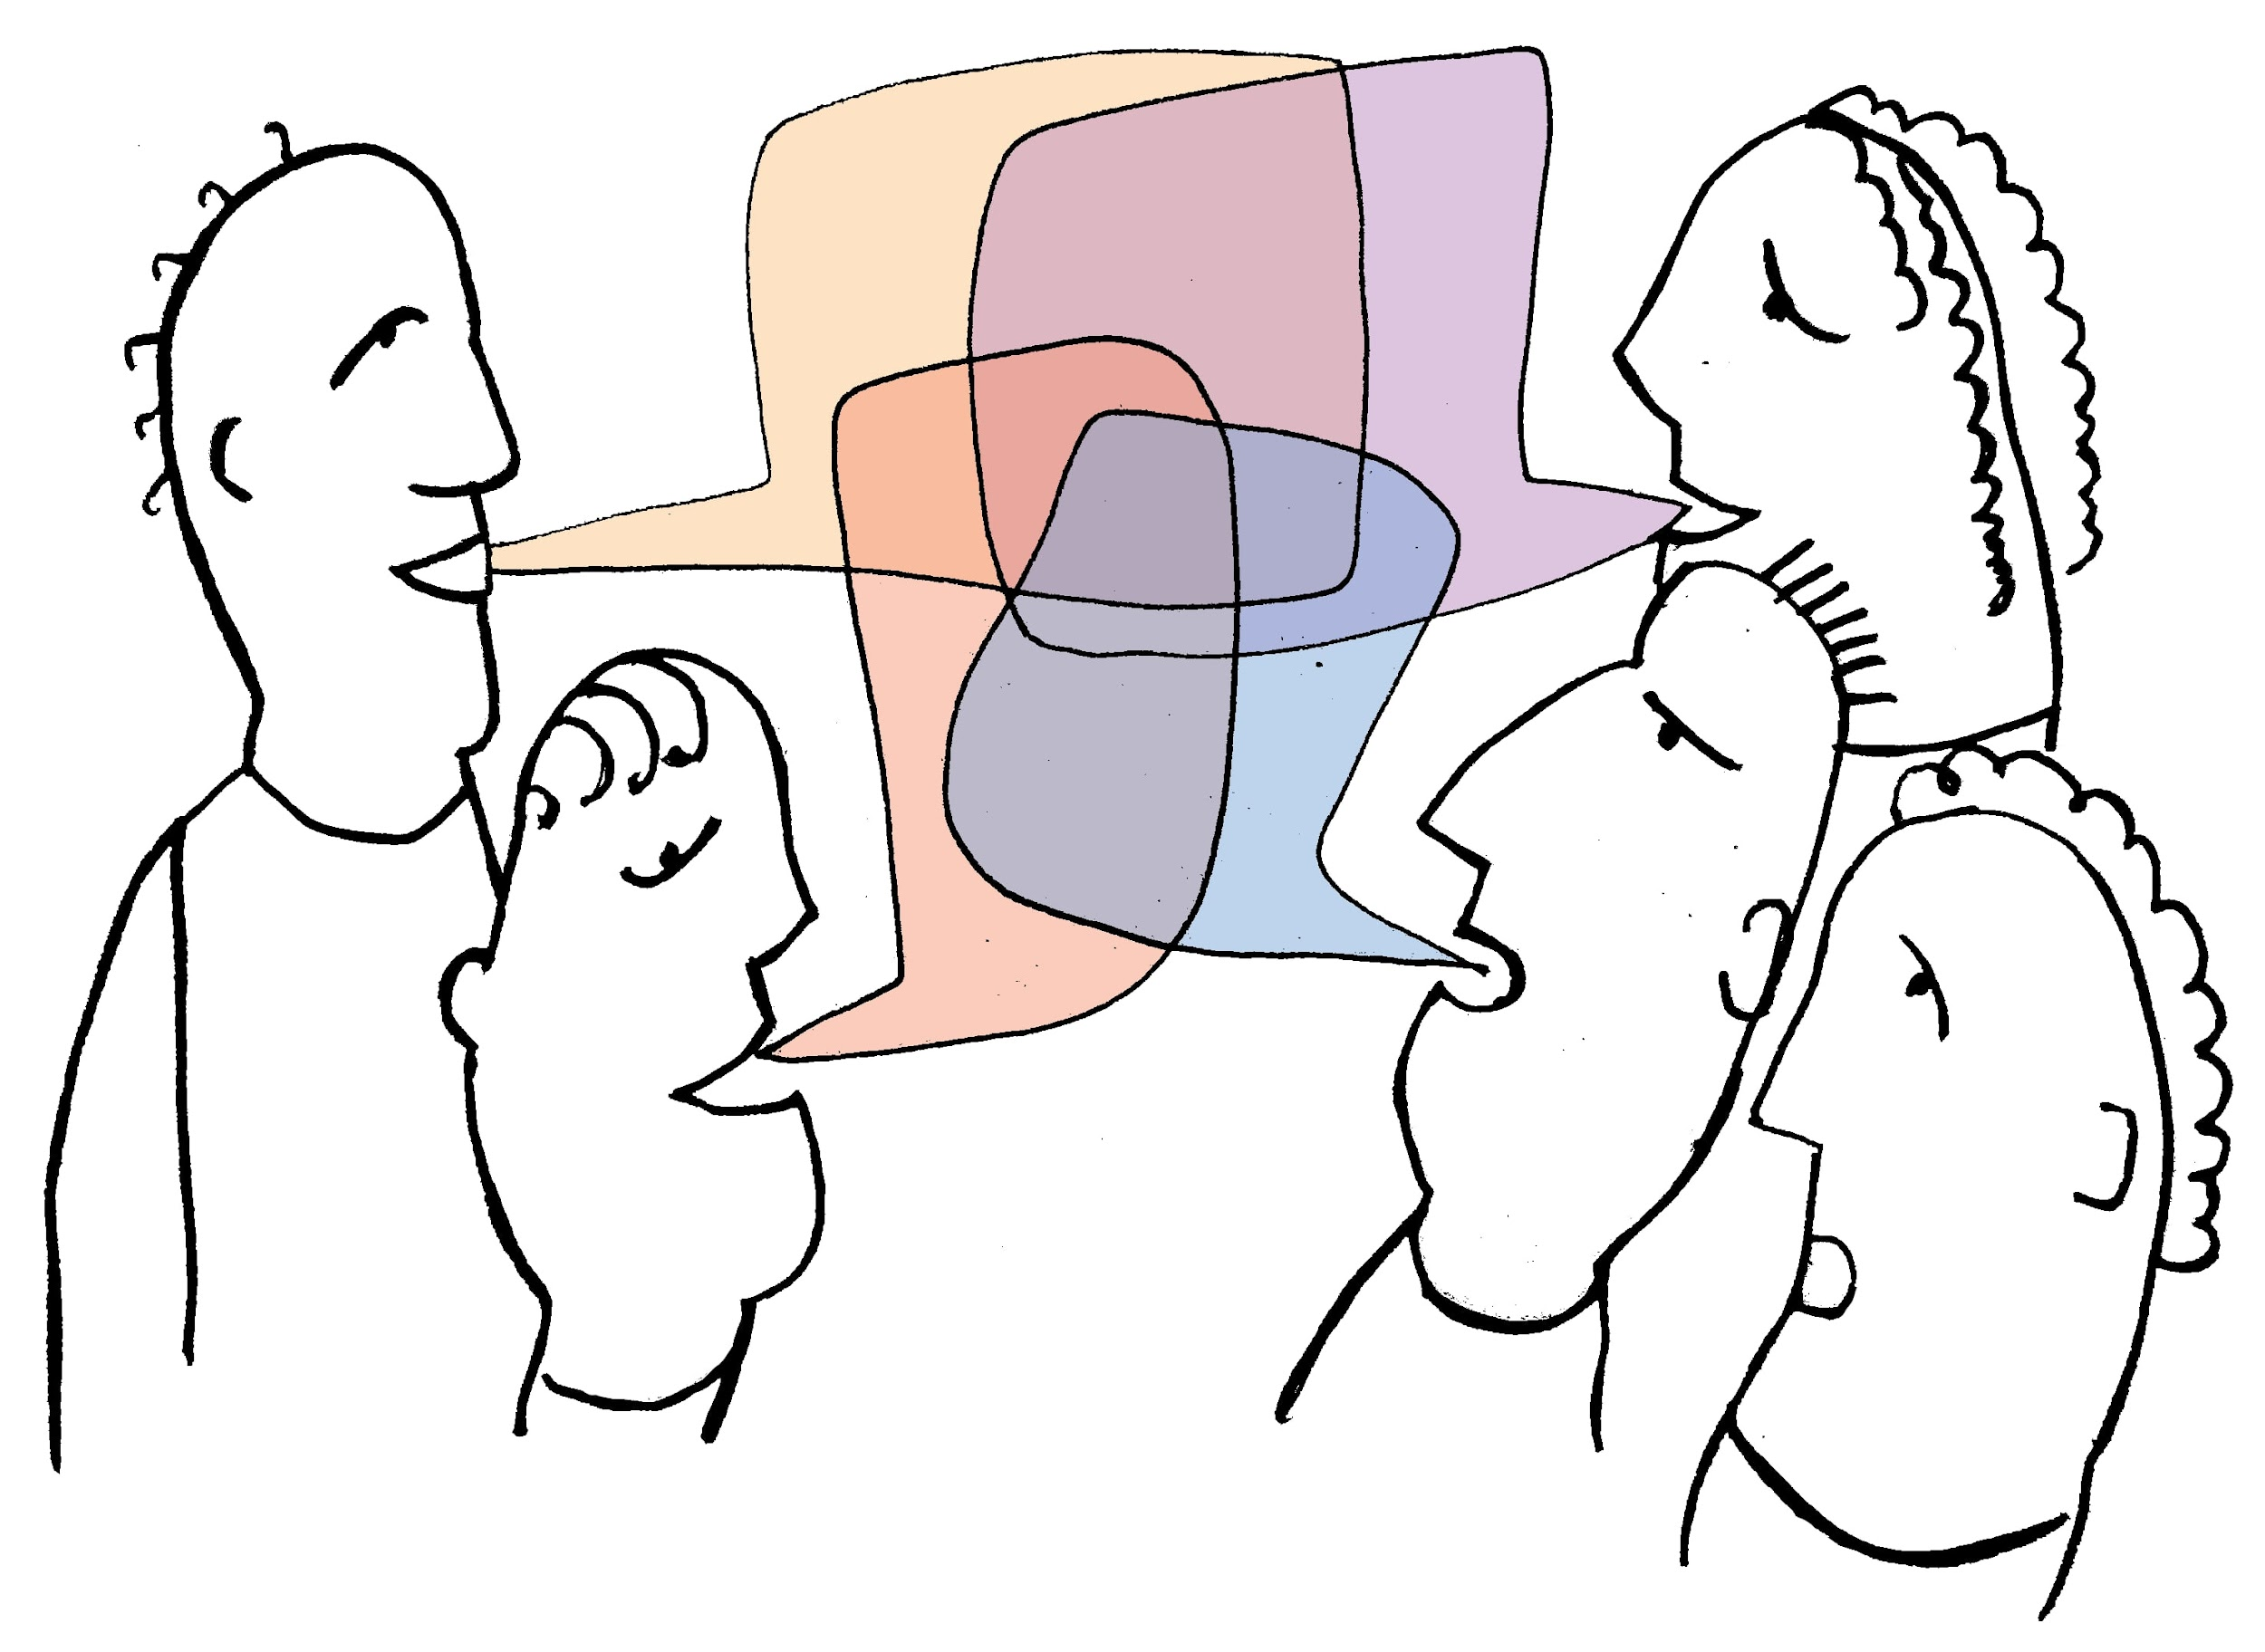
  CREATIVE POTENTIAL OF COMMUNITIES AND CITIZENS
  USING LOCAL HERITAGE
Heritage definition
Heritage - features belonging to the culture of a particular society, such as traditions languages, art,or buildings, that were created in the past and still have historical importance.
Heritage - the traditions, values, cultural practices, and artefacts that are passed down from previous generations.
Cultural heritage is the heritage of tangible and intangible heritage assets of a group or society that is inherited from past generations.

Slide 4

  CREATIVE POTENTIAL OF COMMUNITIES AND CITIZENS
  USING LOCAL HERITAGE
Principles for networked heritage
Start with People.
Embed your work where people live daily life.
Heritage is what you choose to make it.
Use assets in new ways and identify new assets.
Go beyond yesterday’s battles.
Make the offer, rather than the ask.
Open up and lead the change.
Think critically about power and leadership.
Help make heritage your local USP.
And don’t rely on a strategy.

Slide 5
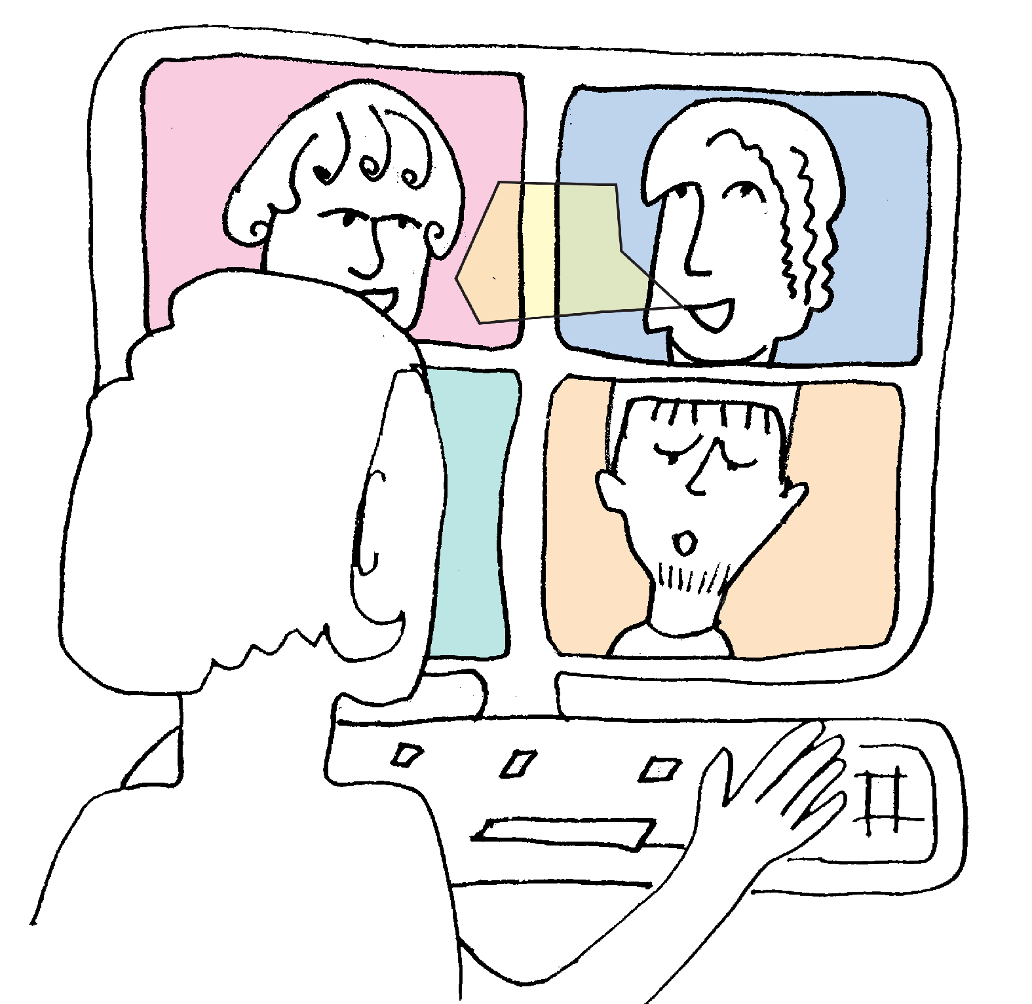
  CREATIVE POTENTIAL OF COMMUNITIES AND CITIZENS
  USING LOCAL HERITAGE
Locally extensive and collaborative networks
Networked heritage means that organisations are linked to the everyday structures that determine the functioning of a place; for example, those related to planning consultation, neighbourhood planning, adult education provision, employment support, youth services and local media activities.
At a local level, deep, broad and collaborative networks help projects and organisations achieve more than they could alone. Such networks are strengthened when heritage activists, volunteers and community leaders have a voice and influence in the decisions of professionalised institutions.

Slide 6

  CREATIVE POTENTIAL OF COMMUNITIES AND CITIZENS
  USING LOCAL HERITAGE
Networks between heritage organizations
The concept of networked heritage corresponds to the reality that we hold personal identities at different scales, belong to networks, and feel associations at different levels.
Neighbourhoods are the building blocks that make up a town, the site of everyday institutions and our personal history. We are simultaneously ‘local’ on the street we live on and citizens of wider communities. And it is at the urban and regional scale – by extension rural areas – that we share cultural experiences, civic amenities and acquire a lived economic logic that dominates the development of places.

Slide 7
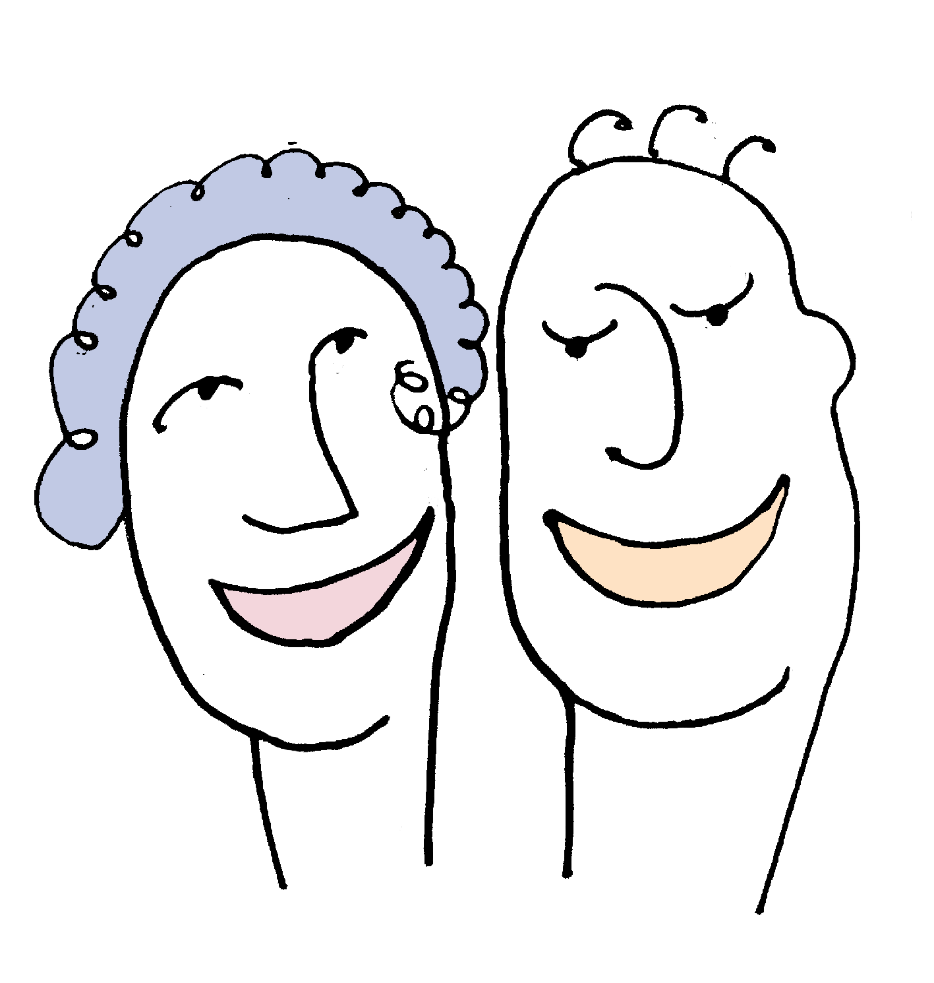
  LOCAL CULTURAL HERITAGE - PLACE AND AUTHENTICITY
Broader and deeper civic engagement
Broader and deeper civic engagement, bringing disengaged communities together to have an influence over how the memory of their local area is taken forward; and at its most ambitious, creating a sense of meaning, belonging and healing social divides.
Achievement of social outcomes in heritage settings, such as improving learning outcomes in schools, or offering heritage activities as social prescriptions for social isolation or poor mental health.

Slide 8
  LOCAL CULTURAL HERITAGE - PLACE AND AUTHENTICITY
Networked heritage
Networked heritage means having sufficient connections on the ground so that heritage is understood and treated as a shared public resource, supported and enhanced by the full diversity of citizens and organisations.
The role of the heritage sector will still include facilitating access to heritage assets, but it is by empowering others to integrate heritage into their thinking and actions that networked heritage can have a transformative impact on people and places, helping communities create heritage for themselves.
The heritage sector needs to have a clear understanding of what factors lead to success, the necessary tools to attract the attention of local authorities and the support of national institutions. Networked heritage is an excellent tool to overcome these challenges.
There are also benefits to be gained from networked heritage at a national level. Many national heritage organisations have regional offices but lack the capacity to engage in local dialogue with other national organisations in those cities and counties.

Slide 9
  HERITAGE CONTRIBUTION
  SHAPING PLACE-BASED IDENTITY
Strengthening community and local identity
Without local heritage, the local product can only be shared, not individualized. This includes differences between generations, between national groups, between different religious groups, and so on. The contribution that citizens can make by creating connections as an added value is significant.
The contribution of official institutions is necessary. And providing real support for the promotion of informal networks and cooperation should in itself be considered a transformative local development strategy that relies on the contribution of various segments of society.
Our lived experience of material reality in the places we live, and our connection to those who lived there before, is a deep and powerful bond. Strengthening community and place identity in newly created community territories is a vital contribution to the successful development of the country.

Slide 10
  HERITAGE CONTRIBUTION
  SHAPING PLACE-BASED IDENTITY
The potential for heritage transfer
The potential for networked heritage is crucial in the context of decentralisation. Decentralisation requires a networked heritage to fulfill the promise of enabling places to make locally informed decisions about their future and to create a stronger local identity.
The transfer of powers from central government to local government and the creation of new connected authorities means that citizens of city-regions or rural areas are entering a new identity – a new geography of governance in many local communities.
Because you can’t take politics out of heritage decisions, communities need to ensure that the politics of heritage decision-making are active and inclusive. For heritage groups and organisations, this means that political activism needs to be achieved everywhere, from the places where people live to the schools and communities where people live.In an era of increasing global competition for people and investment, local distinctiveness becomes essential.

Slide 11
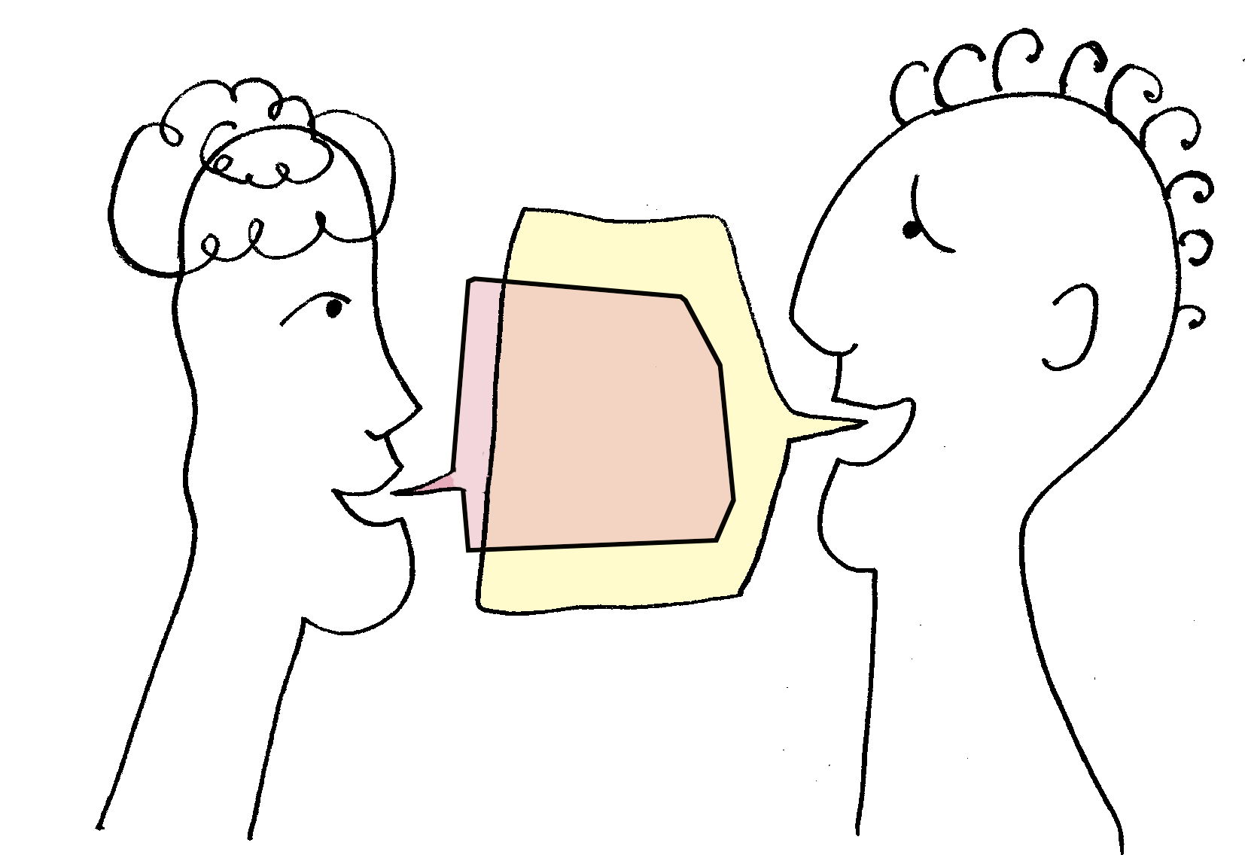
  Best practices
Creative workshops
To mark the International Eldery Day, Third Age University (U3A) in Vilnius with Moletai local community invited the Vilnius university's young students to celebrate Eldery day together and participate in a very specific "brainstorming session".
Need to be noted that Lithuanian territory is divided into five ethnographic regions: Aukštaitija (Highlands), Žemaitija (Samogitia), Dzūkija, Suvalkija and Lithuania Minor with a slightly different dialect, specific food, customs, different national costume elements, songs, proverbs, ect.
Four mixed teams of youth and seniors were formed. The questions were prepared in advance and asked to both teams. It was fun to watch how the young people could not guess what the proverb or what the ancient dialect words meant. Not everyone could sing old ethnographic Lithuanian songs. On the other hand, seniors could not guess modern singers and their songs and words‘abbreviations used by youth. It was very fun and interesting.
All participants concluded that generations need to communicate and cooperate to better understand each other, not to forget their roots,local heritage, and to preserve the identity of their people.

Slide 12







2023-1-EE01-KA220-ADU-000150753
Thank you for your attention
PARTNERS
Funded by the European Union. Views and opinions expressed are however those of the author(s) only and do not necessarily reflect those of the European Union or Estonian National Agency. Neither the European Union nor the granting authority can be held responsible for them.

