Slide 1
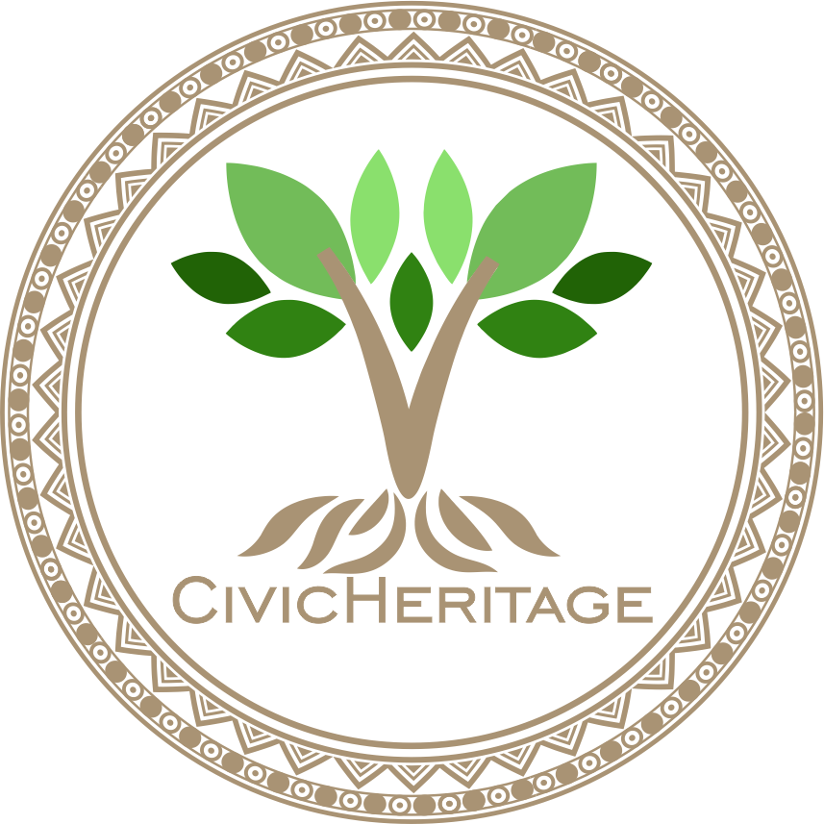


2023-1-EE01-KA220-ADU-000150753
TRAINING PROGRAMME
LEARNING UNIT 7: Digital Competencies
Funded by the European Union. Views and opinions expressed are however those of the author(s) only and do not necessarily reflect those of the European Union or Estonian National Agency. Neither the European Union nor the granting authority can be held responsible for them.

Slide 2
LESSON 1: Introduction to Digital Tools for Heritage Documentation

Slide 3
Interactive Activity: Exploring Heritage Sites with Google Earth
Objective:
Use Google Earth to explore and document a local heritage site.
Learn how to annotate the significance of cultural, historical, or ecological sites.
Materials Needed:
Computers or tablets with Google Earth (or access to the web version).
Local heritage sites to explore
Procedure:
Open Google Earth and search for a local heritage site or use the site suggested by your instructor.
Zoom in to explore the site in detail, using the available tools.
Add annotations to the site, describing its historical, cultural, or ecological significance. You can include any interesting facts or details you find important.
Share your findings with the group, discussing what you learned and how digital tools like Google Earth can help document and preserve heritage.

Slide 4
Interactive Activity: Reflection
Objective:
Reflect on how digital tools like Google Earth can be used to engage with and preserve heritage.
Materials Needed:
Discussion prompts (provided by the instructor).
Procedure / Reflection:
Write a short reflection on how you can use digital tools like Google Earth in your own work or community projects.

Slide 5
Discussion and Reflection
Questions for Group Discussion:
How can digital tools help engage communities in preserving heritage?
What are the barriers to using digital tools for heritage documentation, especially in disadvantaged communities?
In what ways can digital storytelling influence public understanding of local heritage?
How might the use of GIS mapping or Google Earth enhance a community’s connection to its heritage sites?
What are some ethical considerations when using digital tools for cultural and natural heritage documentation?
How can digital platforms help reach younger generations in heritage preservation efforts?
Conclusion:
Digital tools offer innovative ways to document, share, and preserve heritage, but their application must be mindful of local contexts and community needs.
Engaging with digital storytelling and mapping can foster a deeper connection between individuals and their cultural heritage.
Challenges remain, but with collaboration and creativity, digital tools can play a key role in sustainable heritage preservation.

Slide 6







2023-1-EE01-KA220-ADU-000150753
Thank you for your attention
PARTNERS
Funded by the European Union. Views and opinions expressed are however those of the author(s) only and do not necessarily reflect those of the European Union or Estonian National Agency. Neither the European Union nor the granting authority can be held responsible for them.

