Slide 1
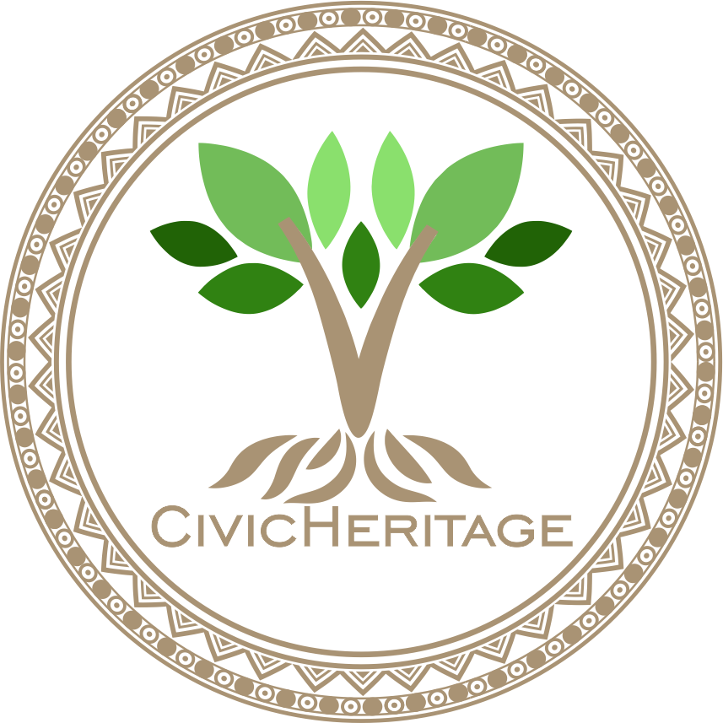
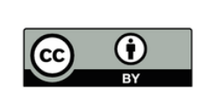

2023-1-EE01-KA220-ADU-000150753
TRAINING PROGRAMME
LEARNING UNIT 7: Digital Competencies
Funded by the European Union. Views and opinions expressed are however those of the author(s) only and do not necessarily reflect those of the European Union or Estonian National Agency. Neither the European Union nor the granting authority can be held responsible for them.

Slide 2
LESSON 1: Introduction to Digital Tools for Heritage Documentation

Slide 3
Introduction to Digital Tools for Heritage Documentation
How Technology Can Help Preserve Our Heritage
Objectives of the course:
Learn how digital tools can preserve cultural and natural heritage.
Explore tools like Google Earth, Canva, and GIS Mapping.
Understand how these tools help make heritage sites more accessible and engaging.
The outcome: create a simple digital project to showcase cultural and natural heritage.
Digital tools play a crucial role in preserving cultural and natural heritage for future generations.
These tools help document, preserve, and share heritage in new, interactive ways.
In this lesson, we will explore Google Earth, Canva, and GIS Mapping, and understand how they support heritage education and preservation.

Slide 4
What is Google Earth? - Exploring Heritage Sites Worldwide
Mapping Heritage Sites
Mapping and Visualizing Cultural Heritage
Google Earth is a digital mapping tool that allows you to explore the world virtually.
You can view satellite images, 3D models, and maps of historical landmarks, cultural sites, and natural features.
Google Earth enables users to annotate and share information about these sites, creating virtual tours that educate others about their significance.
It helps document heritage sites by mapping their locations, offering a broader view of the global heritage landscape.

Slide 5
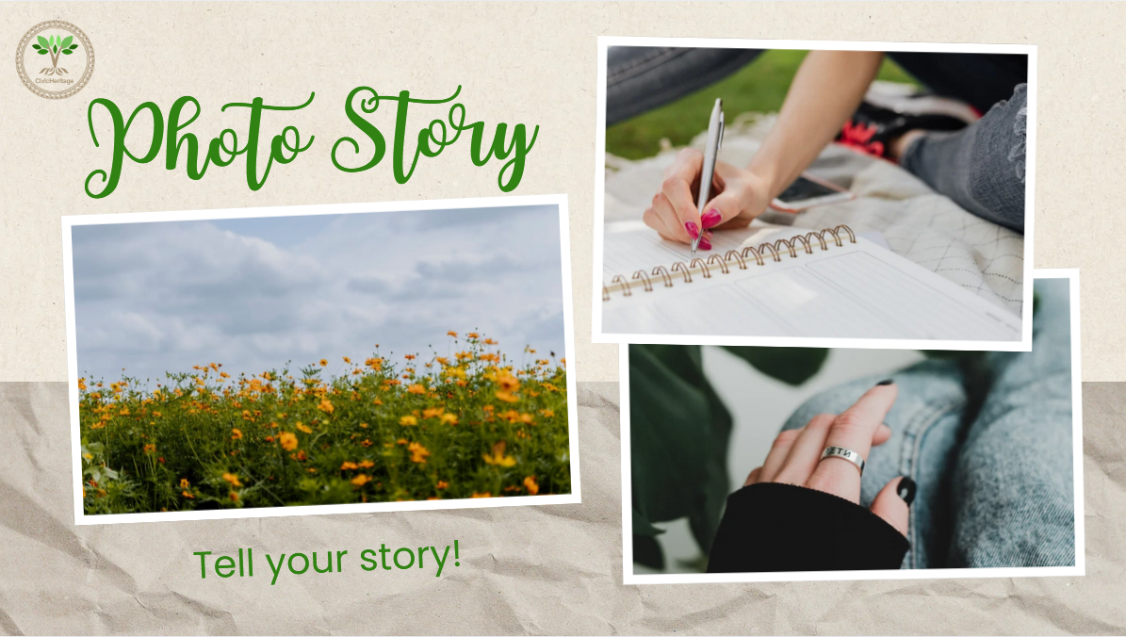
What is Canva? Visual Storytelling with Digital Design
Making Heritage Stories Accessible and Engaging
Canva is a graphic design tool that allows users to create visually appealing content such as posters, photo stories, and presentations.
You can combine images, text, and design elements to tell a compelling story about cultural or natural heritage.
It’s easy to use and allows non-designers to create professional-looking materials that can help share the stories and significance of heritage sites or traditions.
Visual storytelling using tools like Canva helps engage a wider audience, including younger generations, by making heritage content more interactive and visually stimulating.

Slide 6
What is GIS Mapping? Understanding Heritage in Space
Using Geographic Information Systems for Heritage Preservation
GIS (Geographic Information Systems) is a tool that maps data and helps analyze the spatial relationships between cultural and natural heritage sites.
GIS maps provide a detailed view of heritage locations and their surrounding environment, helping researchers and educators understand how heritage sites interact with their surroundings.
It can be used to track changes over time, identify patterns, and plan for the conservation of sites by overlaying different data layers (e.g., historical maps, current land use, environmental data).

Slide 7
Digital Archives and Multimedia for Heritage Preservation
Preserving and Sharing Heritage through Technology
Digital archives store digital versions of cultural materials (e.g., books, photos, audio recordings, videos), making them accessible to a wider audience.
Multimedia tools, like videos, podcasts, and interactive maps, are used to bring heritage to life by combining various forms of media.
These tools allow for deeper engagement, providing audiences with an immersive experience of heritage that goes beyond traditional methods of learning.
Digital archives and multimedia platforms make heritage available online, accessible to anyone, anywhere, while preserving it for the future.

Slide 8
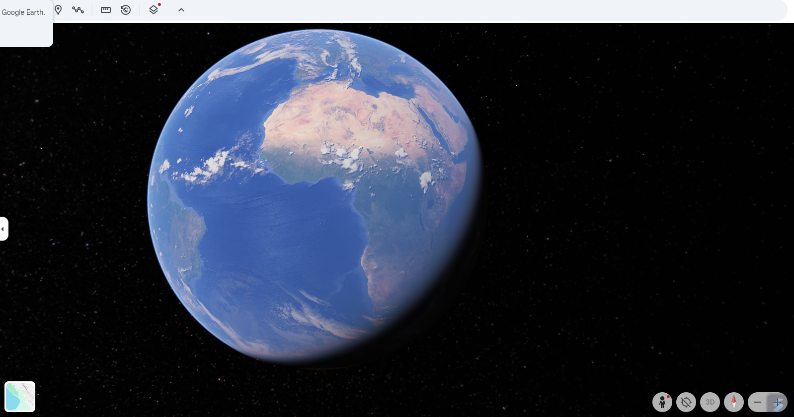
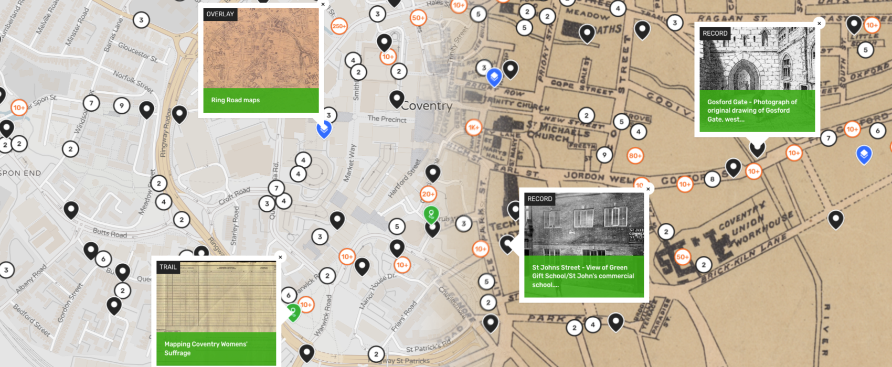
Practical Application of Digital Tools in Heritage Projects
Bringing Heritage to Life through Technology
Use tools like Google Earth, Canva, and GIS to create your own digital projects related to cultural and natural heritage.
These projects might include creating heritage maps, photo stories, or multimedia presentations that highlight the significance of local heritage.
By using digital tools, you can contribute to preserving and sharing heritage, making it accessible to a broader audience and future generations.
https://earth.google.com/web

Slide 9
Best practice on GIS-Based Heritage Documentation in Kavala, Greece
A Case Study on the Saint John the Baptist Historical Complex
Overview: The GIS-based heritage documentation project in Kavala, Greece, focuses on mapping and analyzing the Saint John the Baptist Historical Complex.
Method: The project used GIS tools to create detailed maps, 3D models, and overlays of historical and current data to understand the evolution of the site.
Impact: GIS enabled the documentation of the architectural and cultural significance of the complex, supporting conservation efforts and making the heritage site more accessible to the public.
Key Takeaways:
GIS allows for better visualization and analysis of heritage sites.
Helps identify preservation needs and track changes over time.
Community involvement and collaboration with local experts played a significant role in the project.

Slide 10







2023-1-EE01-KA220-ADU-000150753
Thank you for your attention
PARTNERS
Funded by the European Union. Views and opinions expressed are however those of the author(s) only and do not necessarily reflect those of the European Union or Estonian National Agency. Neither the European Union nor the granting authority can be held responsible for them.

