Slide 1
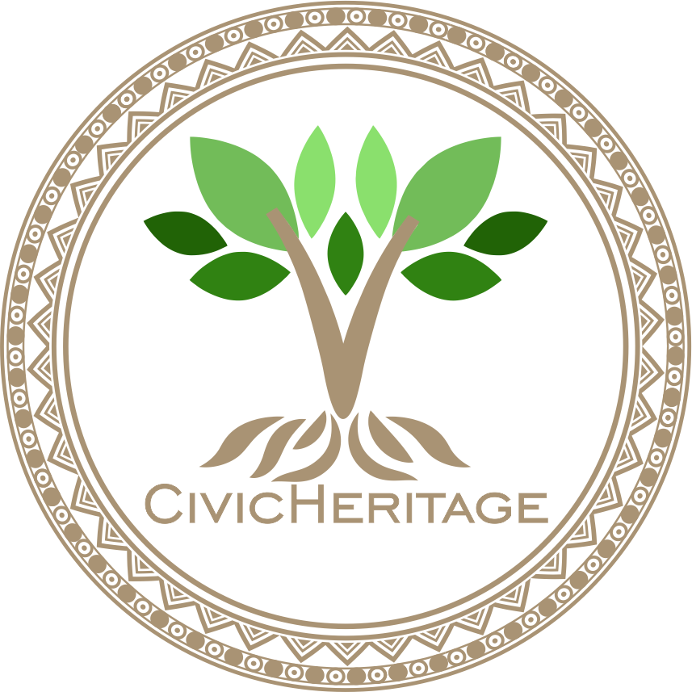


2023-1-EE01-KA220-ADU-000150753
TRAINING PROGRAMME
LEARNING UNIT 7: Digital Competencies
Funded by the European Union. Views and opinions expressed are however those of the author(s) only and do not necessarily reflect those of the European Union or Estonian National Agency. Neither the European Union nor the granting authority can be held responsible for them.

Slide 2
LESSON 2: Digital Storytelling for Heritage Promotion

Slide 3
Introduction to Digital Tools for Heritage Documentation
Introduction to Digital Storytelling for Heritage Promotion
Objectives of the course:
Learn how digital tools can preserve cultural and natural heritage.
Explore tools like Canva, Clipchamp, and online resources for creating engaging stories.
Understand how digital storytelling enhances accessibility and community pride.
Outcome: Create a simple digital storytelling project showcasing heritage.
Digital storytelling plays a crucial role in preserving cultural and natural heritage for future generations. By integrating multimedia elements, such as visuals, audio, and narratives, we can document, share, and celebrate heritage in new, interactive ways.
In this lesson, we will explore tools like Canva, Clipchamp, and various online platforms to understand their potential for education and preservation.

Slide 4
What is Digital Storytelling?
Mapping Heritage Sites
Transforming Heritage Narratives into Engaging Digital Experiences
Digital storytelling is the art of combining multimedia elements such as visuals, audio, and narrative to craft compelling stories. It provides an innovative way to share knowledge, culture, and traditions.
Key Features:
Integrates multimedia tools like videos, images, and audio.
Focuses on audience engagement through emotional and visual impact.
Makes cultural and natural heritage accessible to wider audiences.

Slide 5
Principles of Digital Storytelling
Core Principles of Digital Storytelling
Narrative Structure: Start with a strong introduction, build a meaningful story, and conclude with a clear message.
Visual Appeal: Use striking images or videos to grab attention and complement the story.
Emotional Connection: Engage the audience emotionally through relatable themes or personal anecdotes.
Practical Tip: Balance all elements to create a cohesive and impactful story.

Slide 6
Benefits of Digital Storytelling for Heritage Promotion
Why Digital Storytelling?
Preservation: Helps document and conserve cultural and natural heritage.
Accessibility: Makes heritage more accessible to diverse audiences.
Engagement: Encourages community participation and pride.
Education: Serves as an educational tool to promote heritage awareness.

Slide 7

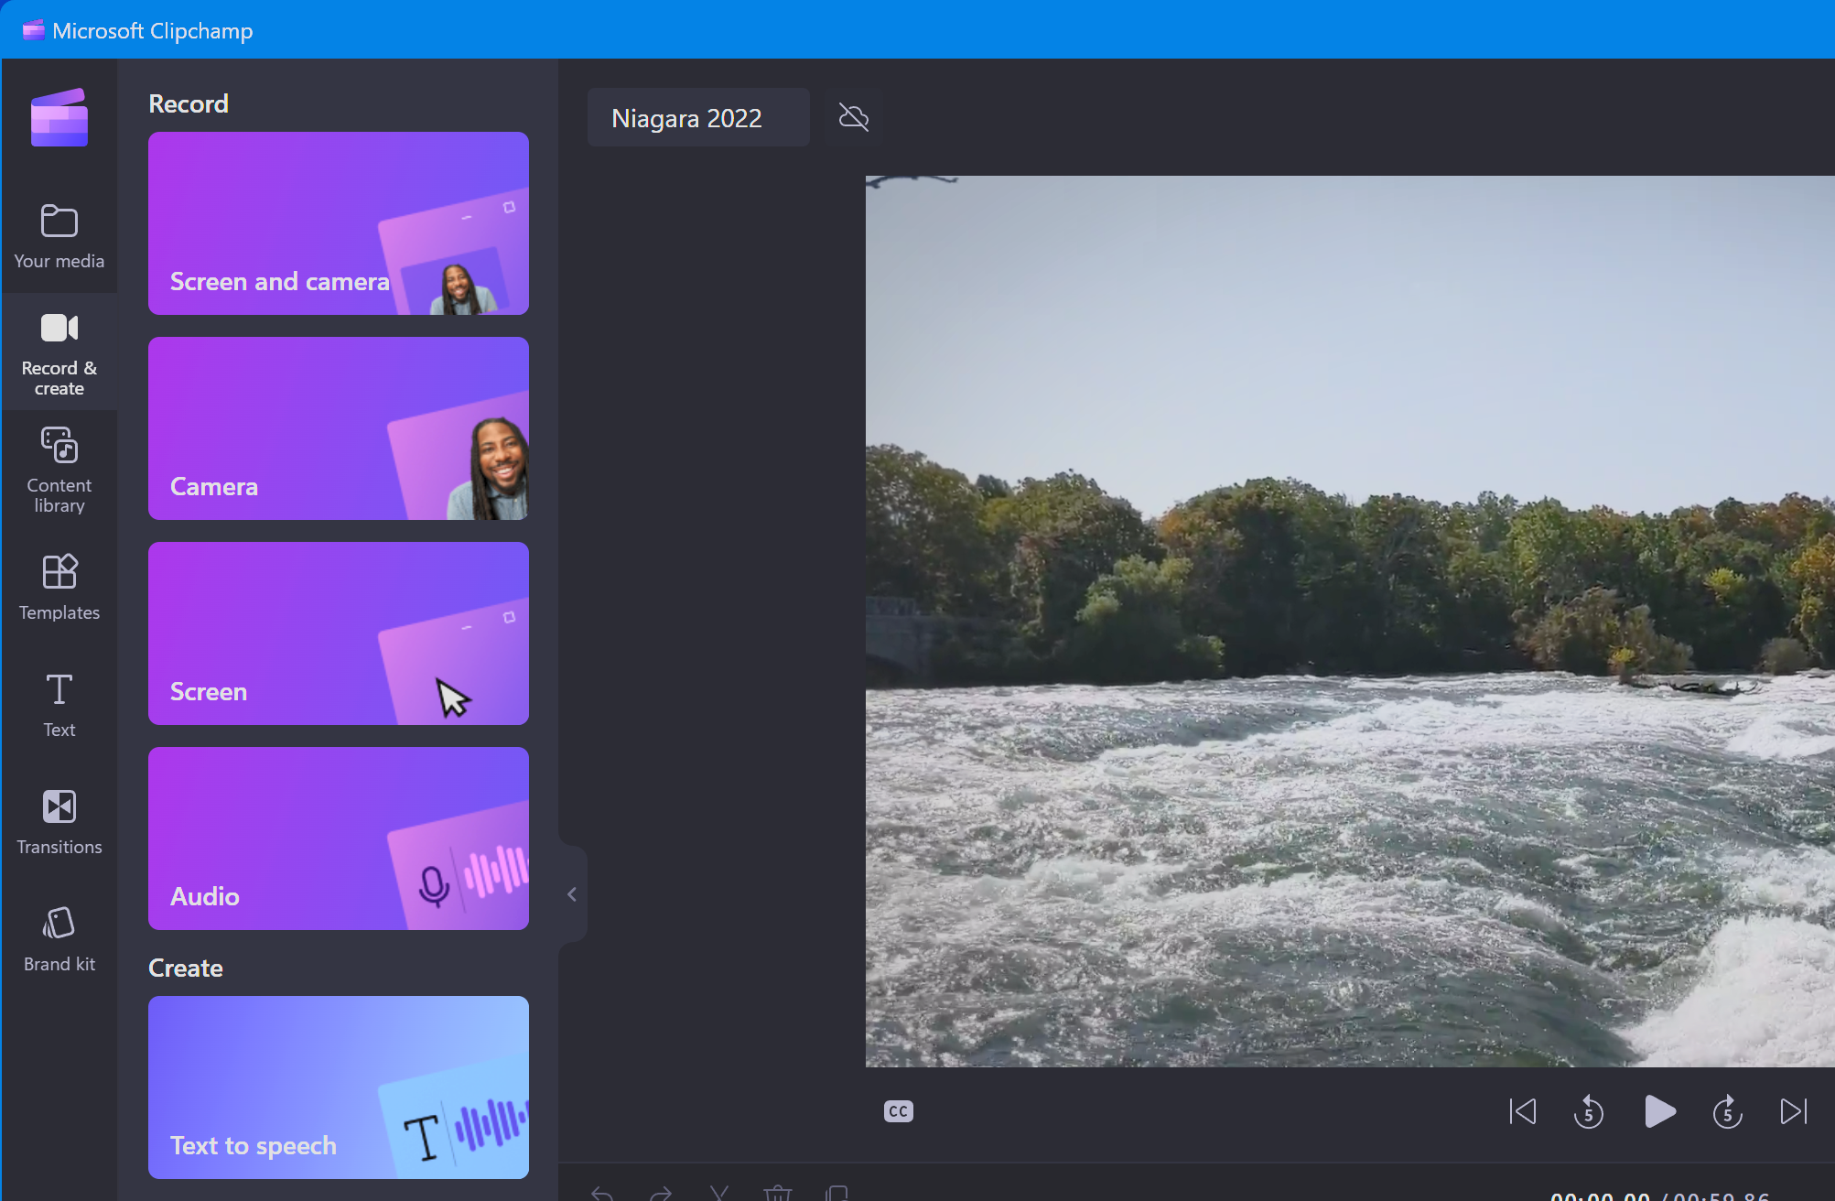


Tools for Digital Storytelling
Popular Tools for Storytelling
Canva: For creating visually appealing photo stories and presentations.
Clipchamp: For editing and creating engaging video content.-
Google Earth & Maps: To integrate geographical contexts into heritage stories.
Audio Tools: Platforms like Audacity for adding narration or music.

Slide 8
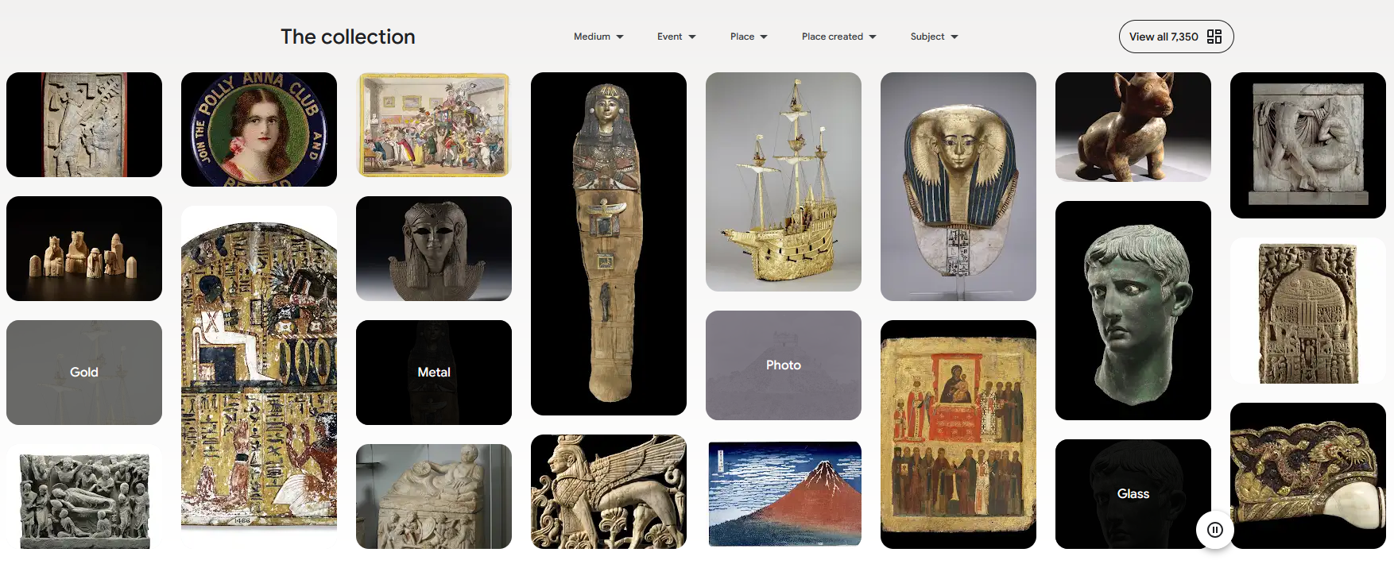
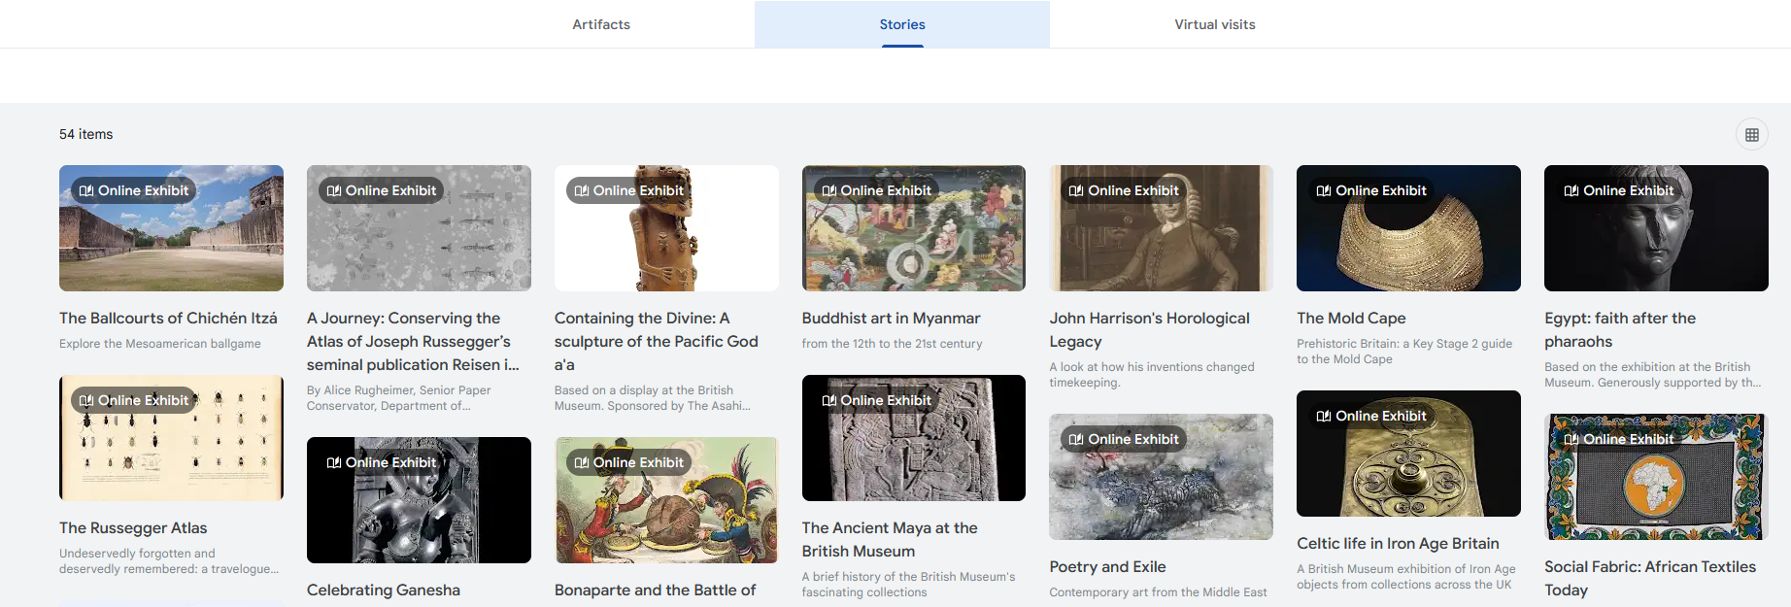
Case Studies of Successful Heritage Digital Stories
Examples of Successful Digital Stories - The British Museum
The British Museum has developed interactive digital stories that showcase artifacts and historical narratives in an engaging way. Visitors can explore collections online through multimedia formats such as images, videos, audio, and animations. These digital stories make heritage accessible to a global audience, allowing people to experience culture beyond physical visits to the museum. The initiative highlights how museums can use digital platforms to enhance learning, spark curiosity, and reach younger audiences who are used to interactive content.
https://artsandculture.google.com/partner/the-british-museum

Slide 9
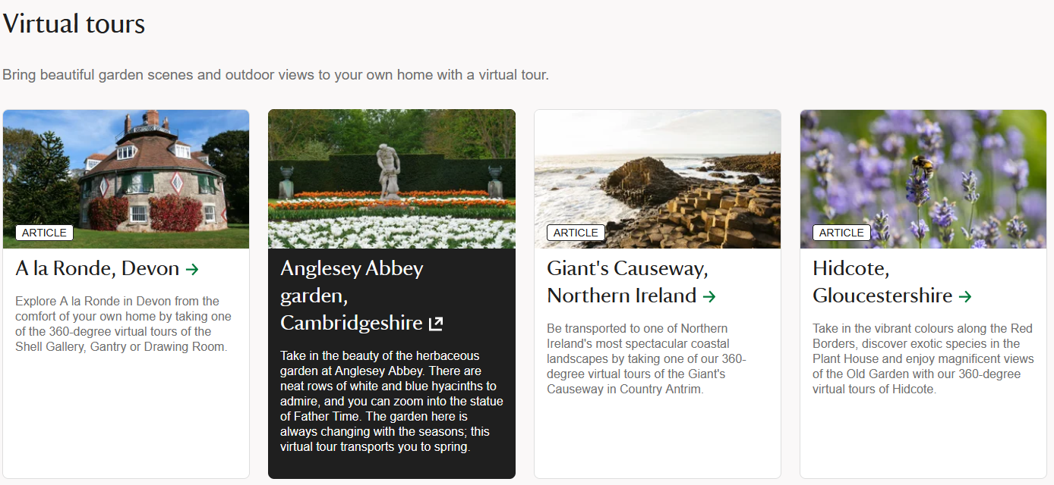
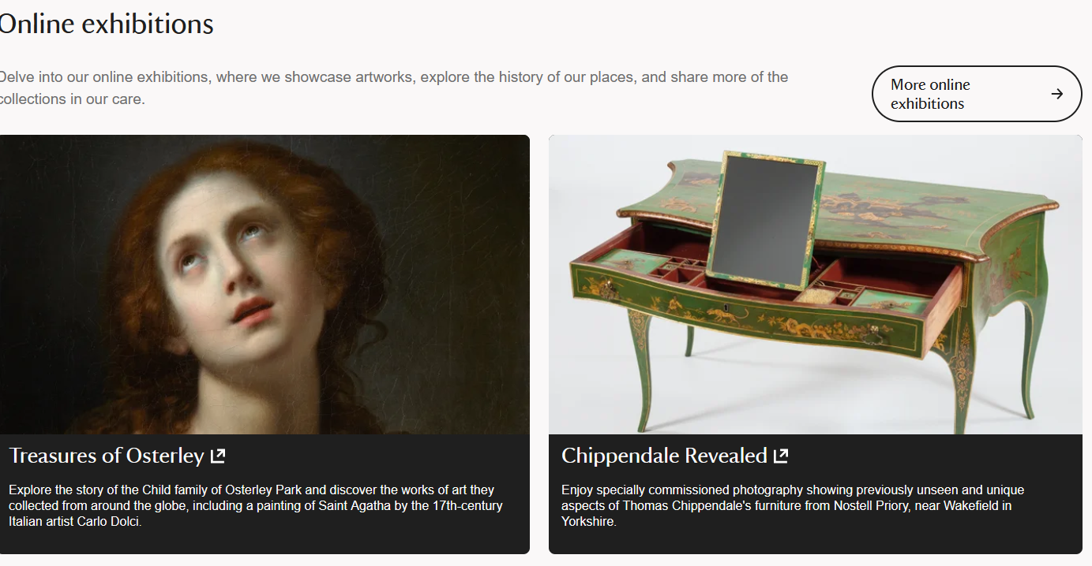
Case Studies of Successful Heritage Digital Stories
Examples of Successful Digital Stories - National Trust: Digital Campaigns for Heritage Promotion
The National Trust in the UK runs digital campaigns that combine photos, videos, and personal narratives to highlight both cultural and natural heritage. Their projects often focus on community involvement, encouraging local people to share stories about heritage sites, traditions, and landscapes. By using social media and online platforms, the National Trust makes heritage visible to wider audiences and inspires community pride. These campaigns demonstrate how storytelling combined with multimedia can strengthen connections between people and heritage, while also attracting visitors and support for conservation.
Discussion Prompt: How can these examples inspire your own projects?
https://www.nationaltrust.org.uk/

Slide 10







2023-1-EE01-KA220-ADU-000150753
Thank you for your attention
PARTNERS
Funded by the European Union. Views and opinions expressed are however those of the author(s) only and do not necessarily reflect those of the European Union or Estonian National Agency. Neither the European Union nor the granting authority can be held responsible for them.

