Slide 1



2023-1-EE01-KA220-ADU-000150753
TRAINING PROGRAMME
LEARNING UNIT 1: Sense of belonging
Elaborated by:
Funded by the European Union. Views and opinions expressed are however those of the author(s) only and do not necessarily reflect those of the European Union or Estonian National Agency. Neither the European Union nor the granting authority can be held responsible for them.

Slide 2

LESSON 1: Heritage and Identity
Source: freshidea/AdobeStock

Slide 3
Interactive Activity: Heritage and identity (1/2)
Objective:
The aim of this activity is to encourage learners to explore local cultural or natural heritage sites, develop critical thinking about the role of heritage in fostering community identity, brainstorm creative ways to use heritage sites to promote community engagement, and cultivate a sense of local pride and shared identity among learners.
Materials Needed:
- Flip chart or whiteboard
- Markers
- Large sheets of paper (for group brainstorming), Pens and sticky notes
- Projector and computer (optional, for presentations)
- Printed or digital materials about local cultural and natural heritage sites (if needed for reference) and Internet access (optional, for research)
Procedure:
- Ask each learner to identify a cultural or natural heritage site from their local area. This could be a historical building, a park, a festival, or any site of local significance. Encourage them to research or share brief background information about their chosen site (e.g., history, cultural importance, community significance)
- Organize learners into small groups (3-5 people) to choose one heritage item and brainstorm ideas on how their selected site/item could be used to enhance community identity and engagement.

Slide 4
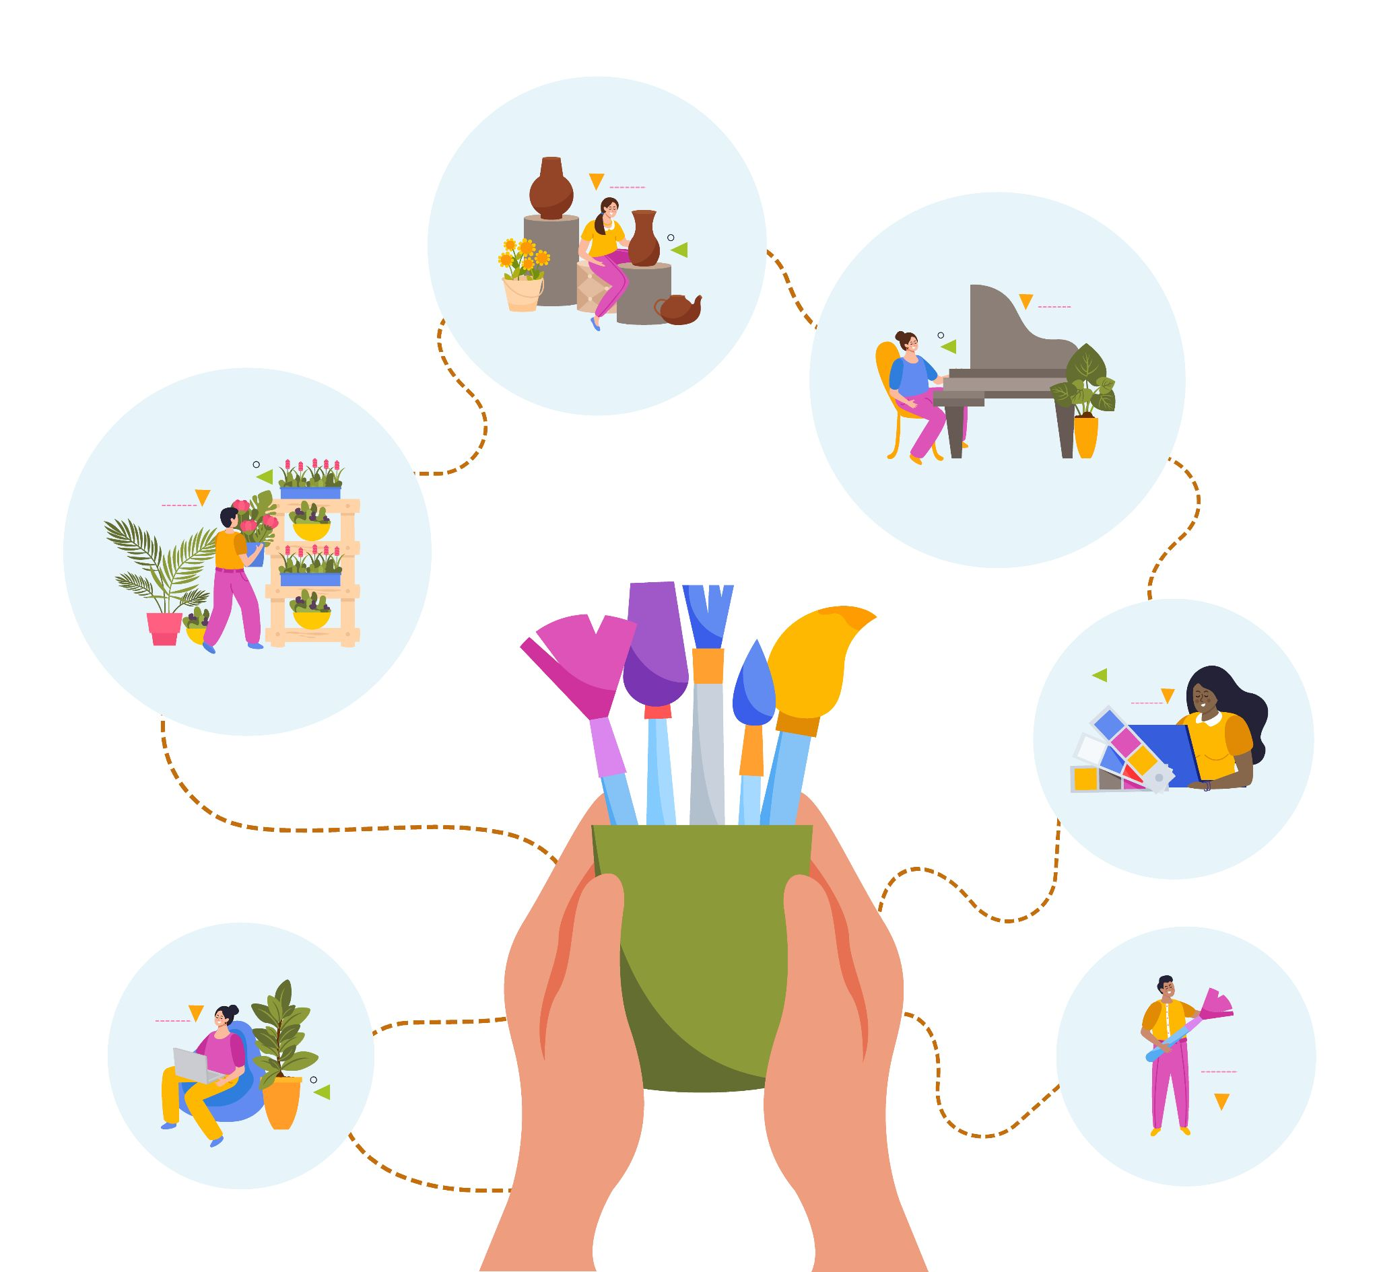
Interactive Activity: Heritage and identity (2/2)
- Provide each group with large sheets of paper and markers. Ask them to consider the following questions during their brainstorming:
How can this site/item be better promoted or preserved to foster community pride?
What events or activities could be organized at this/with this site/item to encourage community participation (e.g., festivals, educational tours, volunteer clean-up events, contest)?
How can this heritage site/item be used to engage different age groups and cultural backgrounds within the community?
What partnerships could be formed (with local schools, businesses, or organizations) to enhance engagement at this site/item?
After brainstorming, each group presents their ideas to the class. Encourage them to highlight the unique qualities of their chosen site and how their proposed activities could foster a stronger sense of local identity and community involvement. As a class, discuss which ideas might be most effective and why. Ask how similar strategies could apply to other local sites or contexts.
Source: Freepik, by macrovector
https://www.freepik.com/free-vector/creative-people-flat-design-concept-with-human-hands-holding-brushes-drawing-little-persons-involved-art-music-dancing-vector-illustration_37421460.htm#fromView=search&page=1&position=3&uuid=0d99e143-8f99-442d-ba97-4ed4e83f8ea4
Optional Extension (to practice the learnings from LU3 – Entrepreneurship) :
If time permits or as a follow-up training, learners can be tasked with developing a more detailed plan for implementing one of their ideas, potentially involving community members, local government, or organizations. This could include outlining the steps, resources, and people needed to make their proposal a reality (Business Plan – refer to LU2)

Slide 5

Discussion and Reflection
Questions for Group Discussion and conclusion:
To help close the activity and highlight key learnings with the learners, here are five reflection questions to ask:
1. How did exploring a local heritage site/item change or deepen your understanding of its importance to the community? (This question encourages learners to reflect on their personal connection to the site/item and recognize its broader significance for the local community)
2. What surprised you most about how a heritage site/item can enhance community identity and engagement? (Learners can share any new insights they gained, perhaps something they hadn’t considered before about the impact of heritage on community life)
3. In what ways do you think your proposed activities could help bring together people from different cultural, generational, or social backgrounds? (This question focuses on inclusivity and how heritage can bridge divides within the community, fostering unity)
4. How can you personally contribute to preserving or promoting local heritage in your community, based on what you’ve learned today? (It encourages learners to think about practical steps they can take to get involved and make a positive impact)
5. What challenges do you think communities might face when trying to use heritage to strengthen identity, and how could they overcome these challenges? (This helps learners consider real-world obstacles (e.g., funding, community interest, accessibility) and brainstorm potential solutions, promoting critical thinking)
Source,Freepik, free image by pch.vector
https://www.freepik.com/free-vector/people-talking-arguing_9176206.htm#fromView=search&page=1&position=32&uuid=9ec0301a-dddf-4d25-a241-a5349c9e3205

Slide 6







2023-1-EE01-KA220-ADU-000150753
Thank you for your attention
PARTNERS
Funded by the European Union. Views and opinions expressed are however those of the author(s) only and do not necessarily reflect those of the European Union or Estonian National Agency. Neither the European Union nor the granting authority can be held responsible for them.

